Slide 1
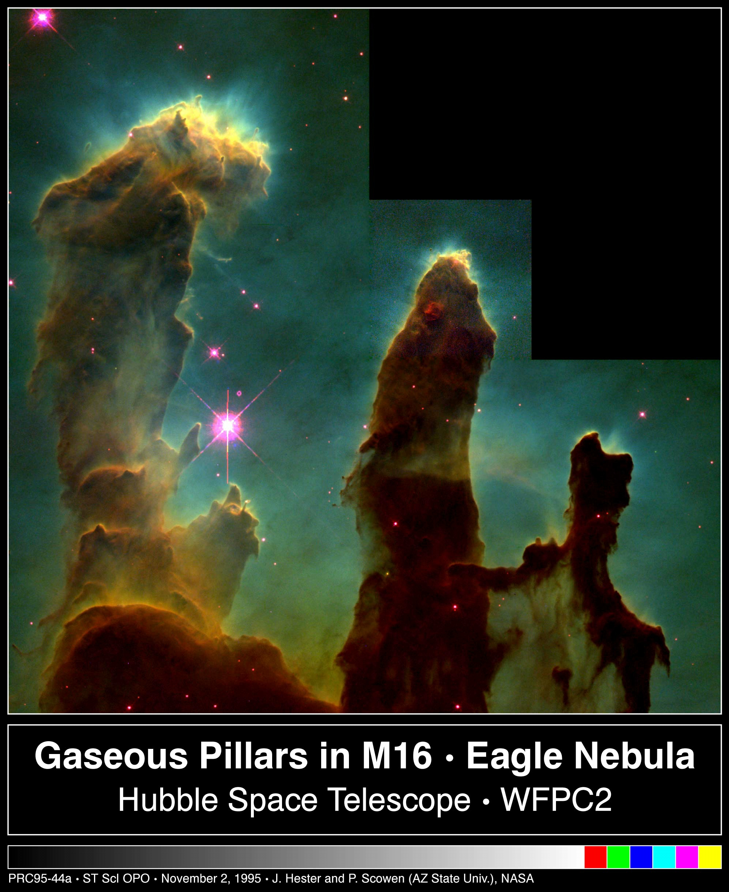
Astronomy 1 – Winter 2011
Lecture 7; January 19 2011

Slide 2
Previously on Astro1
What is light? Light is electromagnetic radiation

Slide 3
Homework – Due 01/26/11
On your own: answer all the review questions in chapter 6
To TAs: answer questions 6.32 6.36 6.48 6.40

Slide 4
Today on Astro1
Blackbodies
Photons
The color of the sky
What are stars and interstellar gas made of?

Slide 5
Blackbody

Slide 6
Definition of a blackbody
A blackbody is an idealized object that absorbs all radiation falling on it. It does not reflect light, instead it re-emits light.
A blackbody does not have to look black! The Sun is nearly a blackbody.
Light in thermal equilibrium
Notes:
Figure 5-11 Blackbody Curves
Each of these curves shows the intensity of
light at every wavelength that is emitted by a blackbody (an
idealized case of a dense object) at a particular temperature. The
rainbow-colored band shows the range of visible wavelengths. The
vertical scale has been compressed so that all three curves can be seen;
the peak intensity for the 12,000-K curve is actually about 1000 times
greater than the peak intensity for the 3000-K curve.

Slide 7
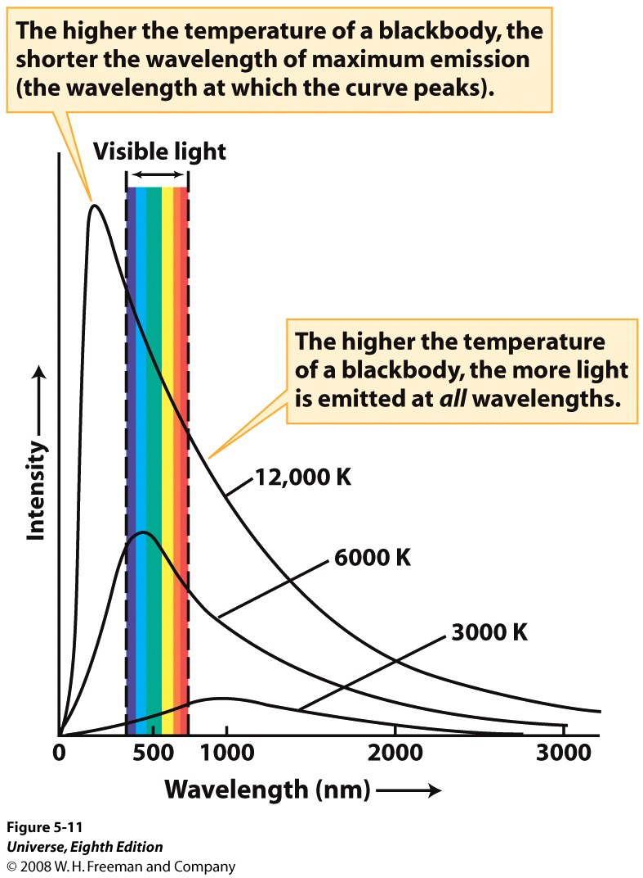
Blackbody Curves
Each curve shows the intensity of light at every wavelength that is emitted by a blackbody at a particular temperature. The rainbow-colored band shows the range of visible wavelengths. The vertical scale has been compressed so that all three curves can be seen; the peak intensity for the 12,000 K curve is actually about 1000 times greater than the peak intensity for the 3000 K curve.
Notes:
Figure 5-11 Blackbody Curves
Each of these curves shows the intensity of
light at every wavelength that is emitted by a blackbody (an
idealized case of a dense object) at a particular temperature. The
rainbow-colored band shows the range of visible wavelengths. The
vertical scale has been compressed so that all three curves can be seen;
the peak intensity for the 12,000-K curve is actually about 1000 times
greater than the peak intensity for the 3000-K curve.

Slide 8
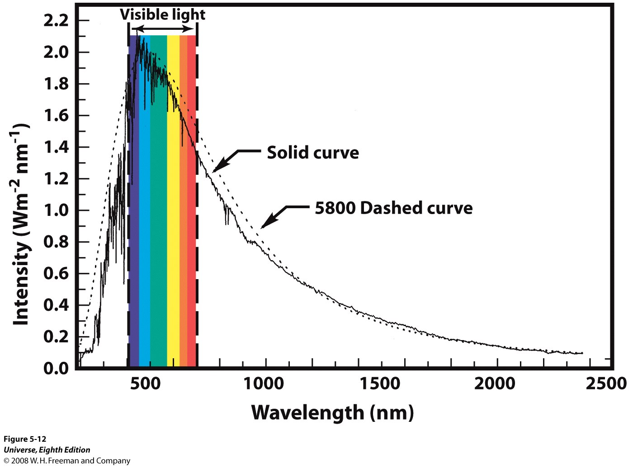
Notes:
Figure 5-12 The Sun as a Blackbody
This graph shows that the intensity of sunlight
over a wide range of wavelengths (solid curve) is a remarkably close
match to the intensity of radiation coming from a blackbody at a
temperature of 5800 K (dashed curve). The measurements of the Sun’s
intensity were made above the Earth’s atmosphere (which absorbs and
scatters certain wavelengths of sunlight). It’s not surprising that the
range of visible wavelengths includes the peak of the Sun’s spectrum; the
human eye evolved to take advantage of the most plentiful light available.

Slide 9
Wien’s Law for a blackbody
λ_{max} = wavelength of maximum emission of the object (in meters)
T = temperature of the object (in Kelvins).
(The K and m above are units of Kelvins and meters).
Example: At which peak wavelength do people radiate?
Human temperature in K = 273+37 = 310K
This is in the infrared!
Notes:
Figure 5-11 Blackbody Curves
Each of these curves shows the intensity of
light at every wavelength that is emitted by a blackbody (an
idealized case of a dense object) at a particular temperature. The
rainbow-colored band shows the range of visible wavelengths. The
vertical scale has been compressed so that all three curves can be seen;
the peak intensity for the 12,000-K curve is actually about 1000 times
greater than the peak intensity for the 3000-K curve.

Slide 10
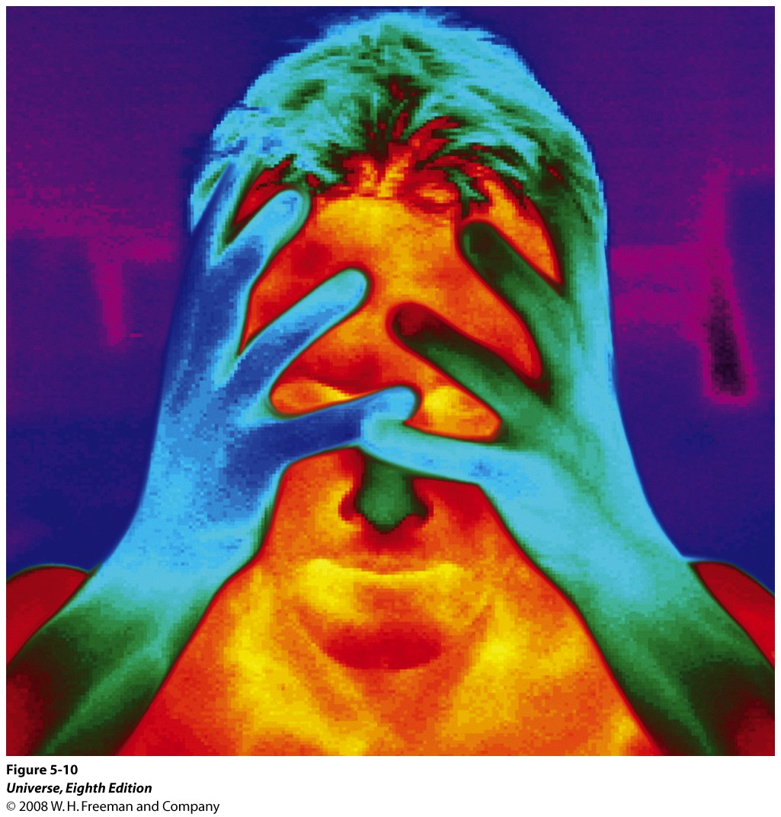
An Infrared Portrait
In this image made with a camera sensitive to infrared radiation, the different colors represent regions of different temperature. Red areas (like the man’s face) are the warmest and emit the most infrared light, while blue-green areas (including the man’s hands and hair) are at the lowest temperatures and emit the least radiation.
Notes:
Figure 5-10 An Infrared Portrait
In this image made with a camera sensitive to
infrared radiation, the different colors represent regions of different
temperature. Red areas (like the man’s face) are the warmest and emit
the most infrared light, while blue-green areas (including the man’s hands
and hair) are at the lowest temperatures and emit the least radiation. (Dr.
Arthur Tucker/Photo Researchers)

Slide 11
Energy flux
Energy is usually measured in Joules (J).
One joule per second is a Watt (W) – a measure of power.
Flux is the amount of energy per second passing through one square meter.
The Stefan-Boltzmann Law gives the flux of a blackbody of a given temperature.
F = σT⁴
σ (a constant)= 5.67×10⁻⁸ W m⁻² K⁻⁴
T = Temperature in Kelvins
Notes:
Figure 5-11 Blackbody Curves
Each of these curves shows the intensity of
light at every wavelength that is emitted by a blackbody (an
idealized case of a dense object) at a particular temperature. The
rainbow-colored band shows the range of visible wavelengths. The
vertical scale has been compressed so that all three curves can be seen;
the peak intensity for the 12,000-K curve is actually about 1000 times
greater than the peak intensity for the 3000-K curve.

Slide 12
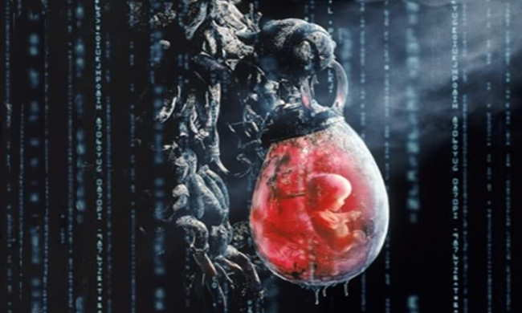
In the movie The Matrix – people are used as batteries. If the average human’s bodily surface area is 1.7 m², and has an average temperature of 37°C, how much energy per second (power) does a person radiate?
Answer. Treating a person as a blackbody, use the Stefan-Boltzmann law to determine the energy radiated per second per square meter, then multiply by the body’s surface area to get the energy radiated per second.
Human temperature in K = 273+37 = 310K
F = σT⁴ = (5.67×10⁻⁸ W m⁻² K⁻⁴)(310 K)⁴ = 524 W m⁻²
Power = 524 W m⁻² (1.7m²) = 891 W
About the power of a toaster!
Notes:
Figure 5-11 Blackbody Curves
Each of these curves shows the intensity of
light at every wavelength that is emitted by a blackbody (an
idealized case of a dense object) at a particular temperature. The
rainbow-colored band shows the range of visible wavelengths. The
vertical scale has been compressed so that all three curves can be seen;
the peak intensity for the 12,000-K curve is actually about 1000 times
greater than the peak intensity for the 3000-K curve.

Slide 13
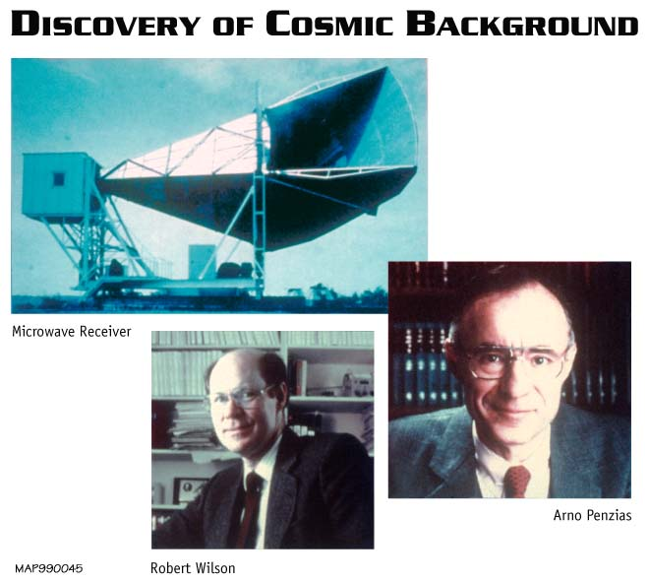
A very important blackbody:
Cosmic Microwave Background
The cosmic microwave background was discovered as a background “noise” a real problem for telecommunication satellites
Wherever Penzias and Wilson pointed their antenna they would detect a microwave signal, very uniform across the sky
This signal is now called the cosmic microwave background…

Slide 14
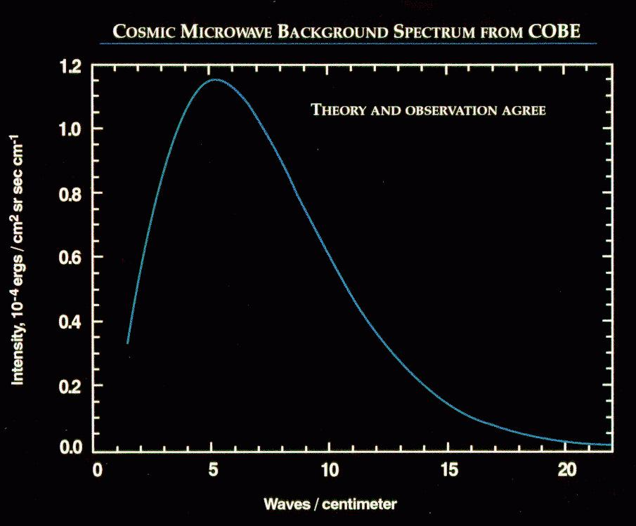
Cosmic Microwave Background. The CMB is a “perfect” Blackbody
COBE FIRAS 1989; T=2.725 K

Slide 15
Question 7.1 (iclickers!)
If all stars are considered perfect blackbodies, then it should follow that all stars
  A) of the same composition emit the same energy flux
  B) of the same size emit the same energy flux
  C) traveling at the same speed emit the same energy flux
  D) of the same temperature emit the same energy flux

Slide 16
Light is also a particle: Planck’s Law
E = Energy of a photon
h = Planck’s constant = 6.625×10⁻³⁴ J s
c = speed of light
λ = wavelength of light
ν = frequency of light
or
Example: DNA molecules are easily broken when hit with ultraviolet light at 260 nm (why you get cancer from sunburns). How much energy does a single photon at this wavelength have?
Notes:
Figure 5-11 Blackbody Curves
Each of these curves shows the intensity of
light at every wavelength that is emitted by a blackbody (an
idealized case of a dense object) at a particular temperature. The
rainbow-colored band shows the range of visible wavelengths. The
vertical scale has been compressed so that all three curves can be seen;
the peak intensity for the 12,000-K curve is actually about 1000 times
greater than the peak intensity for the 3000-K curve.

Slide 17
Question 7.2 (iclickers!)
In what way does a photon of blue light not differ from a photon of yellow light in a vacuum
  A) wavelength
  B) color
  C) energy
  D) speed

Slide 18
Why is the sky blue and the sunset red?

Slide 19
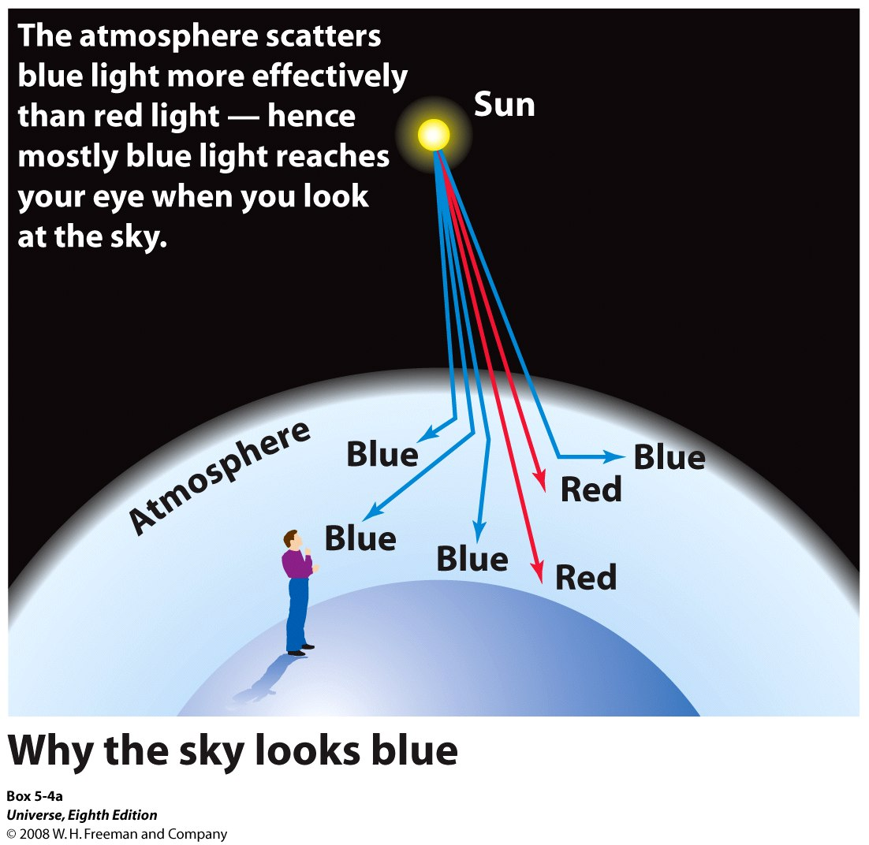
Notes:
Box 5-4 Light Scattering
a) Why the sky looks blue

Slide 20
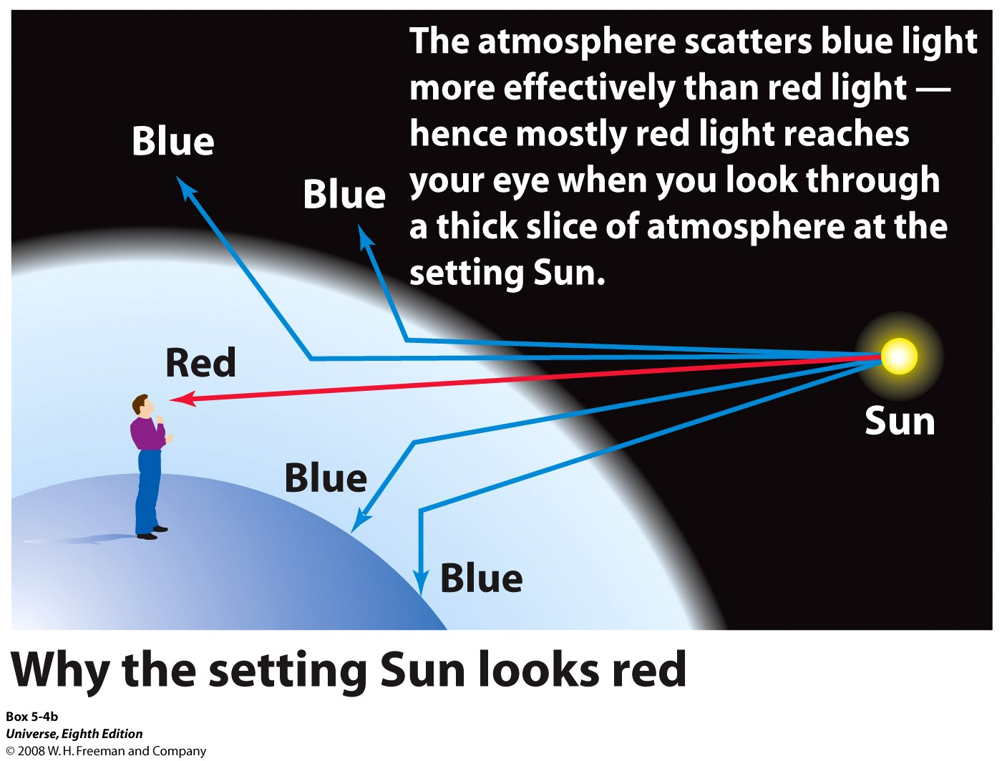
Notes:
Box 5-4 Light Scattering
(b) Why the setting Sun looks red

Slide 21
Spectra as the “fingerprints” of nature

Slide 22
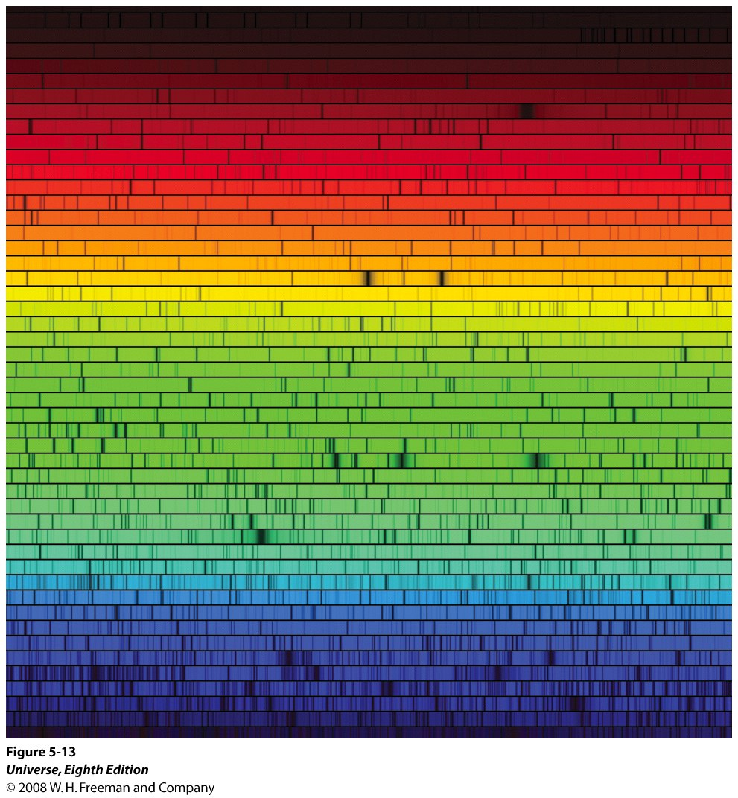
The Sun’s Spectrum
In 1814 Joseph von Fraunhofer magnified the solar spectrum seen through a prism, and found hundreds of dark lines.
Notes:
Figure 5-13 The Sun’s Spectrum
Numerous dark spectral lines are seen in this
image of the Sun’s spectrum. The spectrum is spread out so much that it
had to be cut into segments to fit on this page. (N. A. Sharp,
NOAO/NSO/Kitt Peak FTS/AURA/NSF)

Slide 23
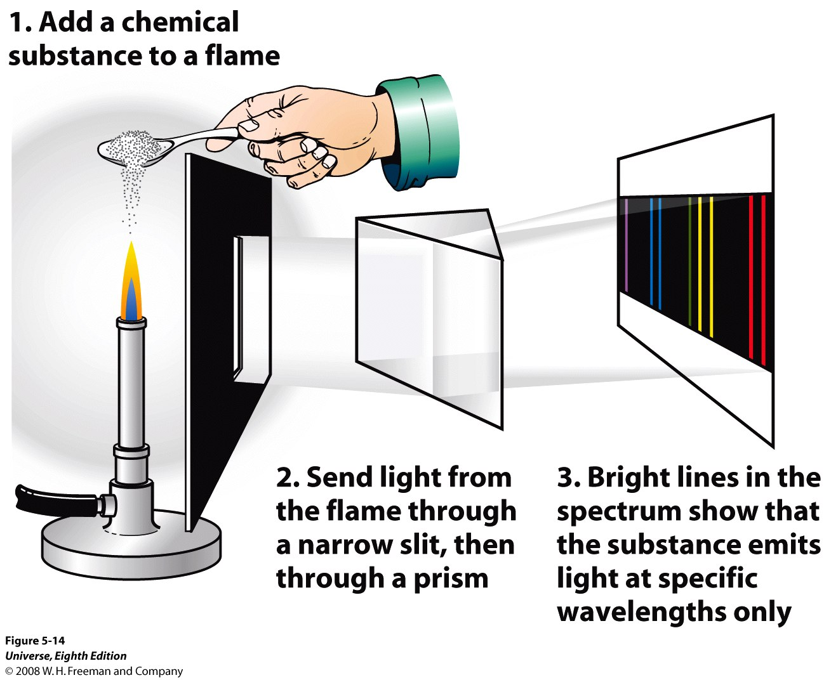
Notes:
Figure 5-14 The Kirchhoff-Bunsen Experiment
In the mid-1850s, Gustav Kirchhoff
and Robert Bunsen discovered that when a chemical substance is heated
and vaporized, the spectrum of the emitted light exhibits a series of
bright spectral lines. They also found that each chemical element
produces its own characteristic pattern of spectral lines. (In an actual
laboratory experiment, lenses would be needed to focus the image of the
slit onto the screen.)

Slide 24
Kirchoff’s Laws
1. A hot, dense object such as a blackbody emits a continuous spectrum covering all wavelengths.
2. A hot, transparent gas produces a spectrum that contains bright (emission) lines.
3. A cool, transparent gas in front of a light source that itself has a continuous spectrum produces dark (absorption) lines in the continuous spectrum.

Slide 25
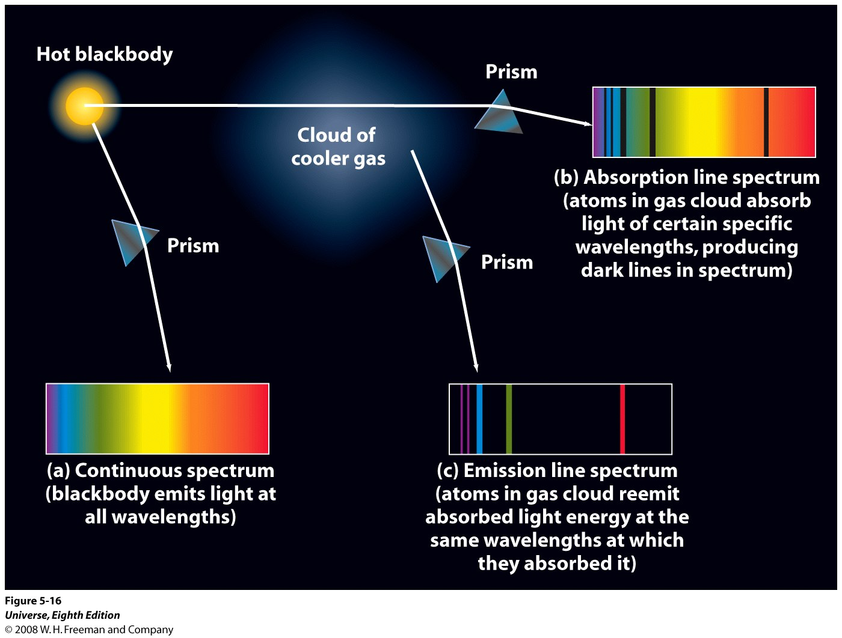
Notes:
Figure 5-16 Continuous, Absorption Line, and Emission Line Spectra
A hot, opaque body (like a blackbody) emits a continuous spectrum of
light (spectrum a). If this light is passed through a cloud
of a cooler gas, the cloud absorbs light of certain
specific wavelengths, and the spectrum of light that
passes directly through the cloud has dark absorption
lines (spectrum b). The cloud does not retain all the
light energy that it absorbs but radiates it outward in
all directions. The spectrum of this reradiated light
contains bright emission lines (spectrum c) with exactly
the same wavelengths as the dark absorption lines in
spectrum b. The specific wavelengths observed depend
on the chemical composition of the cloud.

Slide 26
The energy output of the sun.
Notes:
Figure 5-12 The Sun as a Blackbody
This graph shows that the intensity of sunlight
over a wide range of wavelengths (solid curve) is a remarkably close
match to the intensity of radiation coming from a blackbody at a
temperature of 5800 K (dashed curve). The measurements of the Sun’s
intensity were made above the Earth’s atmosphere (which absorbs and
scatters certain wavelengths of sunlight). It’s not surprising that the
range of visible wavelengths includes the peak of the Sun’s spectrum; the
human eye evolved to take advantage of the most plentiful light available.

Slide 27
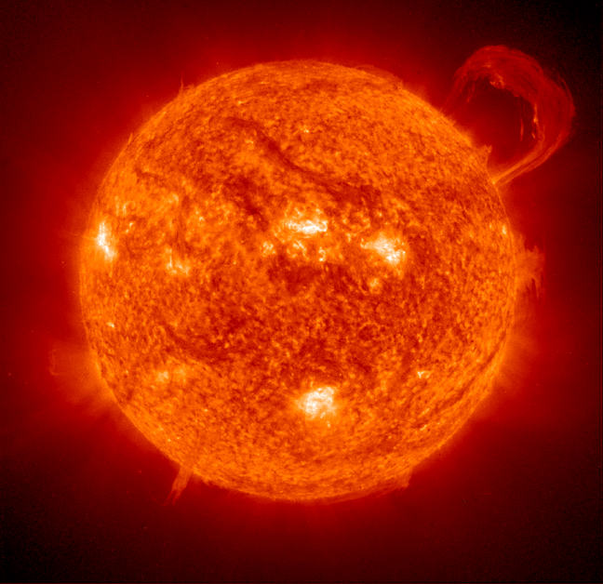
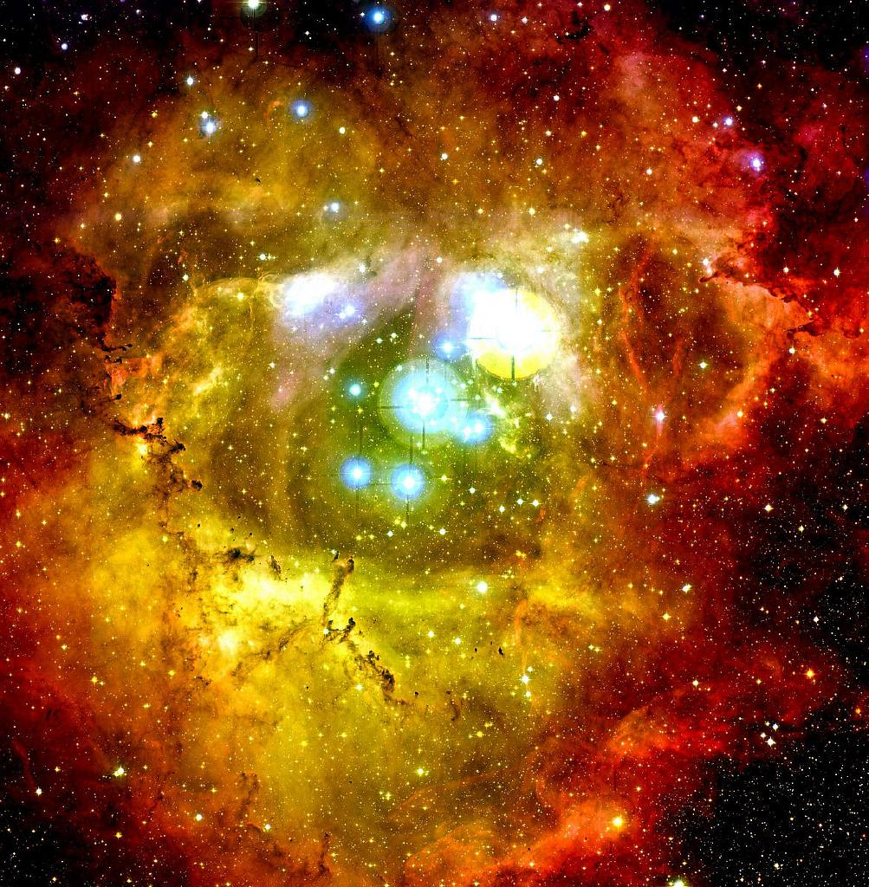
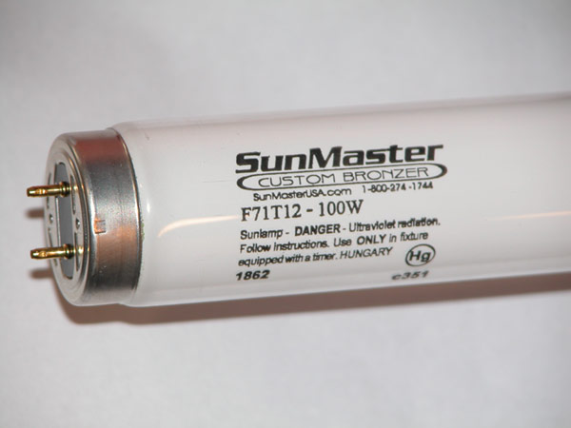


Slide 28
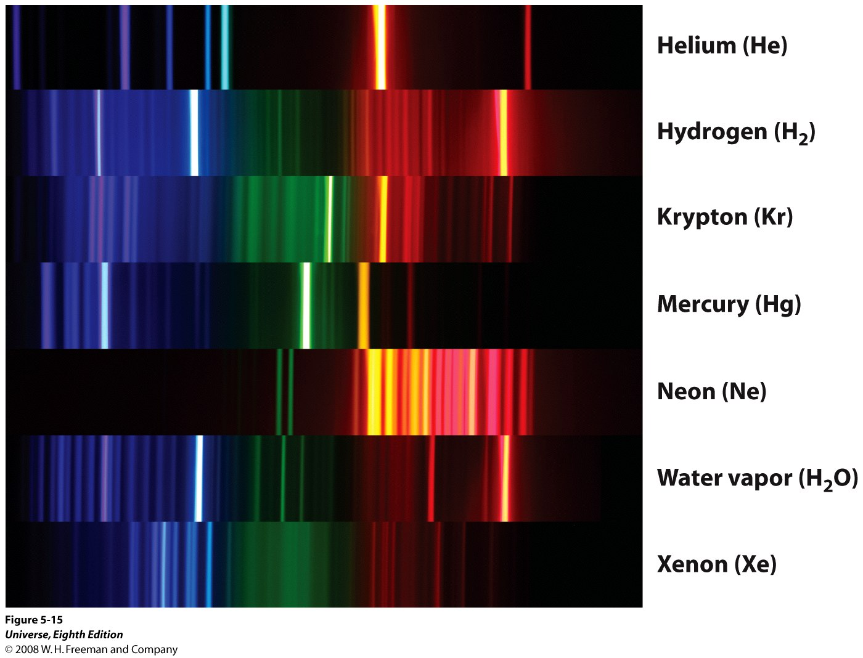
Notes:
Figure 5-15 Various Spectra
These photographs show the spectra
of different types of gases as measured in a laboratory
on Earth. Each type of gas has a unique spectrum that is
the same wherever in the universe the gas is found.
Water vapor (H₂O) is a compound whose molecules are
made up of hydrogen and oxygen atoms; the hydrogen
molecule (H₂) is made up of two hydrogen atoms. (Ted
Kinsman/Science Photo Library)

Slide 29
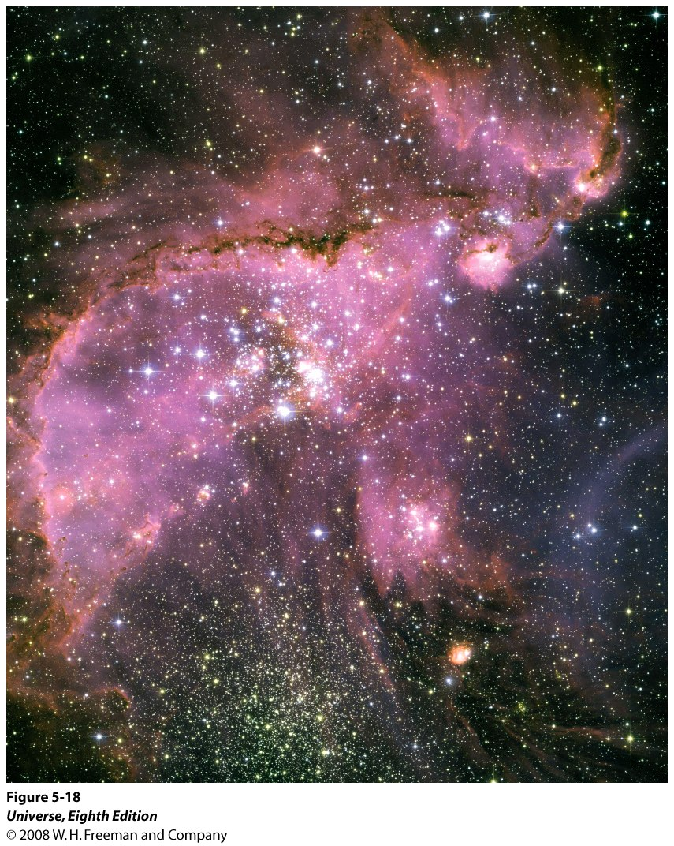
The glowing gas cloud in this Hubble Space Telescope image lies 210,000 light-years away in the constellation Tucana (the Toucan). Hot stars within the nebula emit high-energy, ultraviolet photons, which are absorbed by the surrounding gas and heat the gas to high temperature. This heated gas produces light with an emission line spectrum. The wavelength of red light emitted by the nebula is 656 nm, characteristic of hydrogen gas
Notes:
Figure 5-18 Analyzing the Composition of a Distant Nebula
The glowing gas cloud in this Hubble Space Telescope image lies
210,000 light-years away in the constellation Tucana (the Toucan). Hot
stars within the nebula emit high-energy, ultraviolet photons, which are
absorbed by the surrounding gas and heat the gas to high temperature.
This heated gas produces light with an emission line spectrum. The
particular wavelength of red light emitted by the nebula is 656 nm,
characteristic of hydrogen gas. (NASA, ESA, and A. Nota, STScI/ESA)

Slide 30
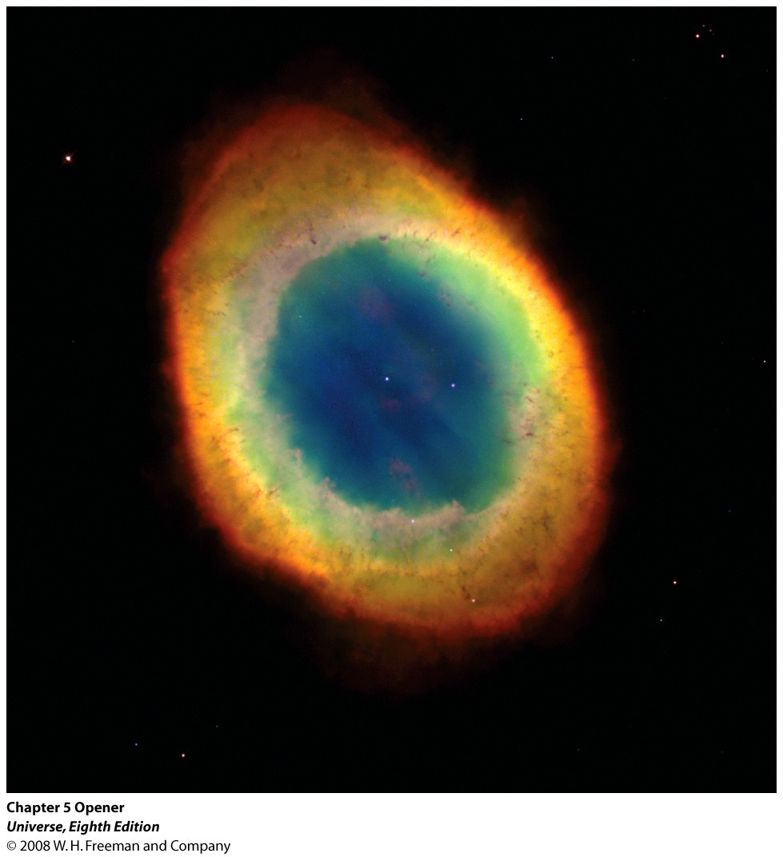
The Ring Nebula is a shell of glowing gases surrounding a
dying star. The spectrum of the emitted light reveals which gases are present.

Slide 31
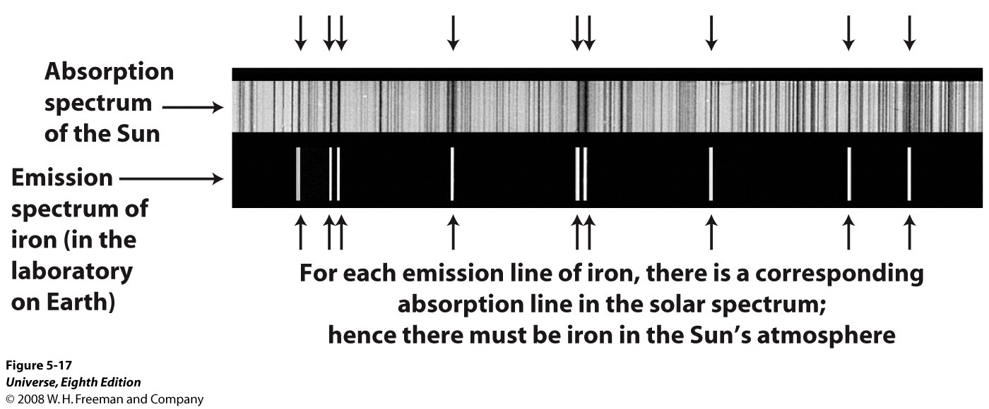
Notes:
Figure 5-17 Iron in the Sun
The upper part of this figure is a portion of the Sun’s
spectrum at violet wavelengths, showing numerous dark absorption lines.
The lower part of the figure is a corresponding portion of the emission
line spectrum of vaporized iron. The iron lines coincide with some of the
solar lines, which proves that there is some iron (albeit a relatively small
amount) in the Sun’s atmosphere. (Carnegie Observatories)

Slide 32
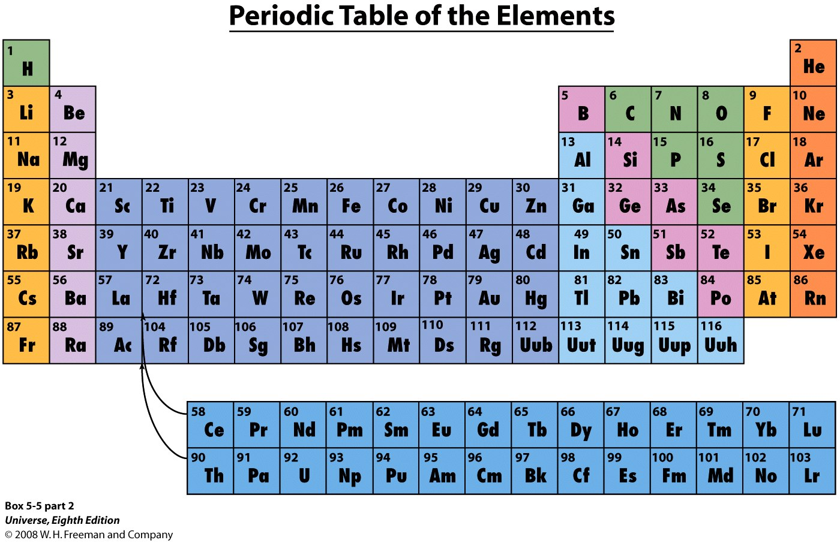
Atomic number is the number of protons in an atom.
Notes:
Box 5-5 Atoms, the Periodic Table, and Isotopes
The number of protons in an atom’s nucleus is the atomic
number for that particular element. The chemical elements are
most conveniently listed in the form of a periodic table (shown
in the figure). Elements are arranged in the periodic table in
order of increasing atomic number. With only a few exceptions,
this sequence also corresponds to increasing average
mass of the atoms of the elements. Thus, hydrogen (symbol
H), with atomic number 1, is the lightest element. Iron (symbol
Fe) has atomic number 26 and is a relatively heavy
element.
All the elements listed in a single vertical column of the
periodic table have similar chemical properties. For example,
the elements in the far right column are all gases under the
conditions of temperature and pressure found at the Earth’s
surface, and they are all very reluctant to react chemically with
other elements.

Slide 33
Question 7.3 (iclickers!)
If light from a hot, dense star is viewed through a cool cloud of gas,
  A) the spectrum of the star will be seen unchanged because the gas cloud is cool
  B) only specific wavelengths of light will be removed from the spectrum
  C) the whole spectrum will be reduced in intensity
  D) the atoms of the gas cloud will add energy to the overall spectrum, producing emission at specific wavelengths

Slide 34
Summary
What is a blackbody?
  Wien’s law: λ_{max} (in meters) = (0.0029 K⋅m)/T.
  The Stefan-Boltzmann law: F = σT⁴.
What are photons?
  light can have particle-light properties. The particles of light are called photons: E = hν = hc/λ
Why is the sky is blue and sunsets red?
  Interaction between light and atmosphere
Kierchoff’s Laws
What are stars and interstellar gas made of?
  The same elements we see on Earth, mostly Hydrogen, He, Oxygen, Carbon

Slide 35
The End
See you on Friday (midterm)!

