Slide 1
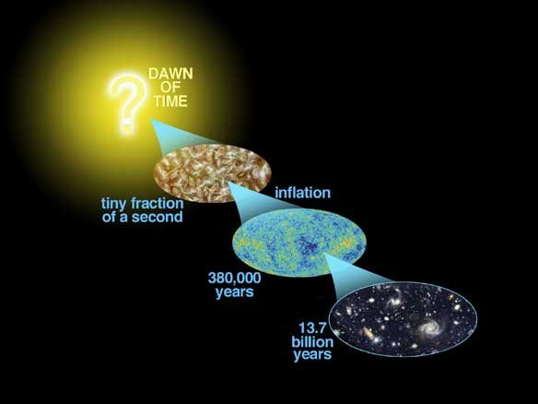
Astro-2: History of the Universe
Lecture 11; May 21 2013

Slide 2
Previously… on astro-2
In an expanding universe the relationship between redshift and distance depends on the cosmological parameters (i.e. the geometry and expansion of the universe). Why?
Every reliable standard candle or rod can provide you with an measurement of the cosmological parameters.
The most popular at the moment are Supernovae Ia. They look dimmer than expected in the past indicating that the universe is accelerating
This is the so called “Cosmic jerk”

Slide 3
Previously… on astro-2
The volume of the universe as a function of redshift depends on the cosmological parameters, so can be used to do cosmography.
Another approach is to measure the properties of the large scale structure of the universe and the abundance and evolution of density peaks (clusters). This is a sensitive measure of the matter density of the universe.
These two approaches are useful but difficult to do in practice. It is important to have more than one method.

Slide 4
Previously… on astro-2
CMB anisotropies are a snapshot of the universe at the last scattering surface at z~1000, when the universe was about 380,000 years old.
Hot and cold spots in the CMB correspond to under and overdensities at that time.
The angular distribution of CMB anisotropies conveys information about the content and geometry of the universe so that many parameters are known to a 10% or better.

Slide 5
Previously… on astro-2
In recent years different methods have reached an agreement over the numerical value of the cosmological parameters
The currently preferred model is one dominated by dark energy. This is referred to as “concordance cosmology”
It is great! Unless there is some poorly understood systematic effect at work..
Depending on the properties of dark energy the universe could keep accelerating so fast to eventually push everything out of our horizon.

Slide 6
Today.. On Astro-2.
The early universe.
Forces and unification
Planck Time
Inflation
False and true vacua
Horizons and flatness problem

Slide 7
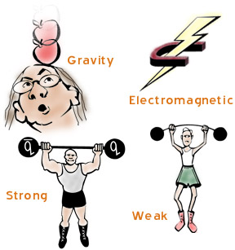
Forces and unification.
In our current understanding of physics all interactions are due to 4 forces:
Gravity
Electromagnetic
Strong Interactions
Weak Interactions

Slide 8

Gravity
Main properties:
Long range
Only attractive
Very weak force
Consider the ratio of the gravitational and electric attraction between a proton and an electron:
FG = G m_{p} m_{e} / R²
FEM = k Q² / R²
FEM / FG = 10³⁹ !
Exchange boson: graviton
Example of systems dominated by gravity?
Universe
Black hole

Slide 9
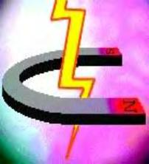
Electromagnetic force
Main properties:
Long range
Attractive and repulsive
Much stronger than gravity but effectively “shielded over long distances”
Exchange Boson: photon
NB: E&M is unified description of electricity and magnetism
Examples of systems:
Atoms (electrons and nuclei)
Electromagnetic waves: light, cell phone…

Slide 10
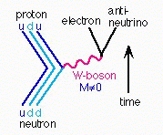
Weak force
Main properties:
Short range
Responsible for change of flavor of quarks (e.g. neutron decaying into proton)
VERY WEAK!!
Exchange Boson: W+-, Z₀
Examples of systems:
Neutrino interactions
Beta decays

Slide 11
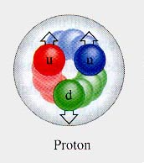
Strong force
Main properties:
Short range
Holds quarks (and nuclei) together
VERY STRONG!!! (keeps protons together even though they have the same electric charge)
Exchange Boson: gluons
Examples of systems:
Nuclei of atoms

Slide 12
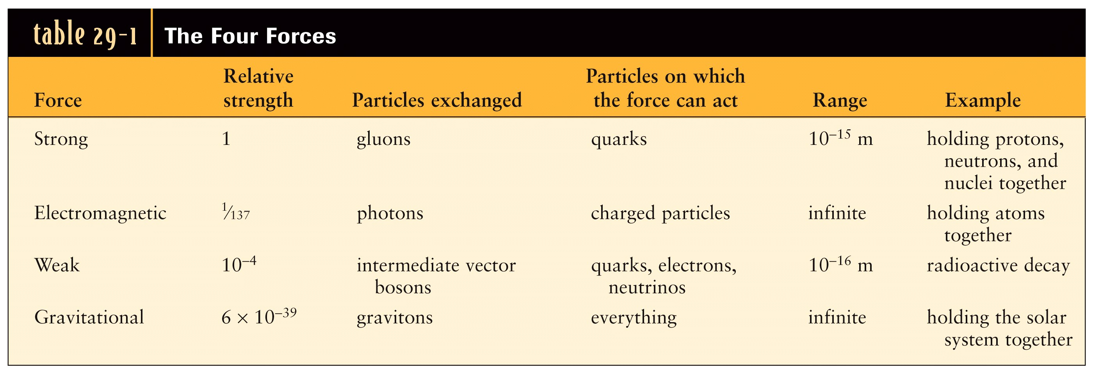
Four forces, or one?
Not quantized

Slide 13
Force unification
Physics is reductionist, i.e. wants to explain complexity with simple laws
One of the major goals is to find a unified description of all forces (called supergrand unified theories). The four forces are just manifestations of what is called “spontaneous symmetry breaking” at low energies
So far, physicist have successfully unified weak and electromagnetic interactions (electroweak interaction), confirmed experimentally
Strong forces are also predicted to be indistinguishable from electroweak interactions at VERY high energies. This is called grand unified theory.
The dream is to unify gravity as well. It is a matter of energy

Slide 14
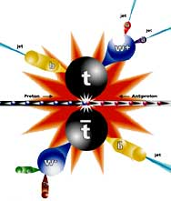
Energy is the name of the game…
Weak and EM interactions unify at 100 Gev. Strong above 10¹⁴ Gev

Slide 15
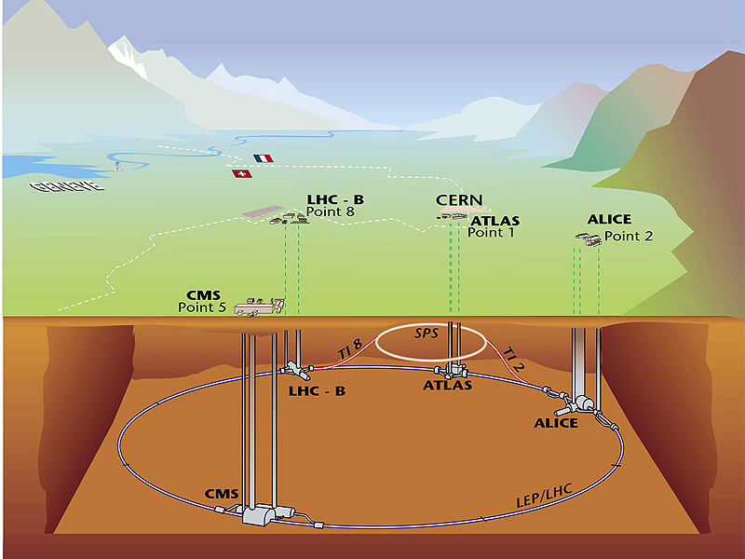
On Earth: particle accelerators
LHC (Large Hadron Collider) is the most powerful accelerator. Starting soon will accelerate protons to 7 TeV = 7,000 GeV

Slide 16
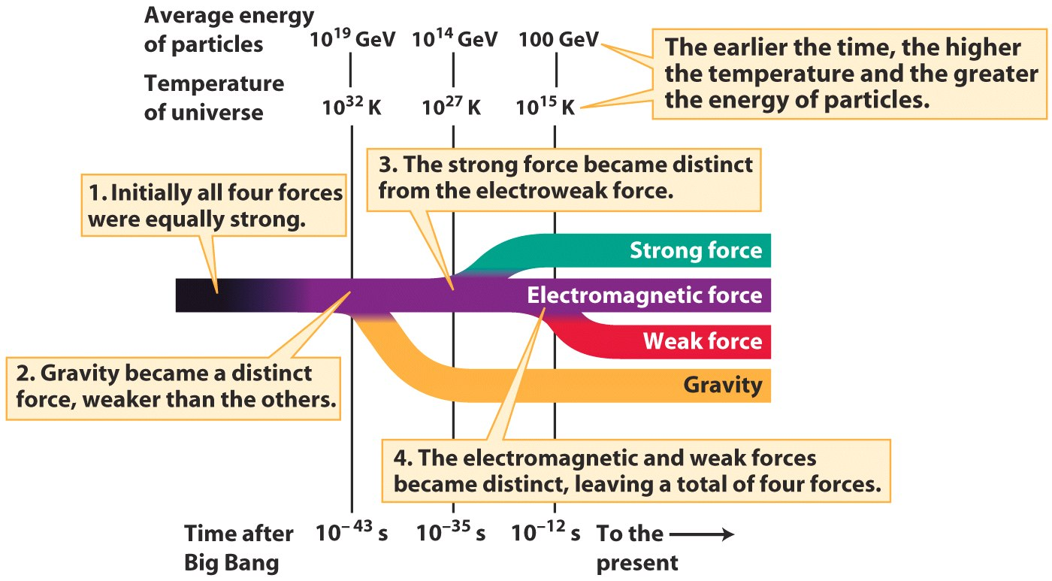
The universe is the most powerful accelerator!!
Plank Time ~ t_{p}=√Gh/c5=1.35e-43s

Slide 17
The very early Universe. Summary
The four fundamental interactions are?
Strong, weak, electromagnetic and gravity.
We think they are unified at high energies, like those in the very early universe
Before Planck time (which is?) energies were so high that a unified theory of all forces (including gravity) is required but we do not know how to do that.
So our description can only begin from Planck time
After that, as the universe expanded “cooled” the various forces froze out via spontaneous symmetry breaking

Slide 18
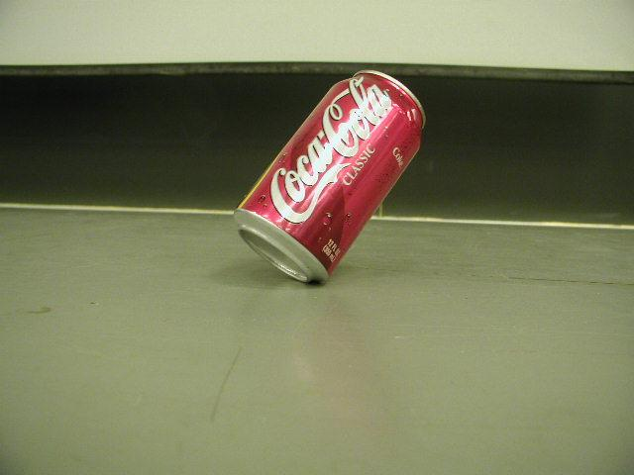
Inflation. True and false vacua
At about ~10⁻³⁶ s after the Big Bang symmetry broke and strong and electroweak forces separated.
A quantity called the inflaton field (similar to the Earth’s magnetic field in some sense) found itself in a position of false vacuum, i.e. in a state that looked like a minimum but was not a minimum of energy

Slide 19
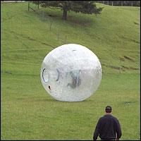
Inflation. The inflaton rolls down
The inflaton wants to roll down to its true vacuum, i.e. the energy minimum
While you roll down you release energy (the guy in the ball is speeding up!) by transforming potential energy into kinetic energy

Slide 20
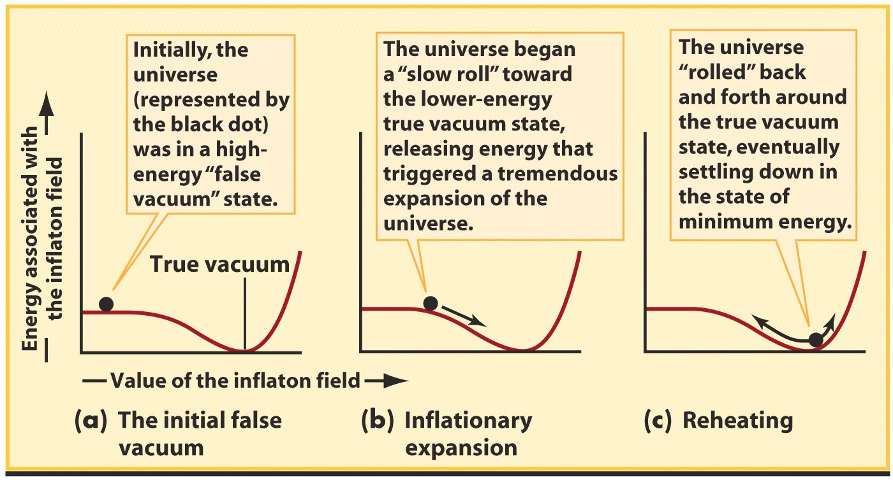
Inflation. The inflaton rolls down
The same thing happens for the inflaton!

Slide 21
As the inflaton rolls down the universe expands very fast (inflates)!
As the universe rolls down it releases huge amounts of energy that make it expand dramatically
This period is called inflation
The size of the universe grows exponentially as a ~ e^{Ht} where H is the “Hubble constant” at that time.
In just 10⁻³² s the universe expands by a factor of 10⁵⁰

Slide 22
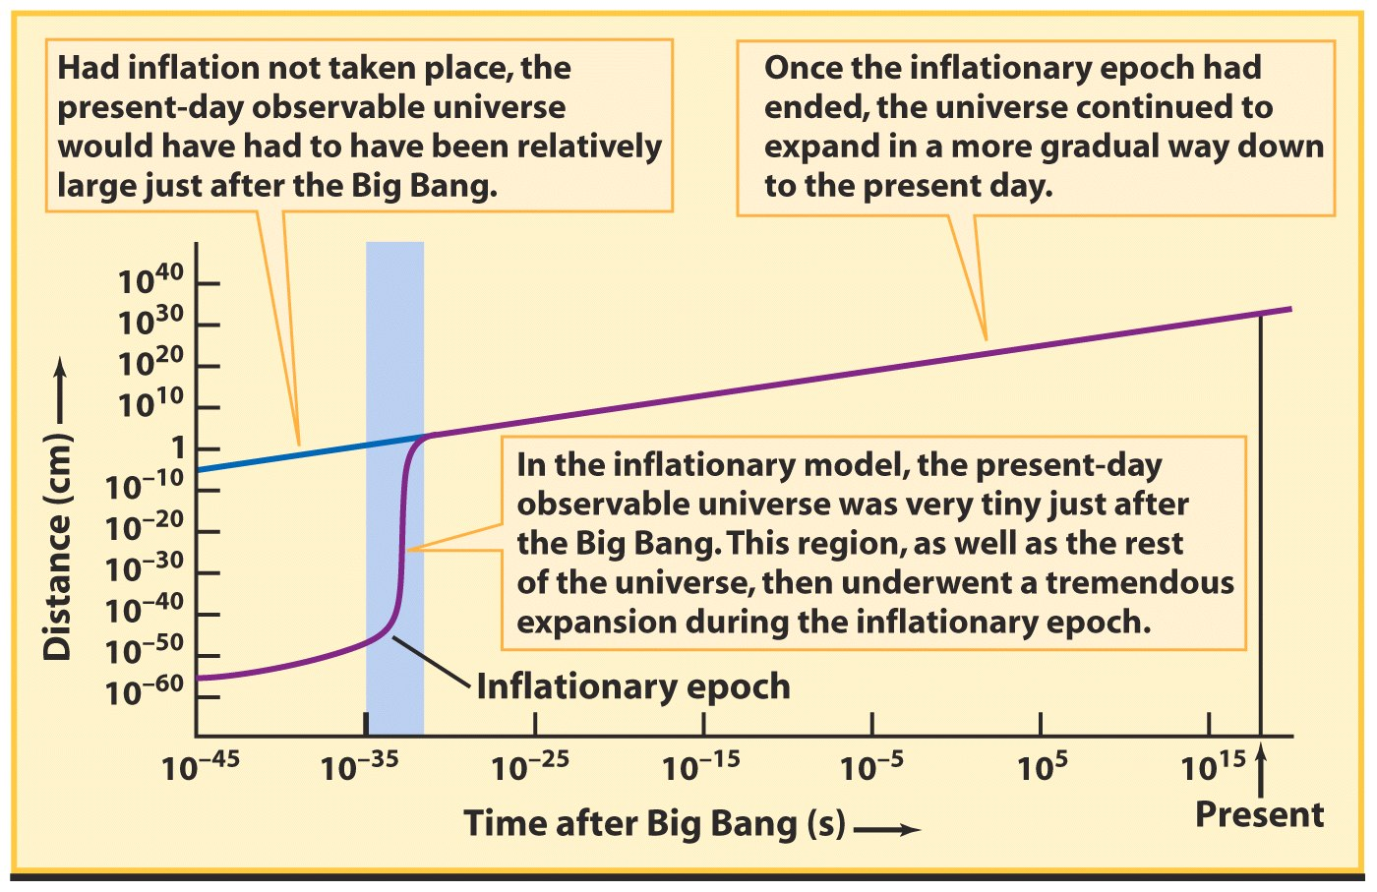
Inflation. The universe expands fast!
The period of ultra-rapid expansion means that our present day horizon was tiny before inflation. There could be a lot of “bubbles”!

Slide 23
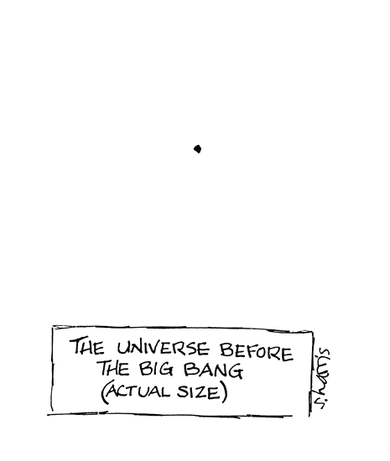
Inflation. Faster than the horizons!
This is very important!!!
Before inflation the universe was small enough to have been in causal contact. This solves the horizon problem of classic Big Bang!

Slide 24

Inflation. What happens to the temperature?
Inflation expands space so much that the temperature of the universe cools down to about 3K at the end of inflation
Is this good?
No, it’s way too cold
But at the end of this phase transition there is a bunch of latent heat released by the inflaton field that heats it back to the right temperature, about 10²⁷ K
It’s similar to boiling water that it doesn’t change temperature while it evaporates…

Slide 25
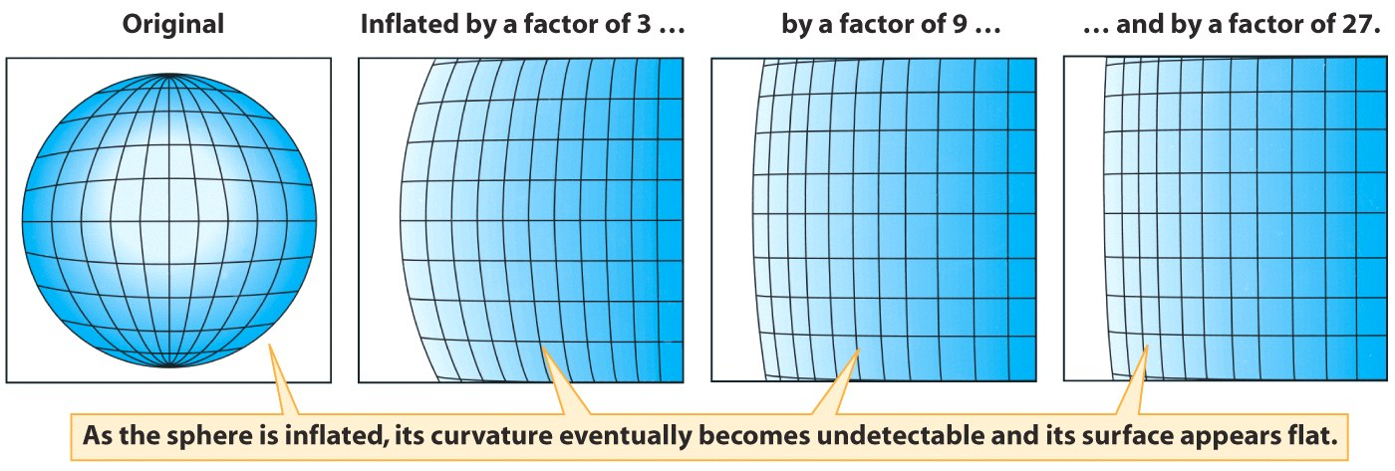
Inflation. A prediction
As space inflates the universe becomes flatter. Inflation predicts that the universe should be close to “flat” at present time.

Slide 26
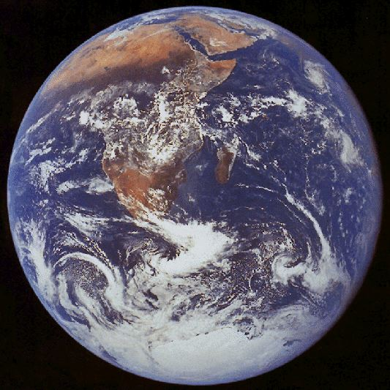

Inflation. A prediction
Pretty much like a basketball court… the players don’t realize it is curved because the radius of curvature of the Earth is so big!!

Slide 27
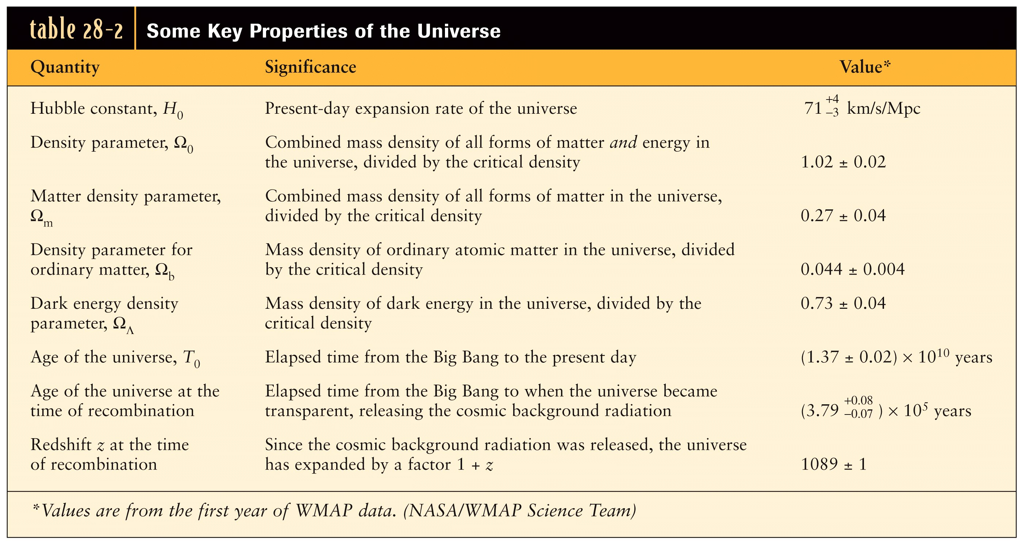
Inflation. Observations of flatness agree with the prediction!!!

Slide 28
Other tests of inflation
Inflationary models can predict the amount of polarization of the CMB (see Universe)
Inflationary models predict fossil gravitational waves, like the CMB but for gravitons.
Precision measurements of polarization in the CMB and of gravitational wave background can test the theory.
Polarization measurements of the CMB are currently starting to become interesting (ESA mission Planck first results just came out; no polarization yet)
For fossil gravitational waves… we’ll have to wait..

Slide 29
Inflation. Summary
In the last twenty year the classic Big Bang model has evolved to include a period of inflation
During inflation, as a result of a phase transition of a field called inflaton, space expanded dramatically so that our entire horizon was once in causal connection
Did anything move faster than light? Is this violating some fundamental law of physics?
NO!
Inflation gives a “natural” explanation for fundamental questions such as the horizon problem
Inflation predicts that space is flat, in agreement with observations
Other observable properties (at least in theory!) of inflationary models are polarization of the CMB and fossil gravitational waves

Slide 30
Inflation. Discussion
Why did people come up with the idea of inflation?
Is inflation a good scientific theory?
Is it as good a scientific theory as classic big bang?

Slide 31
The End
See you on thursday

