Slide 1
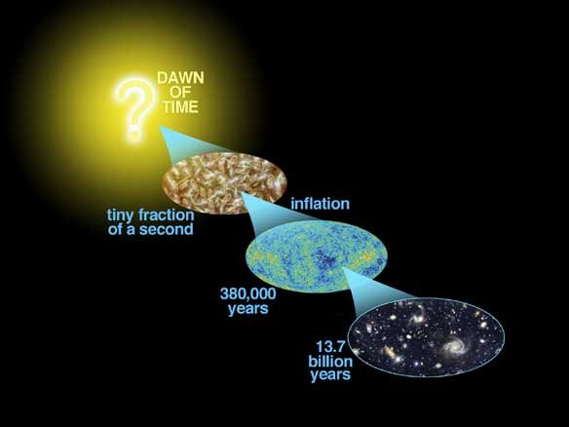
Astro-2: History of the Universe
Lecture 2; April 9 2013

Slide 2
Previously.. On Astro-2
The goal of cosmology is to understand how the universe formed and evolved.
How can we build a theory of the universe valid at all times in every place?
We have to assume that the view of the universe from Earth now is as good as from any other place and time.
You had a nice introduction to Big Bang cosmology from Neil DeGrasse-Tyson

Slide 3
Previously.. On Astro-2
Cosmological Principle
Universe is homogenous and isotropic.
VERIFIED BY OBSERVATIONS
Perfect Cosmological Principle
Universe is homogenous, isotropic, and time-invariant. But..
FALSE, NOT VERIFIED BY OBSERVATIONS, THE UNIVERSE EVOLVES!

Slide 4
Today.. On Astro-2
How big is the universe?
What kind of stuff is in it?
How do we find out how big is the universe?

Slide 5
Assignments. Due Friday April 12 4PM
To TA: Universe 24.34 - 24.37 - 24.41
On your own: 24.1 thru 24.30

Slide 6
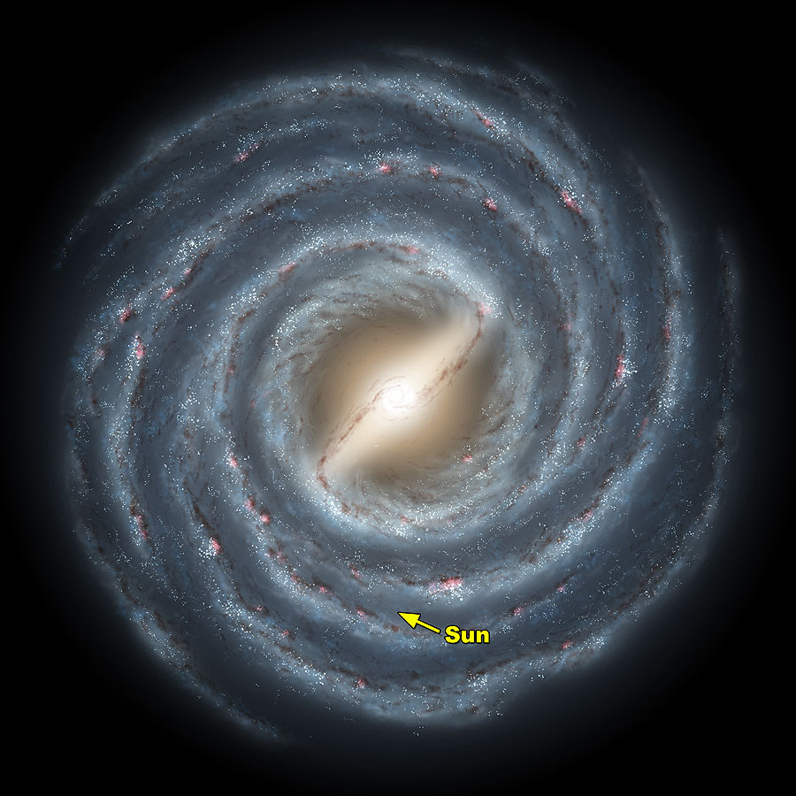
How big? The birth of Modern Cosmology
What is this?
The Milky Way!
In the past people called other galaxies Nebulae.
Nebula=cloud in Latin
In modern times Nebulae (galaxies) were studied and catalogued by Messier (M catalog) and Herschel in the XVIII and XIX century

Slide 7
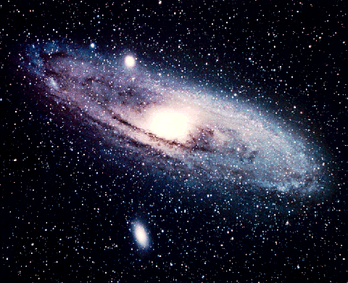
How big? The birth of Modern Cosmology
What are “nebulae”?
Are they part of our own galaxy, the Milky Way?
Are they galaxies themselves?
Is the Milky Way all there is, or is the Universe much bigger and our galaxy is only one of the many?
The closest big galaxy: Andromeda (M31)
Visible with the naked eye!

Slide 8
How big? The birth of Modern Cosmology
We know how big is the Milky Way
50 kpc = 4,000 billion times around the globe (universe chapter 23)
How big are the “nebulae”?
Do they fit in the Milky Way?

Slide 9
How big? “Island universes”?
How big are “nebulae”?
This was the subject of a heated debate in the early 1920s:
Harlow Shapley (galactic=small)
Heber D. Curtis (extragalactic=big)
By looking at them, we do not know if they are small objects nearby or big objects very far.
How do we figure this out?
How big is M31?

Slide 10
How big? 1923 comes Hubble…
In 1923 Edwin Hubble finds the solution measuring the distance to M31.
Discovers Cepheids in M31(what are Cepheids? Universe chapter 21)
Cepheids are “standard candles”. By measuring their period, we know the intrinsic brightness. From that and observed brightness we infer distance.
How big is M31?

Slide 11
Cepheid distance. Example:
A Cepheid in IC4182 has a period of 42 days and an apparent magnitude of m=22.0 in the V band
From the period luminosity relation we know that the absolute luminosity M=-6.5 in the V band
The relation between distance (in parsec) apparent and absolute magnitude is:
m=M+5 log (d/pc) -5
Hence d=10^{0.2(m-M+5)}pc, i.e. 5 10⁶ pc

Slide 12
How big? Hubble discovers the “realm of the nebulae”
Using the Cepheid distance Hubble concludes that M31 is 750 kpc away (15 times the size of the Milky Way)
Thus, the size of M31 is 70 kpc, larger than our own Milky Way.
The same is true for billions of galaxies that populate the universe! Our Milky Way is just and “average Joe” galaxy
Overnight people realized that the universe was thousands of times bigger than they thought
How big is M31? 70 kpc

Slide 13
How big? Answers
The universe is much bigger than the Milky Way
It contains billions of galaxies, each one tens of kpc in size.
The size of the visible universe is of order Giga (Giga=billion) pc, i.e. millions of times that of the Milky Way
It could be infinite…

Slide 14
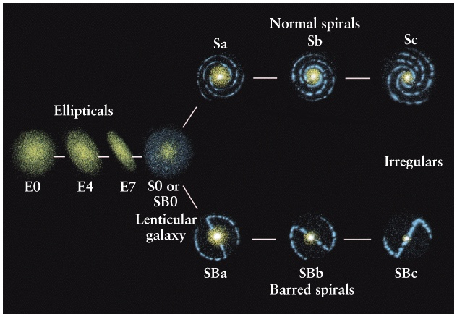
What kind of stuff? The Hubble “tuning fork” diagram
Hubble classified the variety of galaxies according to their “morphology”, i.e. their appearance.
Most galaxies belong to one of these four main types:
Ellipticals
Lenticulars
Spirals. Barred and non Barred
Irregulars

Slide 15
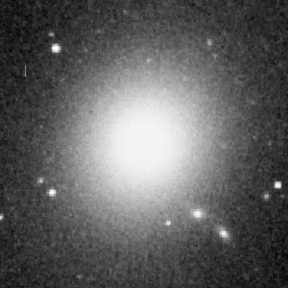
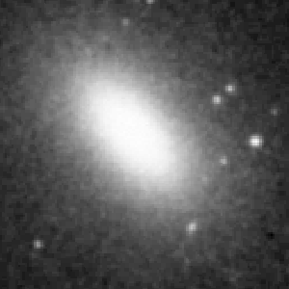
What kind of stuff: Elliptical galaxies
Elliptical galaxies appear elliptical in the sky.
Sub-Classified based on the apparent (what does this mean?) elongation.
If a and b are the major and minor axis, then the galaxy is classifed as En with n = (1-b/a)*10
M87
E0
b/a=?
N3377
E6
b/a=?

Slide 16
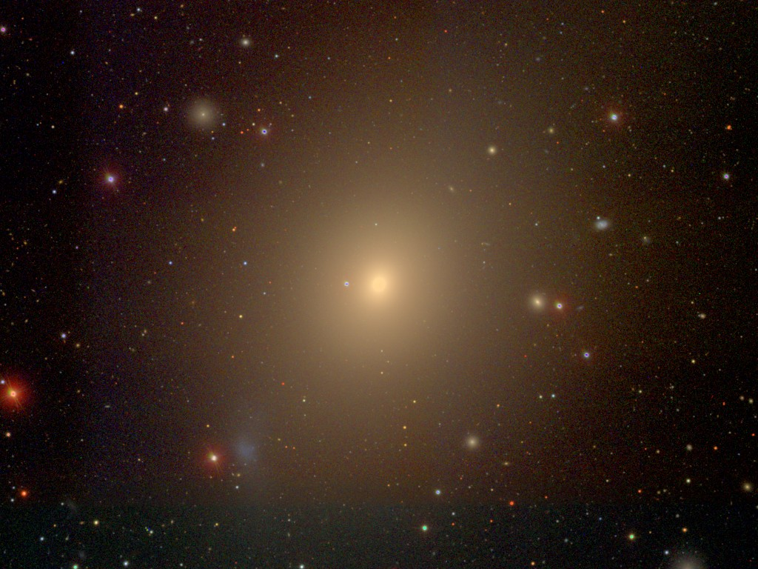

What kind of stuff? After shape, color, or spectrum
When you want to describe something you generally say the shape and then the color
The same things with galaxies:
First morphology, then color
A precise measurement of color is a “spectrum”
A spectrum contains lots of physical information

Slide 17
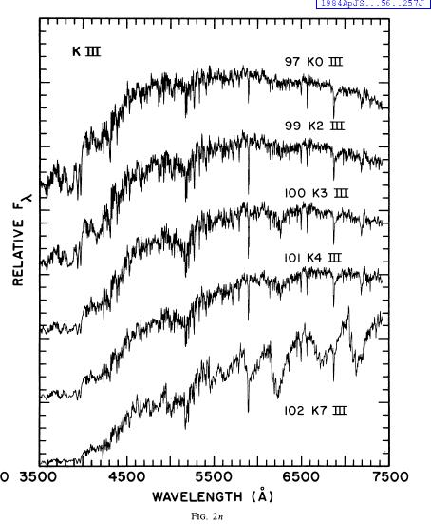
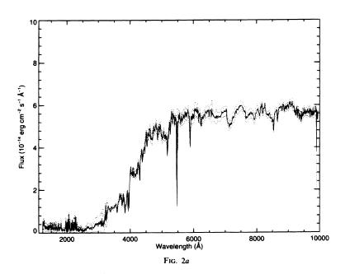
What kind of stuff? The age of Elliptical galaxies.
Elliptical Galaxy
Can you tell the difference?
Old stars

Slide 18
What kind of stuff? Elliptical galaxies contain old stars
Ellipticals are made of OLD stars, older than our own star (4.5 billion years old)
They contain very little gas or grains of solid materials (that astronomers call “dust”)

Slide 19
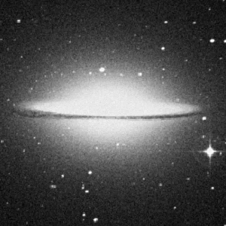
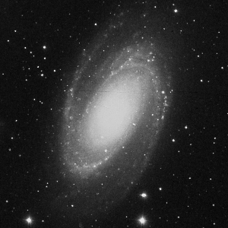
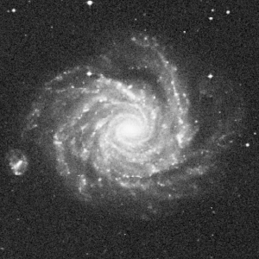
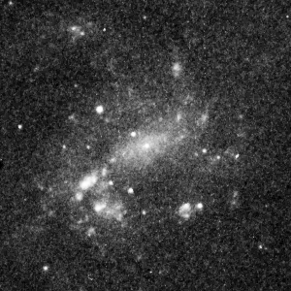
What kind of stuff? Spiral galaxies
Spirals are characterized by spiral arms. Sub-classified based on the relative size of the “bulge” and the “disk”
Sa have big bulges.. Sd have no bulge
Sa
Sb
Sc
Sd

Slide 20
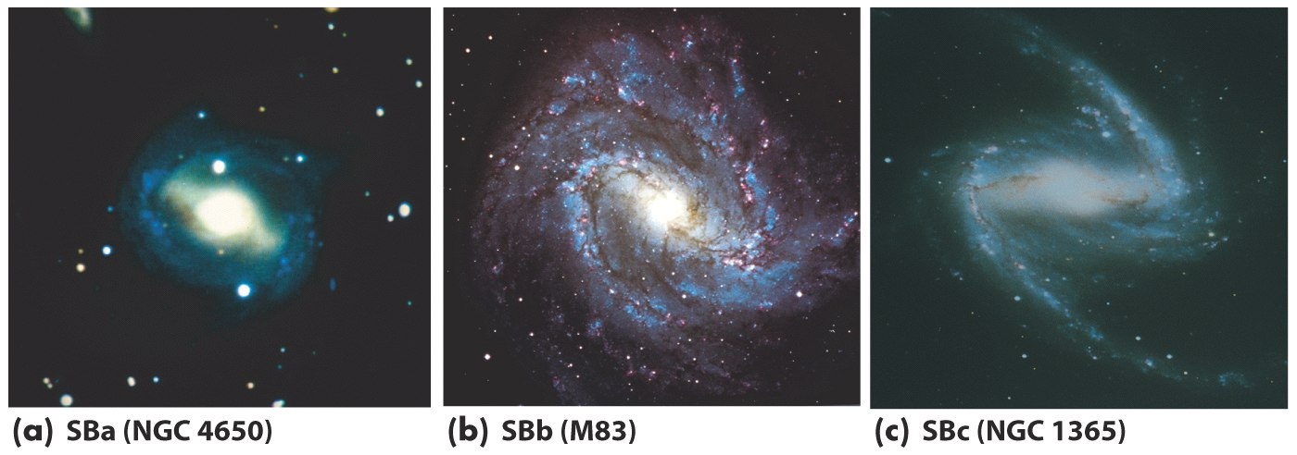
What kind of stuff? Barred spiral galaxies
Barred galaxies are similar to spirals but with a boxy central feature called bar.
Bars are found in ¾ of spirals and are thought to arise from instabilities
It is unclear exactly why not all spiral galaxies are barred…

Slide 21
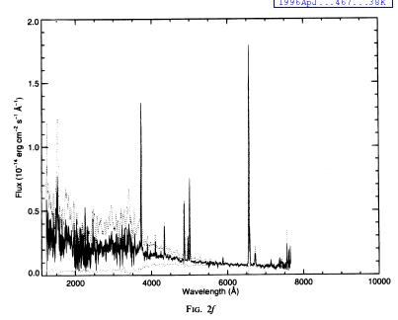
What kind of stuff? Spiral galaxies have young stars
The typical spectrum of a spiral galaxy is different from that of a star.
There are prominent emission lines (Universe Chapter 5).
Sc Galaxy

Slide 22
What kind of stuff? Spiral galaxies have young stars
Emission lines arise from gas “ionized” by very energetic radiation
Such high energy radiation is NOT produced by cold old stars, implying that very young stars (10 million years old) are present.
They also contain vast amounts of gas and dust
Sc Galaxy

Slide 23
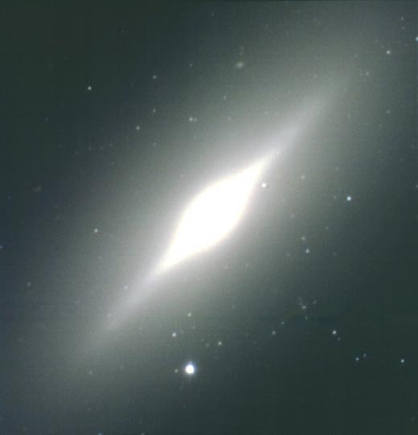
What kind of stuff? Lenticular (S0) galaxies
Lenticulars, like spirals, have a bulge and disk component, buy they have no spiral arms
Spectra are very similar to those of elliptical galaxies, i.e. only old stars.

Slide 24
What kind of stuff? Answers
Galaxies do not take any possible form or shape.
Most galaxies belong to one of these types:
Elliptical
Lenticular
Spiral
Irregular
Ellipticals and lenticulars have stars older than the sun
Spirals and irregulars have stars younger than the sun

Slide 25
What kind of stuff? Discussion
Are there stars younger than the sun in the Milky Way
Yes!!
Why?

Slide 26

How “heavy”? Apples fall, why not stars in galaxies?

Slide 27
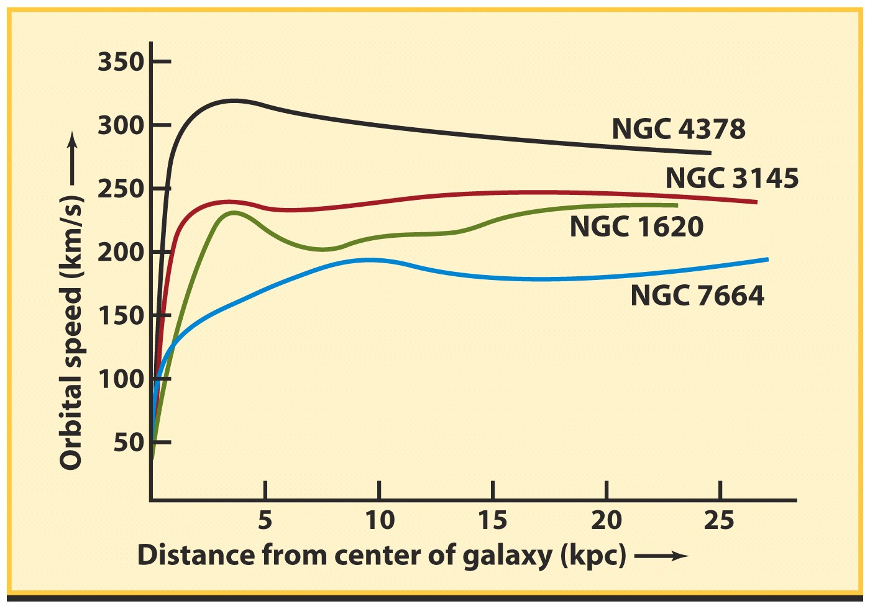
How heavy? Spirals are supported by rotation
Like planets around the sun, stars rotate around the center of spiral galaxies.
Rotation prevents them from falling: rotational support!

Slide 28
How heavy are spirals?
We can use rotation to measure a galaxy’s mass (“weight”)
In Equilibrium, gravity provides just the right amount of centripetal acceleration:
GM/R²=V²/R
We can use the rotation speed to infer the mass of the galaxy:
M(<R)=V²R/G

Slide 29
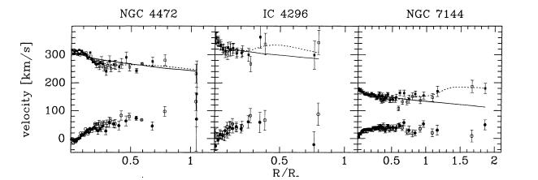
How heavy? Ellipticals do not rotate!

Slide 30

How heavy? Ellipticals do not collapse because of pressure, like a balloon

Slide 31
How heavy? Measuring their pressure and size, we infer their mass
From a spectrum we measure pressure σ
From the distance we infer the size R
From a physics theorem called the “virial theorem” we obtain the mass M:
M= k σ² R /G

Slide 32
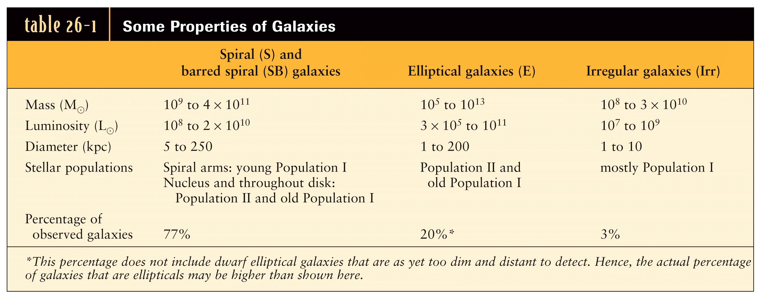
How heavy are galaxies? We need size to measure masses..

Slide 33
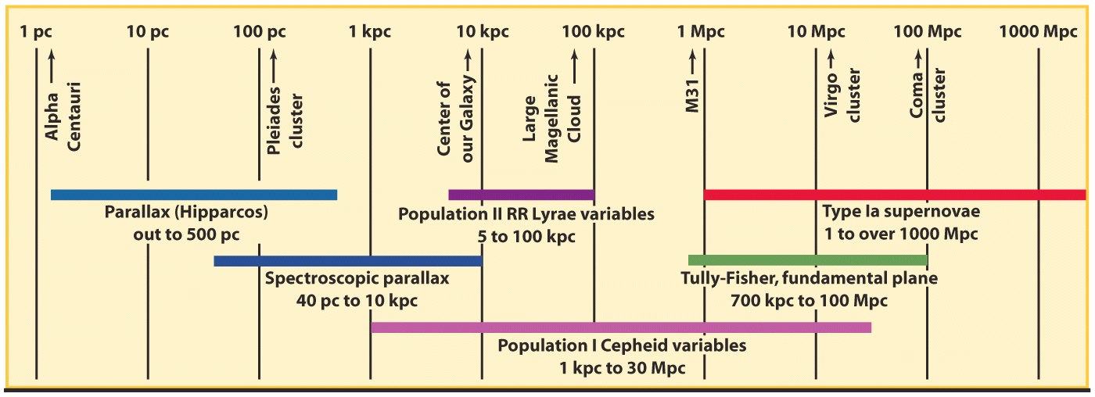
How far? So we are back to square 1. The distance scale..
Parallax (Universe Chapter 17;Big Bang Chapter 3) and variable stars can only measure distances up to a few kpc.
We need some method that can extend to longer distances! Typically a standard candle, or a standard ruler..

Slide 34
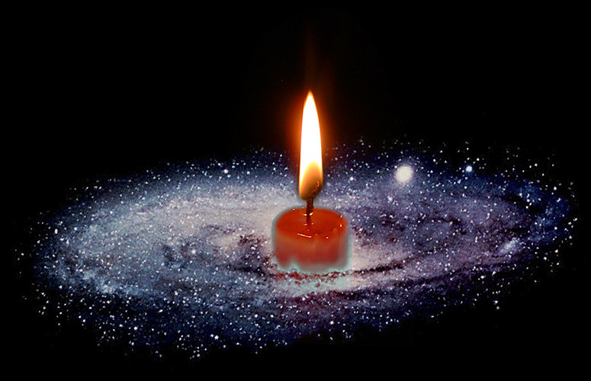
How far? The distance scale standard candles/rulers
If we know the intrinsic luminosity L (size R) of an object and we measure the apparent flux F (angular size θ) we obtain the distance from the expressions F=L/4πd² or d=Rθ

Slide 35
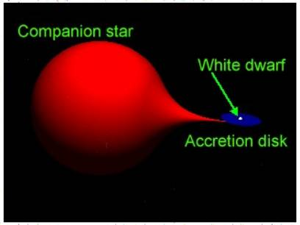
How far? Examples of standard candles/rulers
Cepheids (as discussed earlier)
Supernovae
Tully-Fisher (See Universe Chapter 24)
Fundamental-Plane (Universe Chapter 24)
Gravitational time delays (discussed later..)

Slide 36
How far? Summary
Measuring distances is essential to learn how big is the universe and how much stuff there is in it
To measure distances of far away objects, more than 100kpc or so, astronomers use “standard candles” such as Supernovae
Using Supernovae or other standard candles, astronomers have been able to find a general method to measure distances.
Next, on astro-2: In the process they also discovered that the universe is expanding.

Slide 37
The End
See you on thursday!

