Slide 1
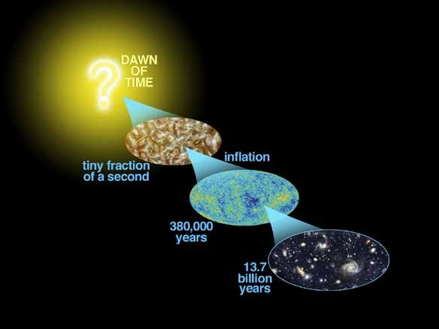
Astro-2: History of the Universe
Lecture 3; April 11 2013

Slide 2
Previously.. On Astro-2
The universe is much larger than the Milky Way (Gpc vs kpc)
There are billion of galaxies, the Milky Way is average Joe galaxy
Most galaxies can be classified based on their appearance as
  Elliptical
  Lenticular
  Spiral
  Irregular
Spirals rotate and have young stars, gas and dust
Ellipticals do not rotate and have old stars, no gas nor dust

Slide 3
Previously.. On Astro-2
It is difficult but very important to figure out the size and distance of things in the universe
One way astronomers do that is by using “standard candles”.
Examples of standard candles are cepheids variable stars and supernovae

Slide 4
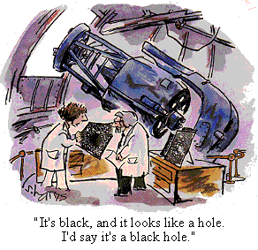
Two important questions
Are there black holes in galaxies?
What is a black hole?

Slide 5
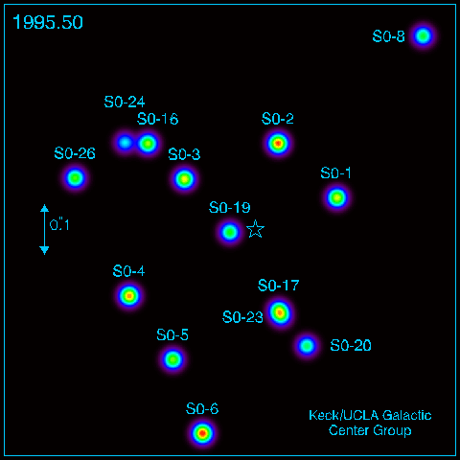
Two important questions
How do we know it?
Exactly in the same way we know the mass of the sun, or the mass of galaxies for that matter!

Slide 6
Two important questions
If the universe is homogeneous and isotropic how do stars know that there is a center of a galaxy to orbit around?
It is a matter of scale:
On scale much larger than a Mpc the universe is homogeneous
On scales much smaller than a Mpc the universe is NOT homogenous, there are galaxies, for example.

Slide 7
Assignments. Due Friday 4/19 4PM
To TA: Universe 24.42 - 24.43 - 24.45
On your own: 24.17 thru 24.30

Slide 8
Today.. On Astro-2
How far are galaxies?
Measuring velocities and “redshifts”.
Hubble’s law.
The Universe is expanding.

Slide 9
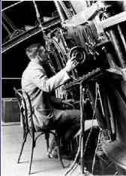
How far are galaxies? Hubble continues to work…
In 1923 Hubble showed that M31 was 750 kpc away
But how big was the universe?
How far were all the other galaxies?
Using the 100 inch telescope on Mount Wilson, Hubble gets back to work and measures distances to many galaxies, as far as Mpc away
He uses standard candles, like cepheids.

Slide 10
Measuring velocities. There is more to life than distances, says Hubble..
Hubble and his colleague Slipher and Humason use big telescopes to take spectra of those galaxies…
They want to find out what galaxies are made of!
Surprise, surprise! they discover that most galaxies are moving AWAY from us

Slide 11
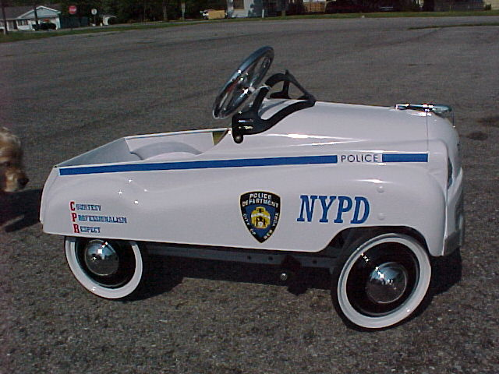
Measuring velocities with a spectrum. Doppler Effect
Like the sound of a police car
When the car is approaching you hear high pitch, when is running away you hear a low pitch
The same with light:
When something is approaching you see “bluer”, more energetic light (blueshift)
When something is receding you see “redder” light, less energetic, light (redshift)
This is called “Doppler Effect”

Slide 12
Measuring velocities with a spectrum. Doppler Effect
Quantitatively, due to the Doppler effect, the WAVELENGTH λ₀ of some spectral feature is moved to a different wavelength λ
For a receding object, the redshift z is the amount of shift towards longer wavelengths:
Z=(λ-λ₀)/λ₀
For z much smaller than 1, the line of sight velocity is v=cz, where c is the speed of light (see Universe Chapter 24 for general formula)

Slide 13
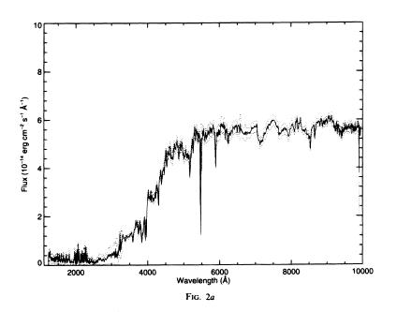
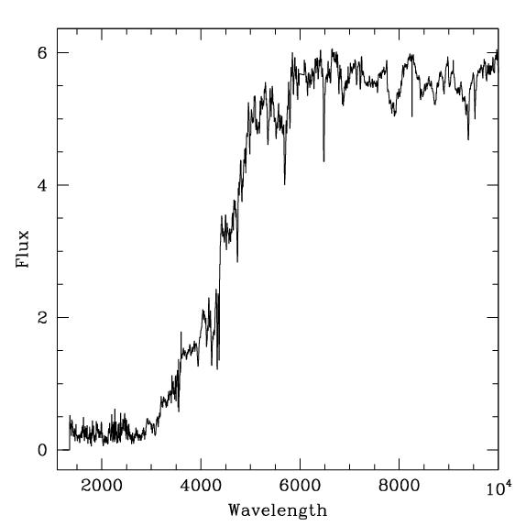
Measuring Redshifts, an example.
CaK 3933 Å
Z=0
Where is the feature now?
Z=?
V=?

Slide 14
Measuring redshifts, an example.
CaK 3933 Å
Z=0
Where is the feature now?
Z=0.1
V=30,000 km/s

Slide 15
First summary
Hubble measured distances to many galaxies out to several Mpc away
Taking spectra of the nebulae, Hubble and his colleagues were able to measure the relative velocity of galaxies with respect to us
They found that most galaxies are redshifted, as if they were moving away from us!!

Slide 16
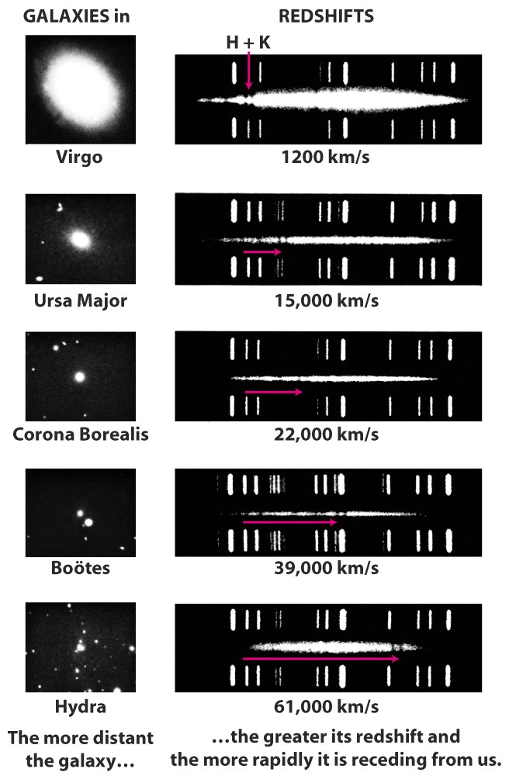
Measuring velocities. Galaxies are moving away from us!
Hubble found that most galaxies were moving away from us!
Furthermore, the more distant the galaxy, the larger the redshift

Slide 17
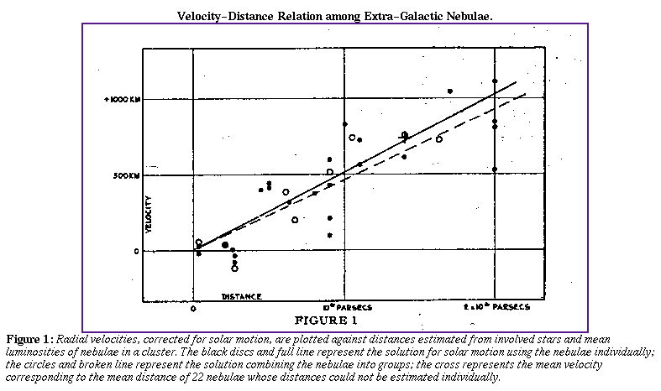
Hubble’s law: galaxies are moving away from us!
Hubble found that redshift (or velocity) is proportional to distance (Hubble’s law): if you measure double speed, you also measure double distance!

Slide 18
Hubble’s law: the Hubble constant
The ratio between velocity v and distance d is a constant, called the Hubble Constant or H₀=v/d
This is phenomenal! If we know H₀ it is sufficient to measure velocity (or redshift), which is easy, as we saw earlier, to find out the distance to any galaxy!!

Slide 19
Even Hubble makes mistakes….
Hubble’s first measurement of the Hubble constant was wrong: 500 km/s/Mpc, instead of the current best estimate of 73.8+-2.4 km/s/Mpc

Slide 20
Even Hubble makes mistakes….
Hubble’s mistake was due to various reasons including that he used as standard candles things that were not standard candles

Slide 21
However Hubble’s law is valid.. and we can use it to infer distances.
Astronomers prefer to use redshift instead of velocity because that is what we measure.
Also redshifts are not properly a measure of speed in the common sense of the world, but a measure of the expansion of the Universe as we will see.
A generalization of Hubble’s law gives you the distance to any galaxy, provided you know the redshift

Slide 22
Hubble’s law. The Hubble constant is NOT a solved problem
The Hubble constant is arguably the most important number in cosmology
Planck recently claimed to have measured a Hubble constant that is somewhat smaller than what previously thought (that depends on some important assumptions)
What is currently considered the best measurement gives the Hubble constant to within 3% as if you knew your height within with 3 inches or so..
A lot of people are still working to improve our measurements of the Hubble constant.

Slide 23
Summary 2
Hubble’s Law solves a big problem, providing distances to any object
If you know the redshift of a galaxy you know its distance with a given precision, equal to the precision with which you know the Hubble Constant
Redshifts can be measured very precisely, much more precisely than you know your height!!! For this reason astronomers generally say a galaxy is at a redshift z=0.4231, rather than quoting its distance
Distances can be known only to about 5%
In cosmology, as in all of physics, measurements also come with an uncertainty, equally important as the number itself

Slide 24
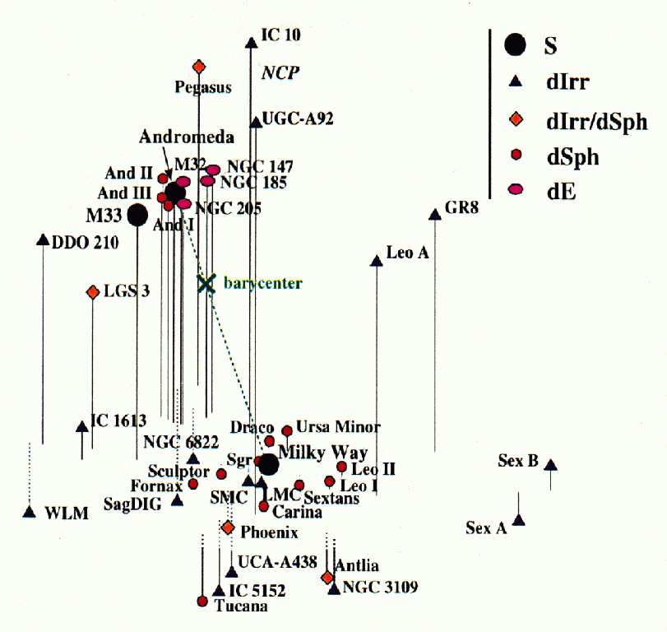
Hubble’s Law. Discussion
Are all galaxies redshifted?
No
Why?

Slide 25
The Universe is expanding
Hubble’s law is not only a convenient way to obtain distances to galaxies from their redshifts
Hubble’s law has a much more profound significance
In the current standard cosmological model, Hubble’s law is believed to be the result of the expansion of the Universe

Slide 26
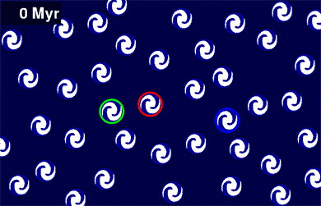
The Universe is expanding

Slide 27
The Universe is expanding. Meaning of the Hubble constant
In our model of the expanding universe the Hubble constant represents the current expansion rate of the Universe
What is an expansion rate? Think about an interest rate on your savings account.. 3% per year now, next year might be different.

Slide 28
The Universe is expanding. Meaning of the Hubble constant
The Hubble constant also gives the timescale for the expansion.
In “normal” units the Hubble Constant is approximately 1/(10 Gyrs)
This tells us that the age of the Universe is of order 10 Gyrs
The large value of the Hubble constant obtained by Hubble implied a much shorter life of the Universe, of order 1-2 Gyrs. This caused problems as it was inconsistent with the age of Earth, for example

Slide 29
The universe is expanding. Frequently asked questions…
What is the universe expanding into?
Nothing, the universe is all there is, spacetime is expanding itself
Where is the center of the expansion?
Nowhere, there is no center, the universe is homogenous and isotropic
Do we expand as well?
No, because we are bound by electromagnetic forces
Do galaxies expand?
No because they are bound by gravity and they detach from the Hubble Flow

Slide 30
The universe is expanding. More frequently asked questions…
Are galaxies at z=2 moving faster than the speed of light?
No, the observed redshift is not really a Doppler effect! It’s only a geometrical effect due to the expansion of the universe. As the universe gets larger wavelengths get stretched, resulting in the observed redshift.
Nothing moves!

Slide 31
Summary 3
Hubble’s law is interpreted as evidence that the universe is expanding.
The universe is not expanding into anything, space itself expands.
The timescale for expansion is given by the inverse of the Hubble constant ~ 10 Gyrs
The universe is approximately 10 Gyrs old.

Slide 32
The End
See you on thursday!
NO CLASS ON TUESDAY APRIL 16

