Slide 1
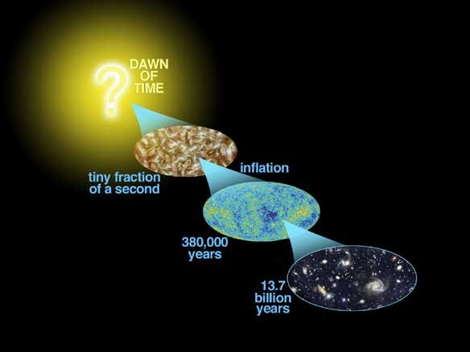
Astro-2: History of the Universe
Lecture 5; April 23 2013

Slide 2
Previously.. On Astro-2
Galaxies do not live in isolation but in larger structures, called groups, clusters, or superclusters
This is called the large scale structure of the universe
The morphological mix depends on local density! Ellipticals live in high density regions like clusters, spirals in low density regions (the so-called “field”)

Slide 3
Previously.. On Astro-2
Sometimes galaxy collide and merge
Merging can induce bursts of star formation and changes in morphology
One of the central assumption of the standard model of galaxy formation is that elliptical galaxies form by mergers of spirals

Slide 4
Previously.. On Astro-2
The motion of stars in galaxies and that of galaxies in clusters cannot be explained by the gravitational field of known matter
This has been interpreted as evidence for exotic dark matter
Dark matter makes up most of the mass of the Universe
In the current standard model galaxies and clusters live in dark matter halos
This model successfully reproduces the properties of the universe on large scales
There are problem on small scales, such as the substructure problem. Perhaps the model is not right…

Slide 5
Today.. On Astro-2
Additional evidence for dark matter: Gravitational lensing
Measuring the Hubble constant and dark matter substructure with gravitational lensing
What is dark matter? Machos and wimps
Is it really dark matter? Modified Newtonian Dynamics

Slide 6
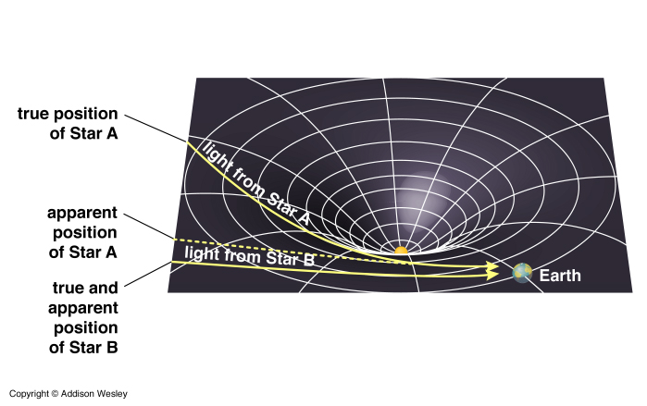
Detecting dark matter. Gravitational lensing!
Mass concentrations perturb spacetime, altering the propagation of light

Slide 7
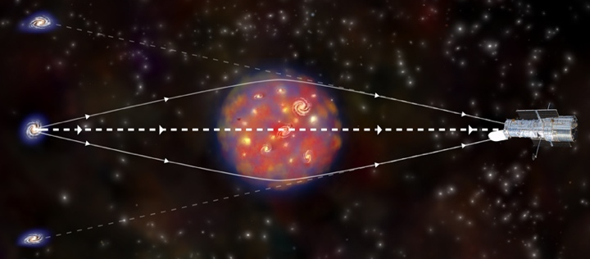
Detecting dark matter. Strong gravitational lensing!
Under special circumstances the distortion is so strong that creates two images of a background object. This is called strong lensing

Slide 8
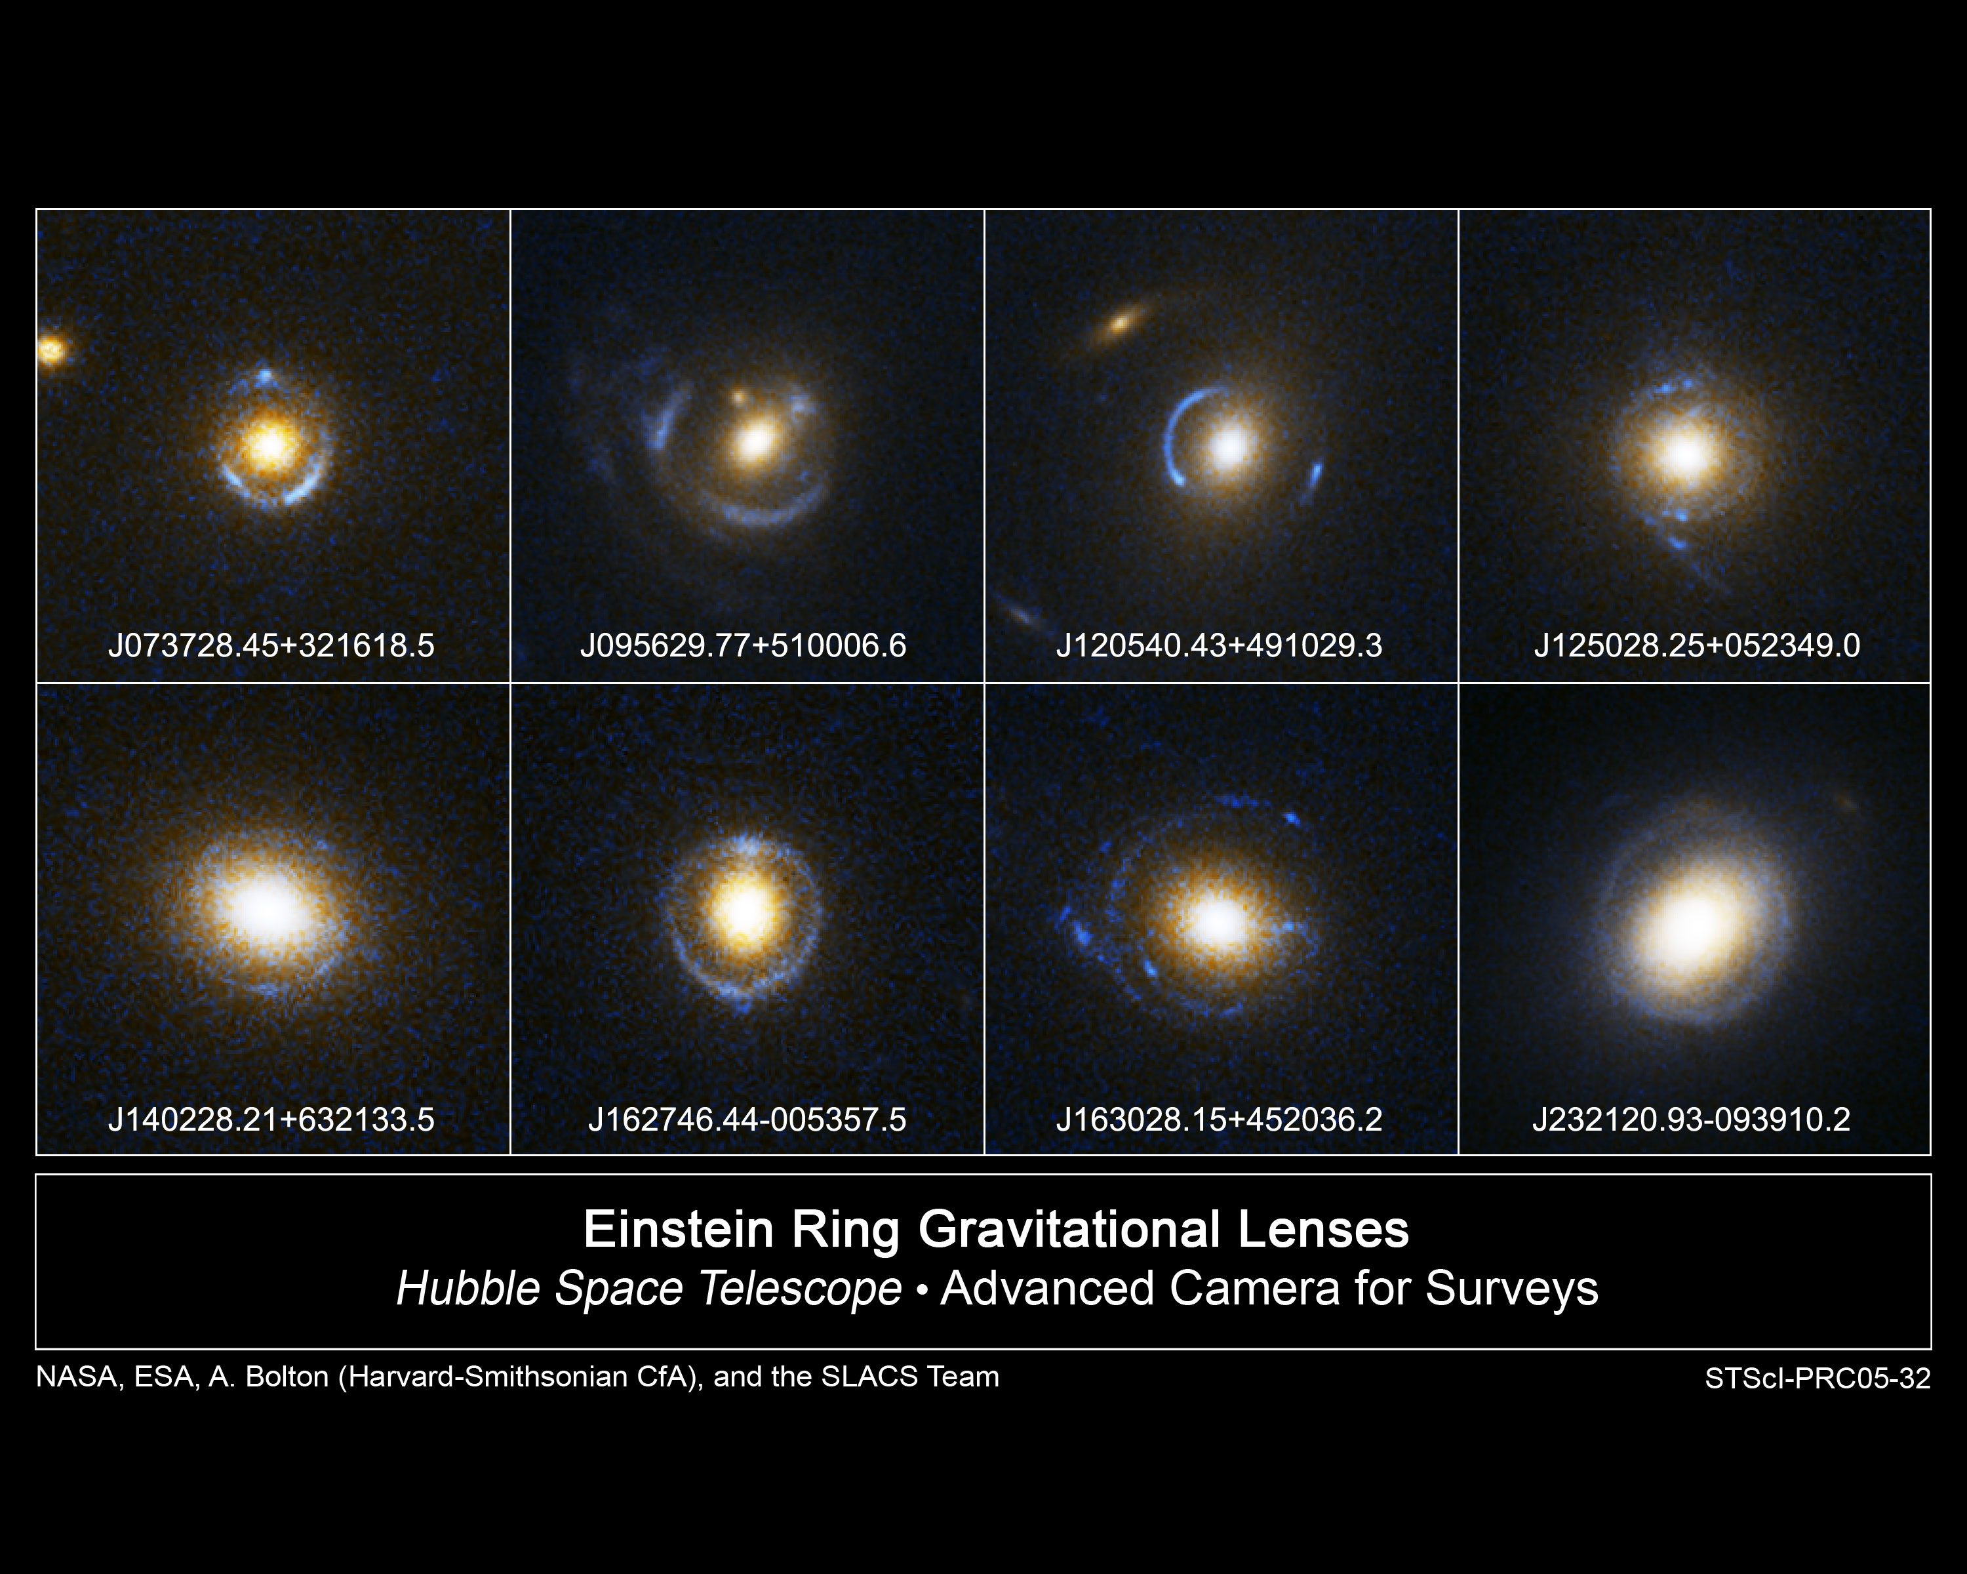
Detecting dark matter. Examples of strong lenses

Slide 9
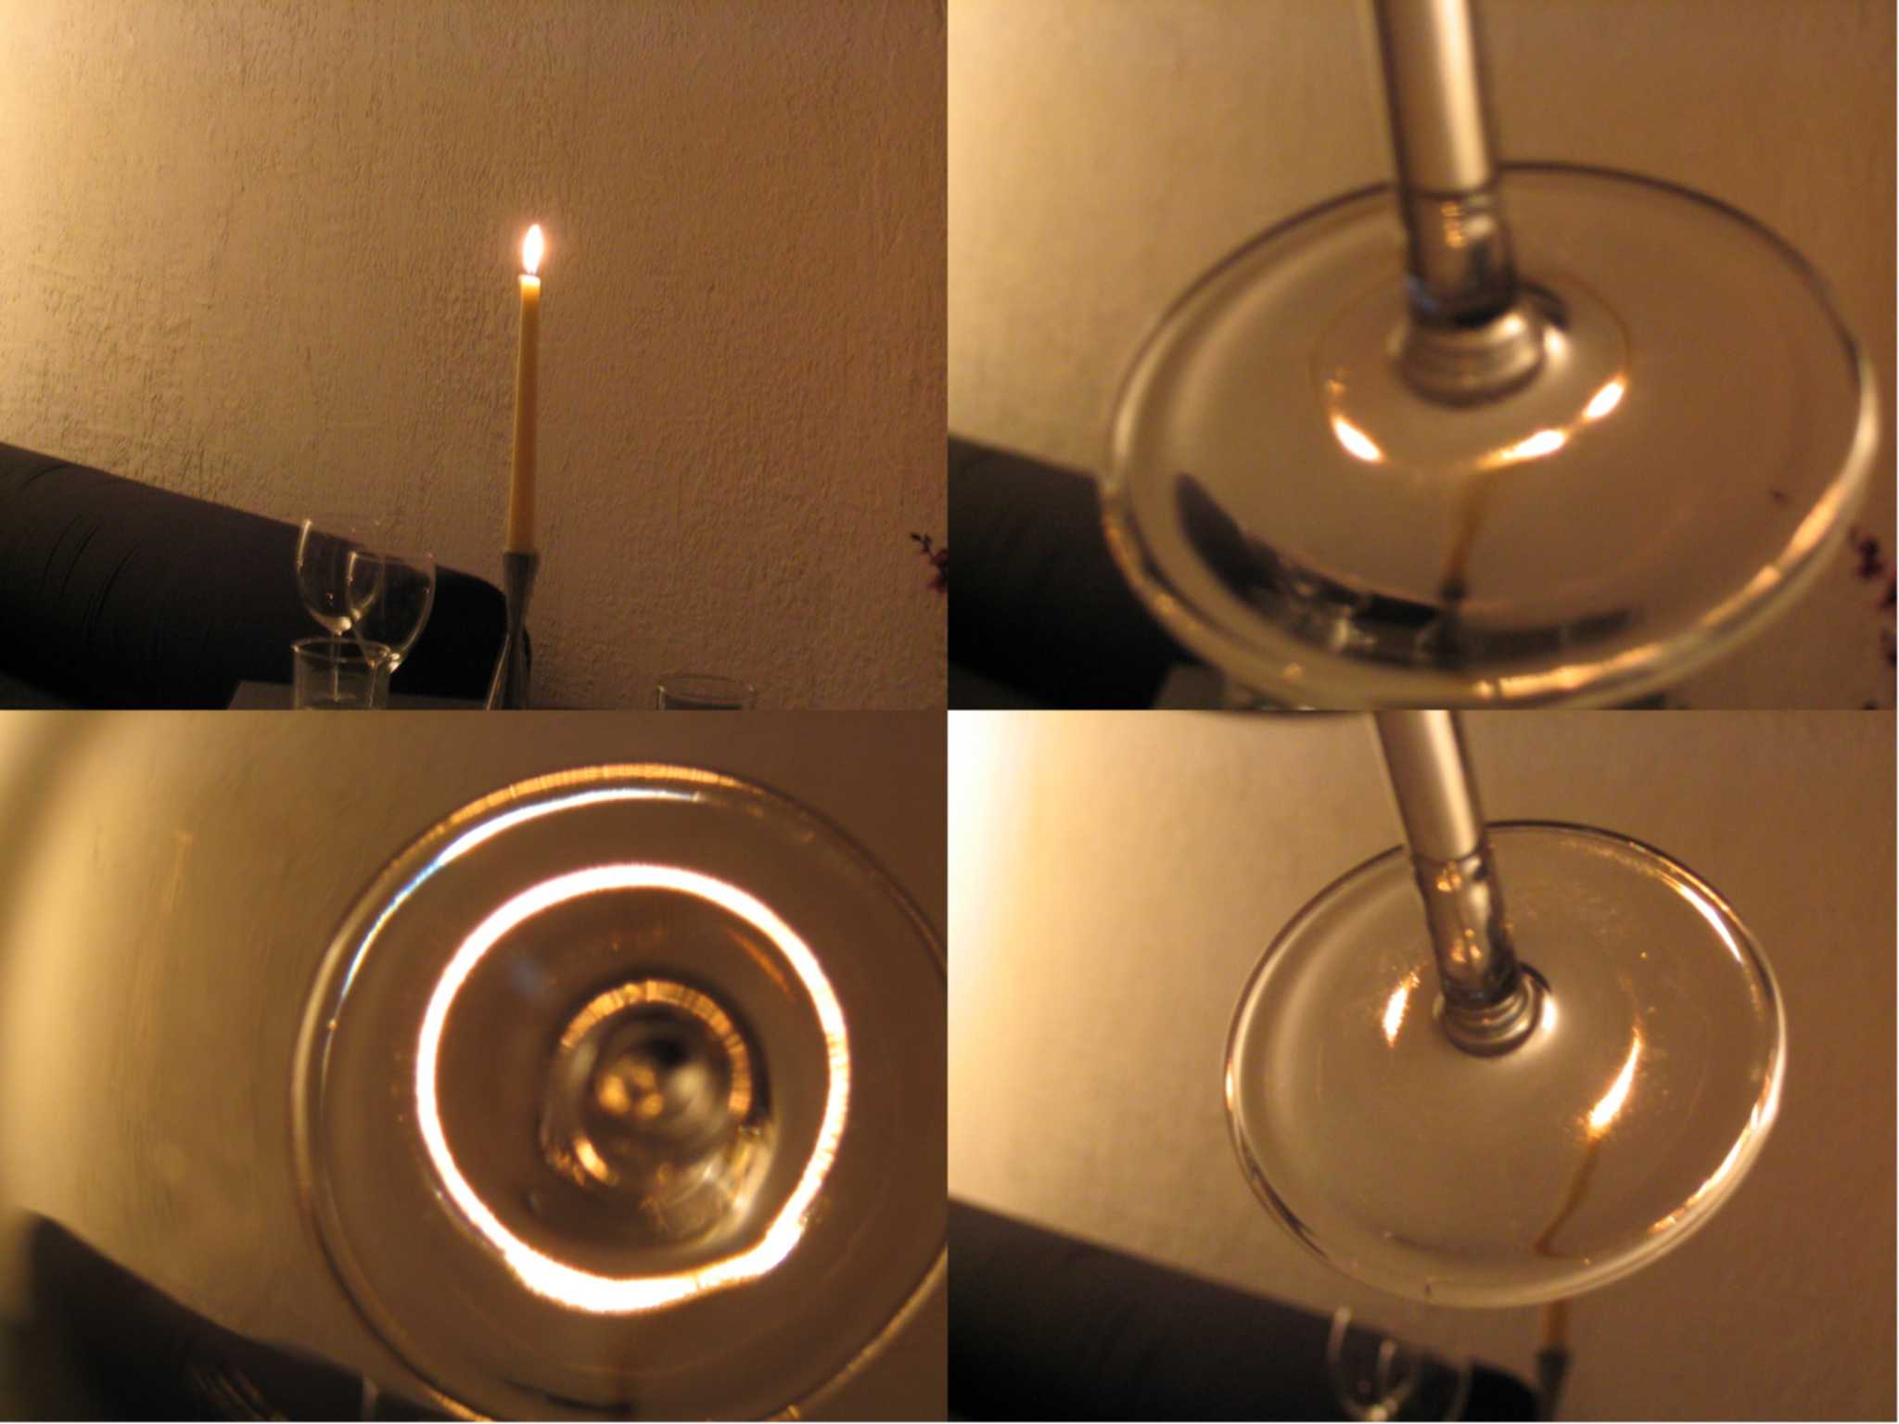
Detecting dark matter. Why is it called lensing?
The physics is very similar to that of common optical lenses
In fact many of the features of gravitational lensing can be reproduced by common optical devices.
Quadruple
Source
Einstein Ring
Double

Slide 10
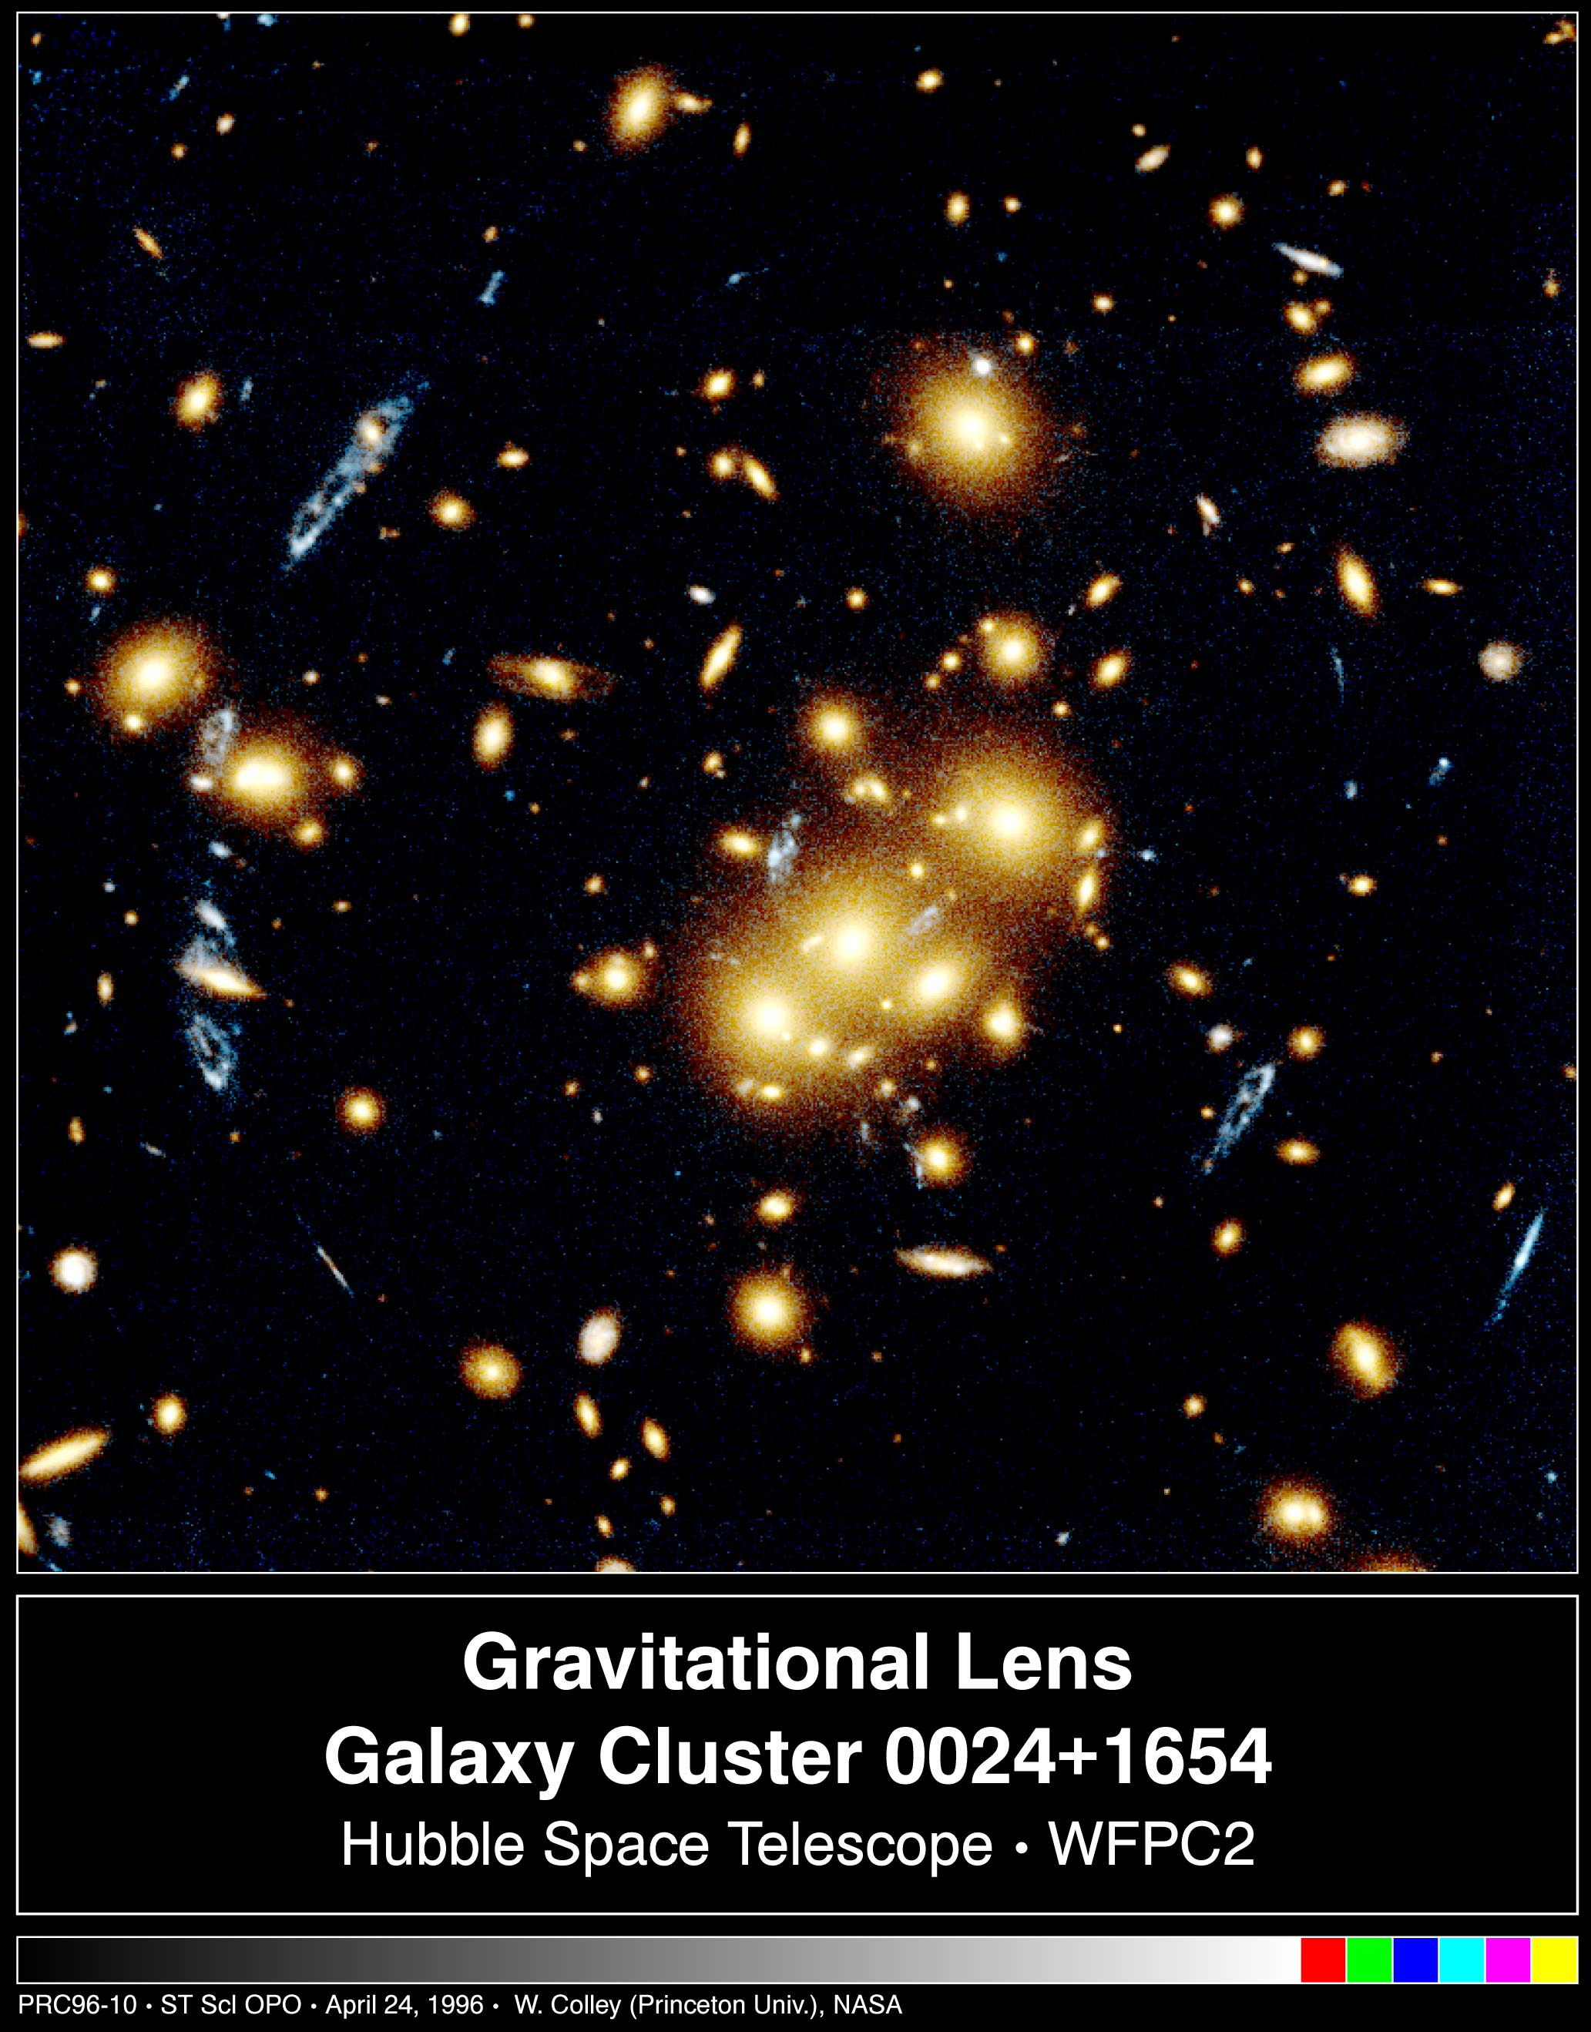
Detecting dark matter. Strong lensing by clusters
Clusters are also strong lenses
The blue objects here are distorted images of the same object

Slide 11
Detecting dark matter. Why do we care about lensing?
The image separation gives us a direct measurement of the mass enclosed by the images.
It is arguably the most precise measurement of mass that we can make.
And there are other applications too (we’ll see later..)

Slide 12
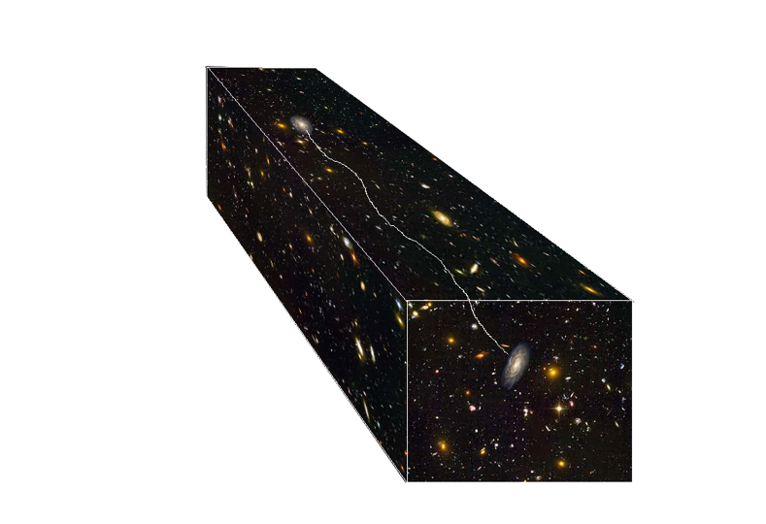
Detecting dark matter. Weak lensing
Even when the gravitational field is not strong enough to produce multiple images, the large scale structure perturbs space time
This alters the shape of observed galaxies in the sky, shearing and magnifying them in a measurable way

Slide 13
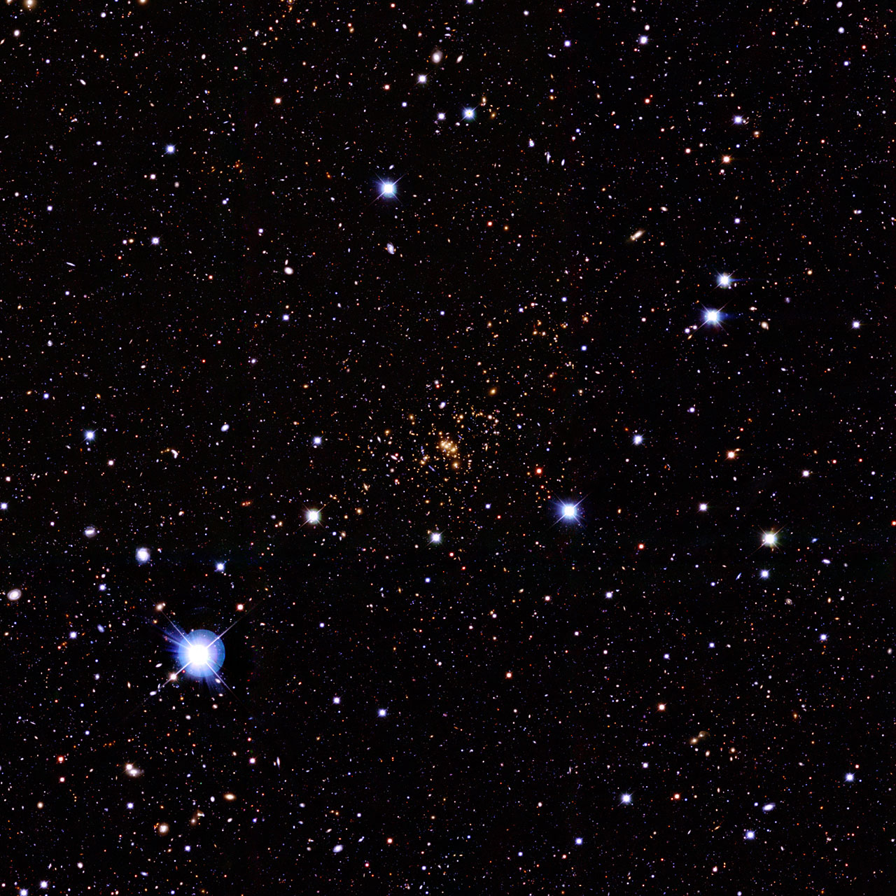
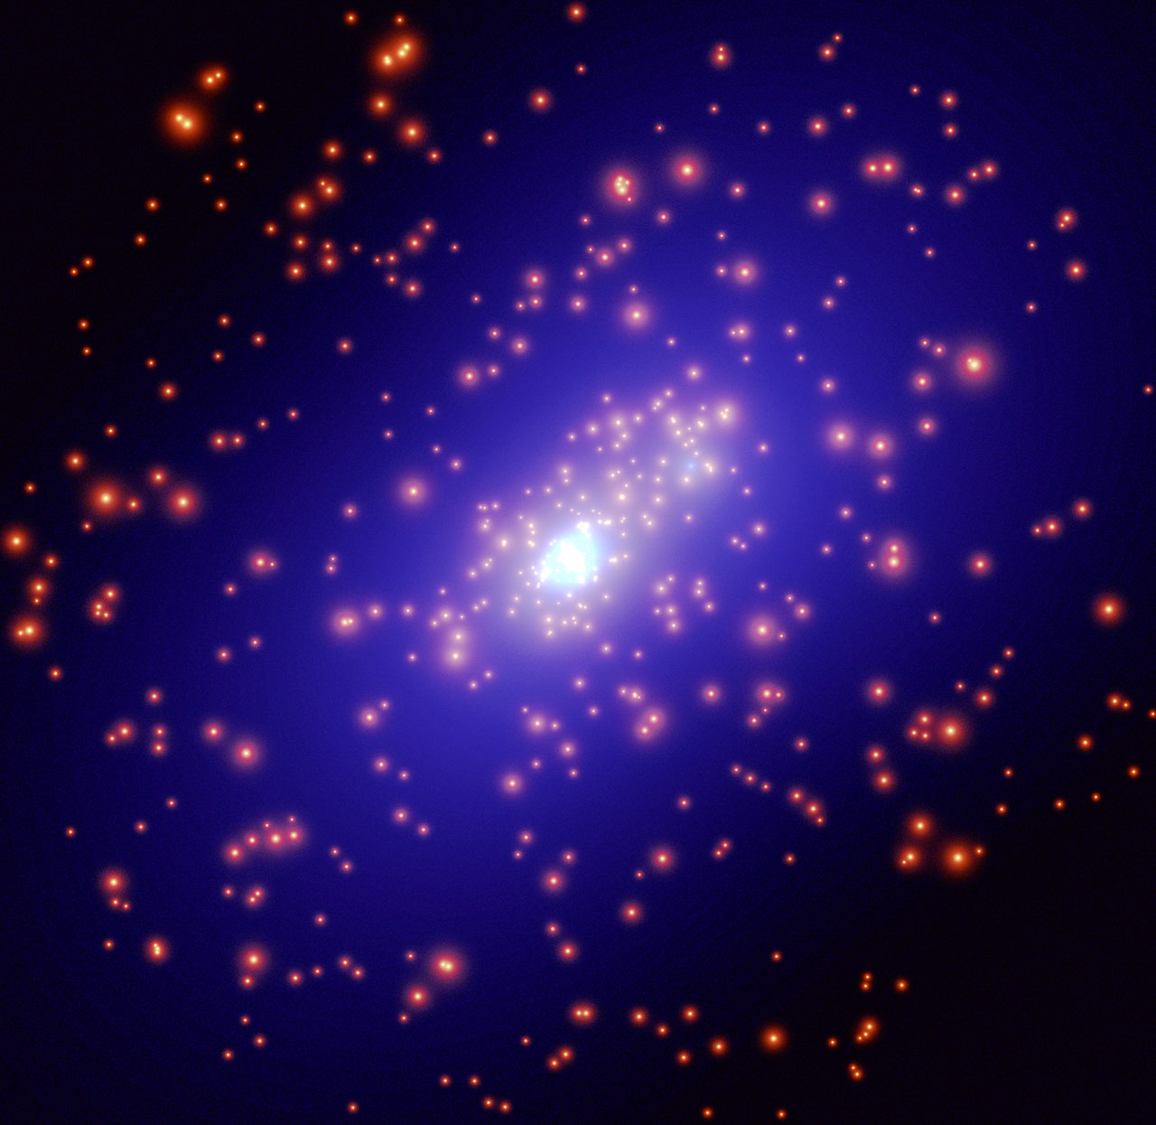
Detecting dark matter. Weak lensing mass maps
Optical image
Dark matter mass

Slide 14
Summary 1. Lensing detections of dark matter
Mass concentrations distort the images of objects in on the sky in a way similar to that of optical images.
Strong and weak lensing provide very accurate mass maps of objects
In most cases much more mass is detected than what is visible, providing independent evidence (very important) for dark matter
Dark halos have been shown by gravitational lensing to extend for 100s of kpc outside galaxies

Slide 15
Gravitational lensing. Measuring the Hubble constant
Gravitational fields not only bend light, but they also “slow” down time
For this reason as light travels close to a lens it takes longer than it should in normal geometry
We can use this effect to measure the Hubble constant

Slide 16
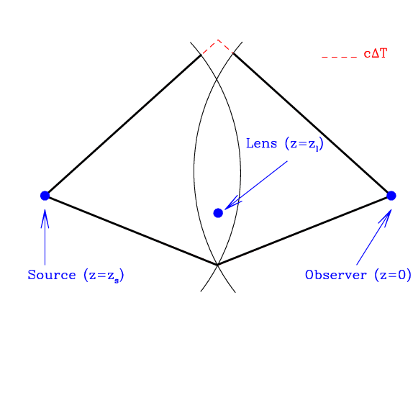
Gravitational lensing. Measuring the Hubble constant. How does it work?
The source is variable (e.g. goes off at a precise point in time)
You will see one image appear after the other
Since we know the speed of light, the time delay measures the different optical path+gravity
From that we can infer the size of the system and we have a standard ruler!
Time delays values agree with standard measurements and can potentially achieve sub 1% precision

Slide 17
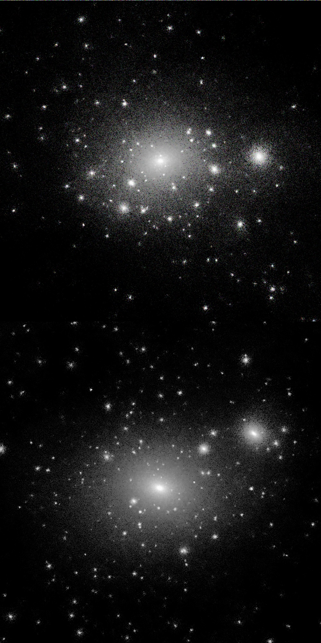
Gravitational lensing. Detecting substructure..
Do you remember the substructure problem?
Two alternatives:
1) Cosmological model is wrong
2) Satellites are present but not visible
Lensing can detect them through their effects on multiple images.. There have been claims that this has been detected.. The jury is still out..

Slide 18
Summary 2. Other applications of lensing
Gravitational lensing is a way to measure mass in the universe directly.
Using gravity to make measurements provides us with a different and independent point of view, that is essential to validate/falsify competing models
This is the essence of the scientific approach

Slide 19
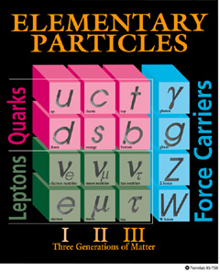
What is dark matter? Or what is “normal” matter
Ordinary matter is made for the most part of protons and neutrons, i.e. quarks up and down.
For this reason we refer to ordinary matter as baryonic matter
Neutrinos should not have mass in the standard model, but if they do, they could explain at least part of dark matter

Slide 20
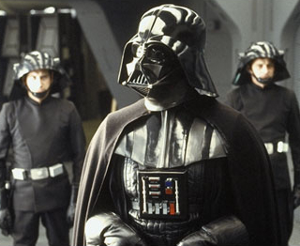
What is dark matter?
What is this dark matter?
First of all, can it be that we are just not seeing all the ordinary matter that there is?
Perhaps dark matter is just baryons in the hiding….

Slide 21
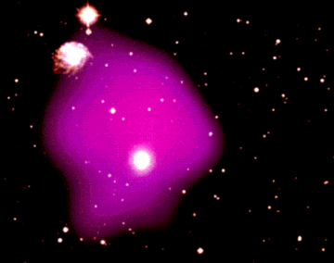
What is dark matter? Searching for baryonic dark matter
The first thing to look for (Ocam’s razor) is baryonic dark matter
This would require no change in the standard model
One example of previously dark matter that was discovered with X-rays is hot gas in clusters

Slide 22
What is dark matter?
Baryonic dark matter
Baryons interact with light
It is difficult (impossible) to hide baryons in gaseous form since they emit absorb light to a level that we can detect
The only places that dark matter could hide in are dark compact objects, like white dwarfs, neutron stars, brown dwarfs, or black holes. Collectively they are called MACHOs (massive compact halo objects)

Slide 23
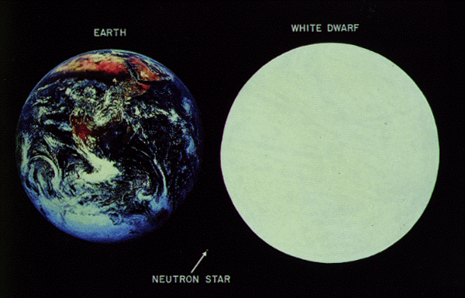
What is dark matter?
White Dwarfs & Neutron stars
Late evolutionary stages of massive stars (> 1 solar mass)

Slide 24
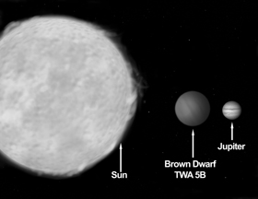
What is dark matter?
Brown dwarfs
Failed stars (>12 Jupiter masses; < 8% solar mass)

Slide 25
What is dark matter?
Not enough in WD and BD
White dwarfs and brown dwarfs emit some form of light and therefore can be detected with sufficient patience
They do not seem enough to account for all the known dark matter, perhaps maybe up to 20% of the total mass of the Milky Way

Slide 26
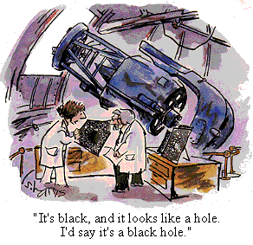
What is dark matter?
Black holes
Black holes are extremely compact:
If Earth was a black hole, I could hold it in my hand
They do not emit light, directly

Slide 27
What is dark matter?
Not enough in NS and “normal” BH
Neutron stars and black holes are harder to detect (black holes can be detected indirectly. How?)
However, if they came from massive stars they should have left behind massive amounts of light and heavy elements, which are not seen.
The only remaining possibility appears to be very massive black holes (100,000 solar masses) that are not efficient “pollutants”

Slide 28
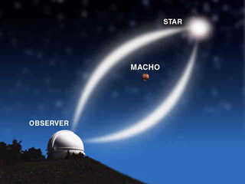
What is dark matter?
Microlensing…
How can we detect NS and BH if they don’t shine (lensing!)
Machos transiting in front of stars should produce an observable phenomenon called microlensing
We cannot see the multiple images (they are too close)
But we can see the lensing amplifications
Dedicated experiments have monitored huge parts of the sky to detect MACHOS in this way
It is very difficult because there are lots of transient events that could contaminants
It looks like there aren’t enough MACHOS to explain dark matter…

Slide 29
What is dark matter? Non baryonic dark matter
The other alternative is that dark matter is non-baryonic
1) A very appealing possibility is that they are in the form of very massive particles that interact only weakly, i.e. no electromagnetic interaction, called WIMPS, for weakly interacting massive particles. “Cold” dark matter
2) An alternative is massive neutrinos. “Hot” dark matter.

Slide 30
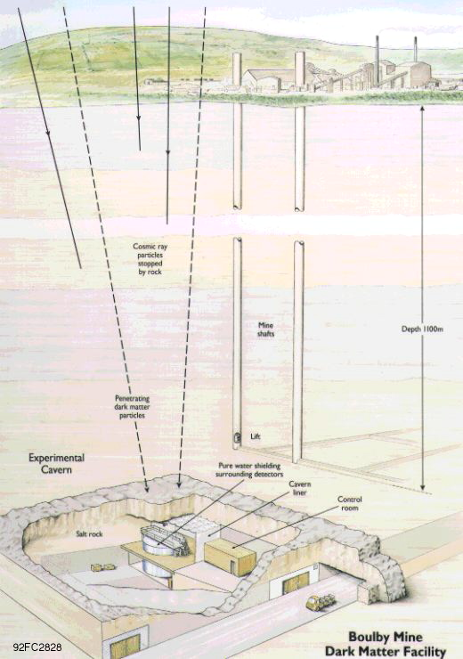
What is dark matter? WIMPS?
Findings WIMPS in a lab is very hard, because they interact only weakly
The main difficulty is that you have to filter out all sort of particles that are not of cosmic origin (e.g. Earth’s natural radioactivity)
Such searches for dark matter have so far been inconclusive…

Slide 31
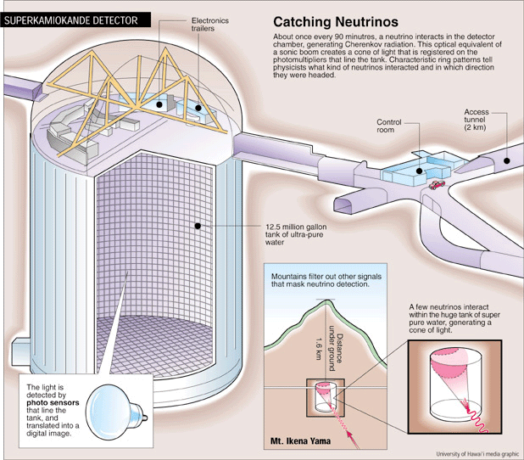
What is dark matter? Neutrinos?
In the standard model there are three distinct families of neutrinos (electron, muon and tau)
It is observed that neutrinos change family (oscillations)
Some of the electron neutrinos get lost on their way from the source to the detector (similarly from the sun, we get too few electron neutrinos)
The probability of neutrino oscillations sets a limit on the difference in mass
Neutrinos are a form of hot dark matter, but not enough to account for all the observed dark matter
They also give rise to other problems..

Slide 32
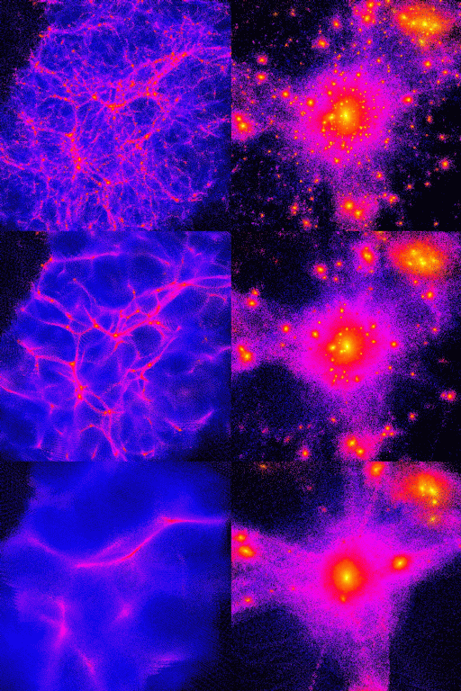
What is dark matter? Dark matter cannot be hot
If dark matter is hot it escapes too easily from overdensities.. Smoothing out the large scale structure
This would not match the observed large scale strcture
So we can rule out hot dark matter
COLD
WARM
HOT

Slide 33
What is dark matter? Discussion
Is dark matter baryonic or non-baryonic?
Pick one side:
Baryonic vs non baryonic
Let’s discuss!

Slide 34
What is dark matter? Summary
We do not know what is dark matter.
It could be hidden baryons, under the form of massive compact objects, but we haven’t found enough of them..
It could be new exotic particles, but we haven’t detected them..
Indirect arguments that we will see later on (primordial nucleosynthesis and cosmic microwave background) indicate that indeed most of dark matter is non-baryonic

Slide 35

What if gravity is wrong? MOND
An alternative to dark matter is that gravity is wrong.
It has been suggested that gravity works differently than Newtons’s law for weak fields

Slide 36
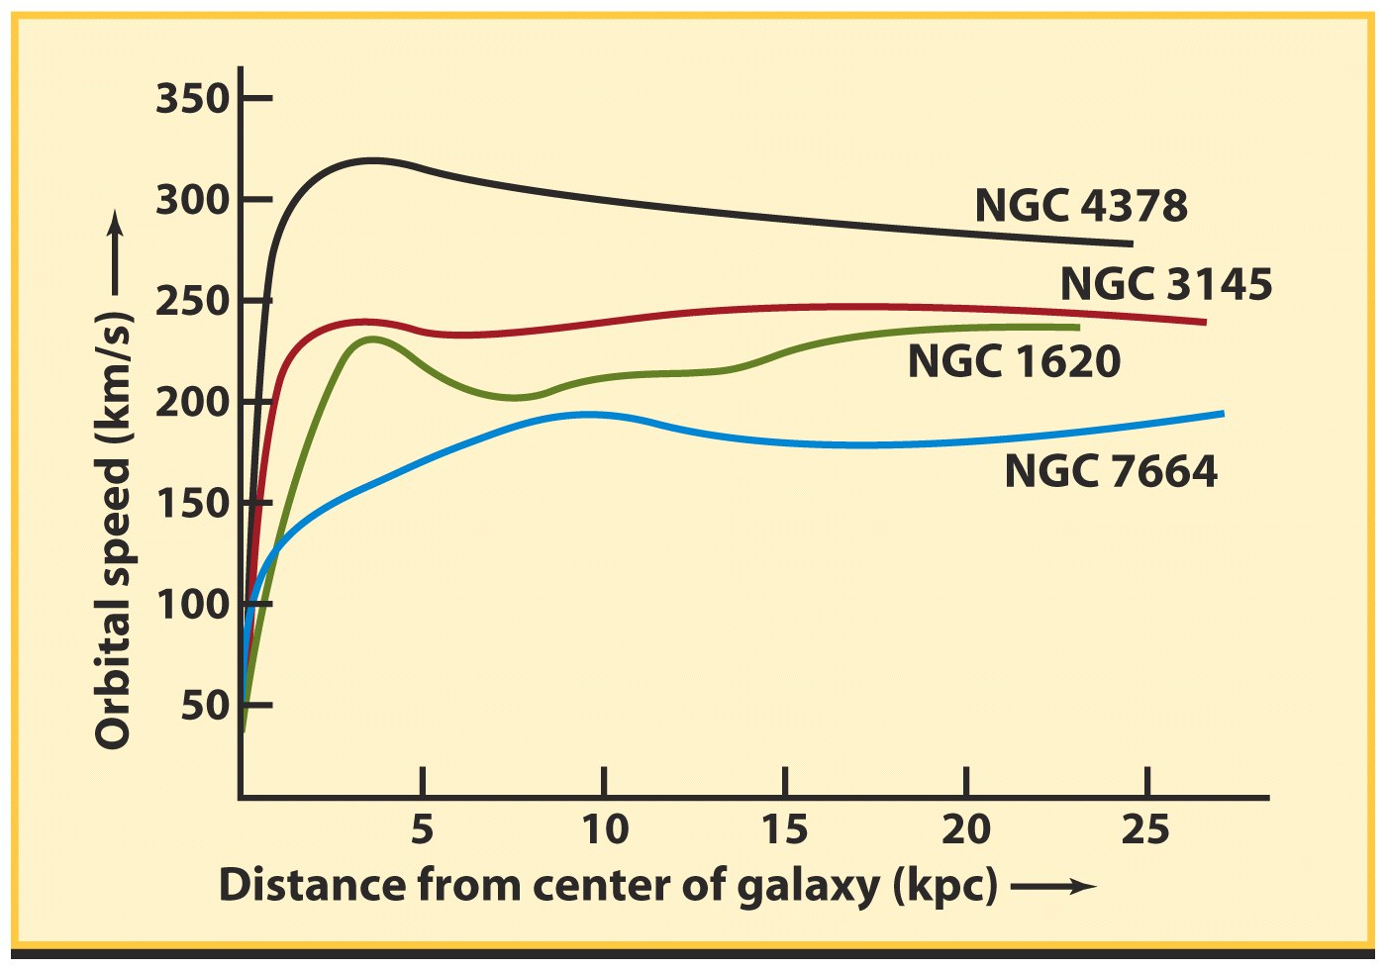
What if gravity is wrong? MOND
For example, if in the weak limit, the force falls off with distance R as 1/R instead of 1/R²
Then a star in circular orbit would need a rotation speed such that:
A) V²/R=1/R instead of
B) V²/R=1/R²
Under the hypothesis A it is natural to find flat rotation curves
This is known as Modified Newtonian Dynamics

Slide 37
What if gravity is wrong? MOND
The one extra parameter is the limit defining weak acceleration, when does MOND apply as opposed to Newton’s law
This is quantified by one parameter, a critical acceleration
Early work showed that rotation curves can be fitted pretty well based on the known baryonic mass and a single value of the critical acceleration

Slide 38
What if gravity is wrong? How do we evaluate competing theories?
MOND has been built to fit galaxy rotation curves
We need to find another experiment that is independent of the original one and see if MOND can reproduce that
The alternative theory has also to explain all the facts explained by General Relativity (which is the generalization of Newton’s gravity)

Slide 39
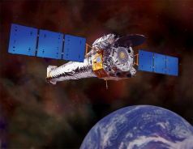
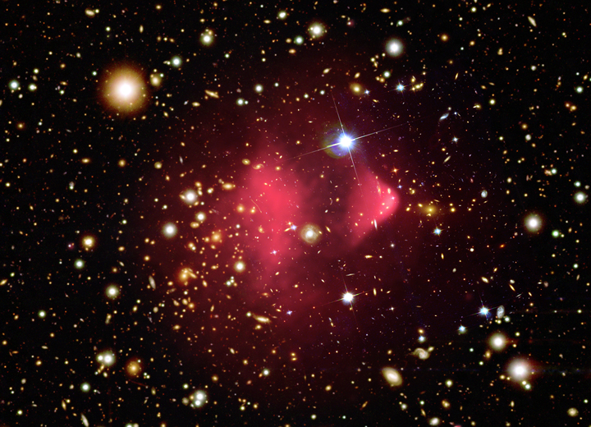
What if gravity is wrong?
Testing MOND
Unfortunately clusters of galaxies seem to rule out MOND for two reasons:
1) The same law that explains the dynamics of spiral galaxies does not work with clusters, we are forced to introduce dark matter even in MOND
2) In this cluster, known as the bullet cluster, weak lensing and X-ray analysis indicate the center of mass and the center of baryonic mass are offset, which is impossible for MOND

Slide 40
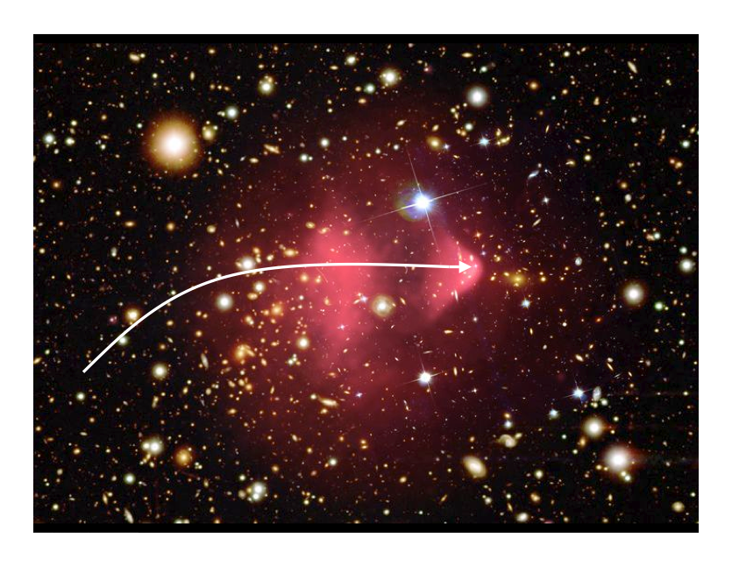
Bullet Cluster

Slide 41
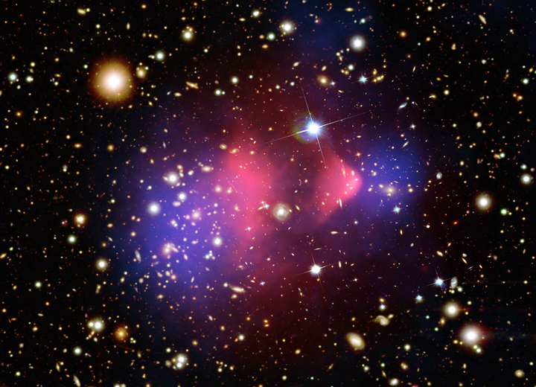
Bullet Cluster
Total Matter
Gas
≅
baryons

Slide 42
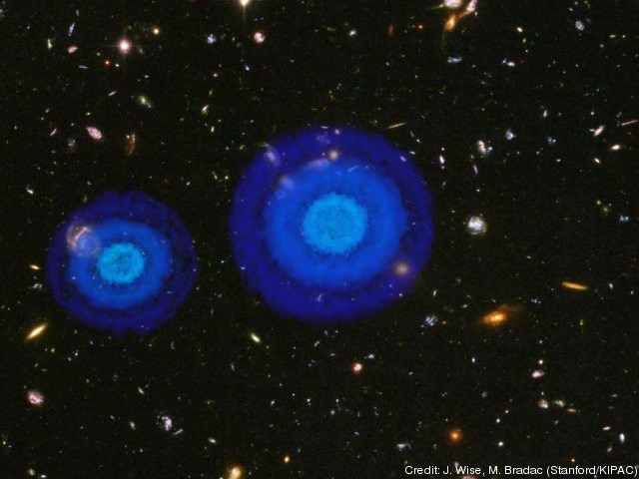

Slide 43
What if gravity is wrong? Summary
An alternative to dark matter is that our theory of gravity is wrong
That would be great…
Problem is: we do not know of an alternate theory of gravity that passes all the empirical tests of general relativity and cosmology and has no dark matter..
The search is still on..

Slide 44
The End
See you on Thursday (MIDTERM)!

