Slide 1
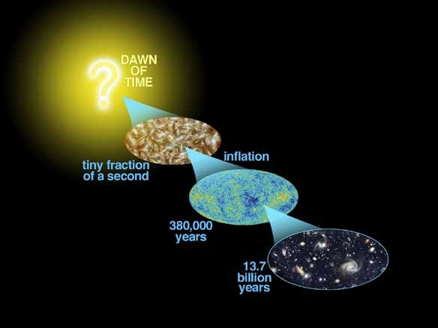
Astro-2: History of the Universe
Lecture 6; April 30 2013

Slide 2
Lecture 5 - Summary 1
Mass concentrations between us and a given object in the sky distort the image of that object on the sky, acting like magnifying lenses.
Strong and weak lensing provide very accurate mass maps. Much more mass is detected than what is visible, strengthening the case for dark matter.
The Hubble constant can be independently measured via lensing, as mass concentrations also stretch time, causing time-delays.
Lensing can detect dark matter satellites’ as well, if any..

Slide 3
Lecture 5 - Summary 2
Most of the mass content in the Universe is unaccounted for: what is dark matter?
If baryonic, it could be due to massive, compact halo objects (MACHOs). They don’t seem to be enough.
If non-baryonic (as likely), dark matter could be made of elusive, massive particles (WIMPs), or massive neutrinos. Searches have proved inconclusive so far.
The possibility remains that Newtonian gravity does not apply everywhere...

Slide 4
Scientific model or theory.
A scientific theory is a logically self-consistent model or framework for describing the behavior of a related set of natural or social phenomena.
It originates from and/or is supported by experimental evidence.
In this sense, a theory is a systematic and formalized expression of all previous observations that is predictive, logical and testable.
Scientific theories are always tentative, and subject to corrections or inclusion in a yet wider theory.
Good scientific theories should be “simple”. Ockham’s razor

Slide 5
In physics, theories are often formalized as models of reality
A theory is a model of reality, one that explains certain scientific facts
The model does not aspire to be a “true” picture of reality. Another, more accurate, model can later replace the previous model.

Slide 6
Today.. On Astro-2.
Evidence for the big bang
Olbers’s paradox. The Universe is evolving
Hubble’s Law. The Universe is expanding
Timescales.
The age of the Universe and the age of stuff in the Universe. Is there a conflict?

Slide 7
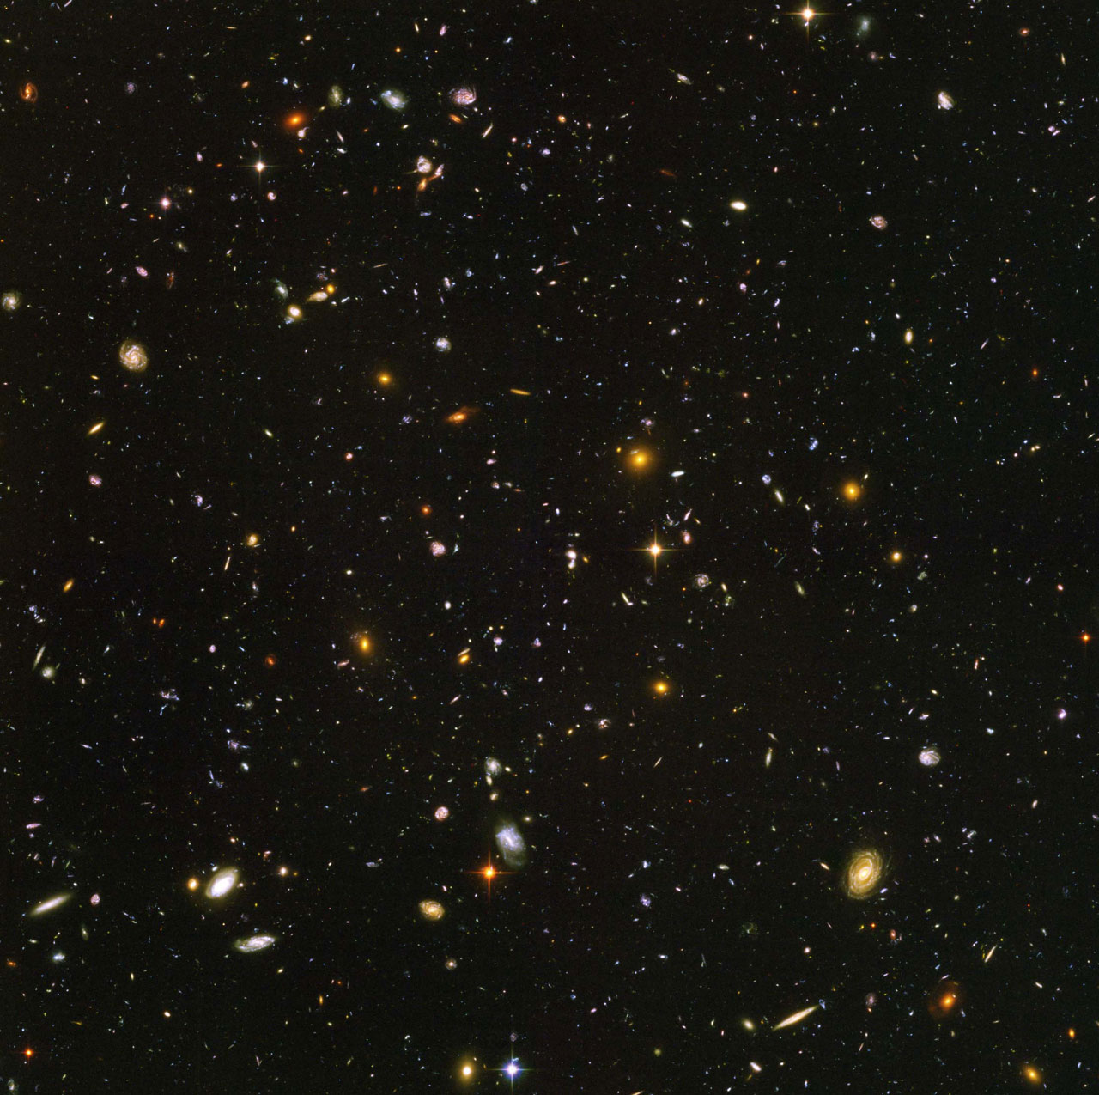
Olbers’s paradox. The night sky
What strikes you of the night sky?
It is dark!!
This apparently superficial statement (formulated by Heinrich Olbers in the early 1800s) has very profound consequences and is one of strongest pieces of evidence in favor of the big bang

Slide 8
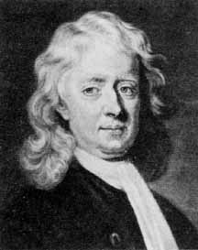
Olbers’s paradox. A step back..
Newton’s model of the universe was:
Eternal
Infinite (otherwise it would collapse gravitationally)
Flat Space
Time independent of space

Slide 9
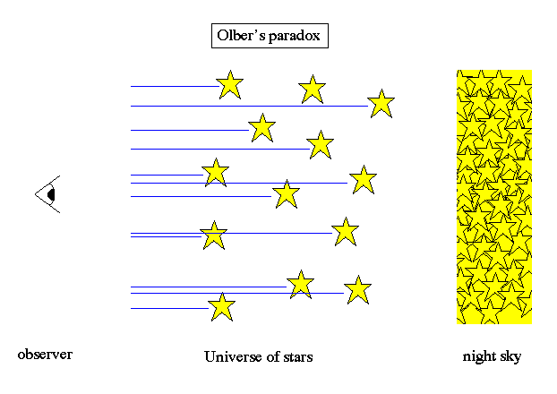
Olbers’s paradox. What does the sky look like in Newton’s model?
For every line of sight sooner or later you find a star
Surface brightness is independent of distance for a Euclidean flat space (draw on the blackboard)
This would mean that the sky should have the same surface brightness of the sun, your average Joe star.

Slide 10
Olbers’s paradox. What does the sky look like in Newton’s model?
How much is that?
The sun angular diameter is ½ a degree.. i.e. the solid angle covered is π(1/4)²= 0.2 sq degrees.
The whole sky is 41,253 sq degrees…
And the answer is?
Does this make sense to you?

Slide 11
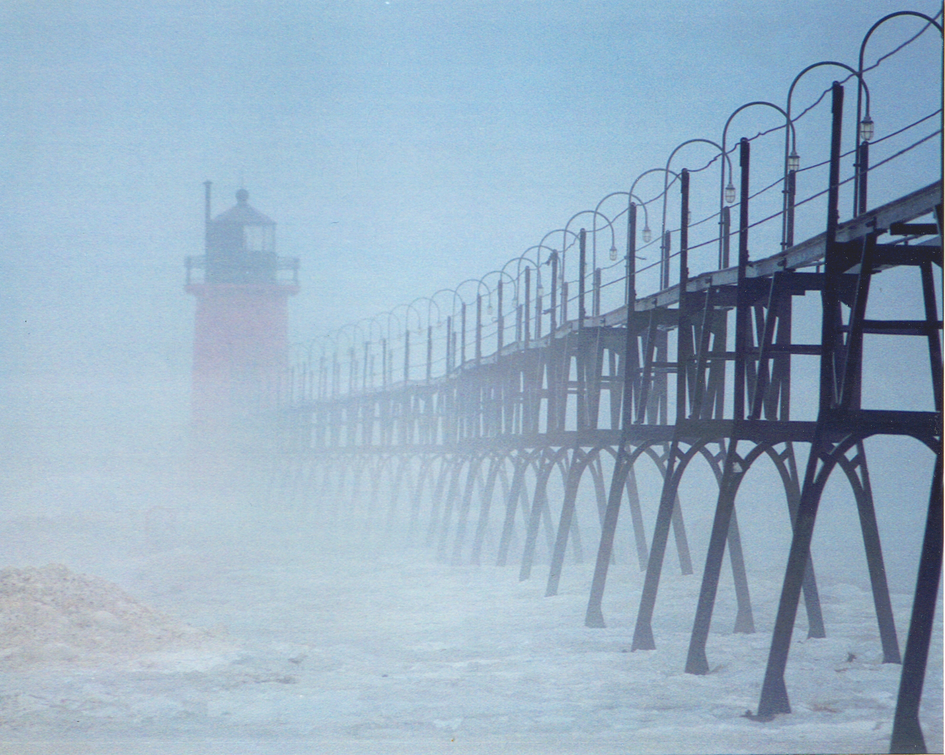
Olbers’s paradox.
Olbers’s solution.
Olbers postulated that the Universe was filled with an absorbing medium, like fog
However, if light is absorbed it will also re-radiate, producing light albeit at different wavelengths, so this doesn’t work!

Slide 12
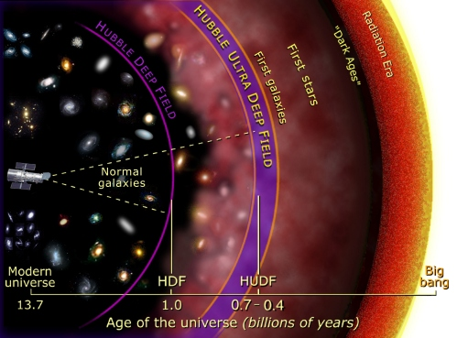
Olbers’s paradox.
The Big-Bang’s solution
In the Big Bang model the Universe is finite in TIME (13.7 billion years)
This means that we can only see as far away as light has had time to travel
Furthermore stars were not always shining (the sun for example is 4.5 Gyrs old).

Slide 13
Olbers’s paradox. Summary
The night sky is dark
This implies that the emission of starlight in the universe must be finite, in space, time or both.
This is fundamental test for any cosmological model
The Big-bang explains Olbers’s paradox with the finiteness of the lifetime of the Universe and hence of its stars:
The universe is NOT eternal in the past! The universe evolves!

Slide 14
Olbers’s paradox. Discussion
The night sky is dark
This implies that the emission of starlight in the universe must be finite, in space, time or both.
This is fundamental test for any cosmological model
Let’s discuss if there are other solutions to Olbers’s paradox… and possible observational tests!

Slide 15
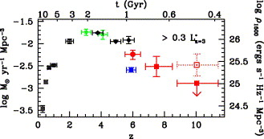
Other evidence for evolution:
Star formation history of the universe

Slide 16
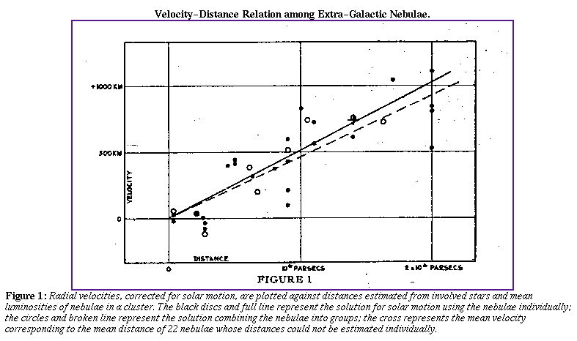
Hubble’s law: galaxies are moving away from us!
Hubble found that redshift (or velocity) is proportional to distance (Hubble’s law): if you measure double speed, you also measure double distance!

Slide 17
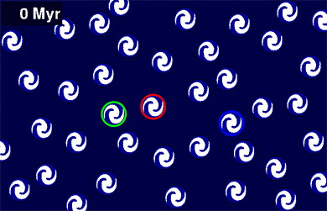
The Big Bang explanation: The Universe is expanding

Slide 18
Frequently asked questions…just checking…
What is the universe expanding into?
Nothing, the universe is all there is, spacetime is expanding itself
Where is the center of the expansion?
Nowhere, there is no center, the universe is homogenous and isotropic
Do we expand as well?
No, because we are bound by electromagnetic forces
Do galaxies expand?
No because they are bound by gravity and they detach from the Hubble Flow

Slide 19
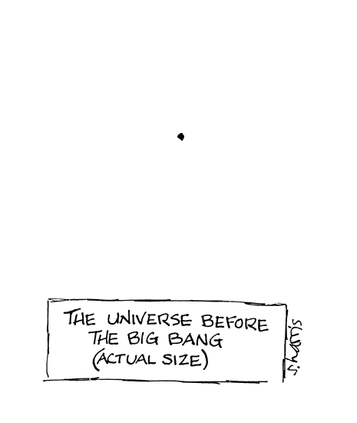
The expansion of the Universe in the Big-Bang model
In the Big Bang model if you extrapolate back in time the size of the universe (or the average distance between galaxies) you find that it goes to zero in a finite amount of time (the age of the Universe).
If you pick any arbitrary distance as small as you like (e.g. two inches), a finite amount of time ago any two points in the universe was closer to each other than that distance.

Slide 20
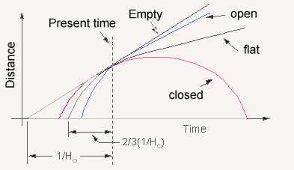
The expansion of the Universe in the Big-Bang model
In the Big Bang model the dynamics of the universe depends on of its geometry and content
The simplest order of magnitude estimate of the age is a straight line:
  That means that the age of the universe now is 1/H₀

Slide 21
A unit conversion problem..
How much is 1/H₀ in billion years?
First 1/H₀ is equal to Mpc s /(71 km) = 0.014 Mpc s / km
1 Mpc = 3.08e22 m
So 1/H₀ = 0.014 x 3.08e22 m s / 1000 m = 4.34e17 s
1 yr = 365 x 24 x 3600 s = 3.15e7 s
So 1s = 1/3.15e7 yr
Hence 1/H₀ is equal to 4.34e17/3.15e7 yr ~14e9 yr = 14 Gyr

Slide 22
The age of the universe
1/H₀ is approximately equal to 14 Gyr
The life of the universe is of order of 14Gyr.
Accurate calculations are possible if we know how much mass and dark energy there is in the universe
For example for a simple Einstein-de Sitter Universe (i.e. a closed Universe with no dark energy) the age of the universe is 2/3 of that, i.e. approximately 9 billion years.

Slide 23
The expansion and age of the universe. Summary
Hubble’s law is explained by the Big Bang model as a result of the expansion of the Universe
The Hubble constant gives us the current expansion rate of the universe, which we can use to estimate the age of the Universe.
1/H₀ is approximately equal to 14 Gyr
We should test whether this is consistent with the age of “stuff” in the universe.
If we found something significantly older than the Universe, than we would have falsified the Big Bang theory

Slide 24
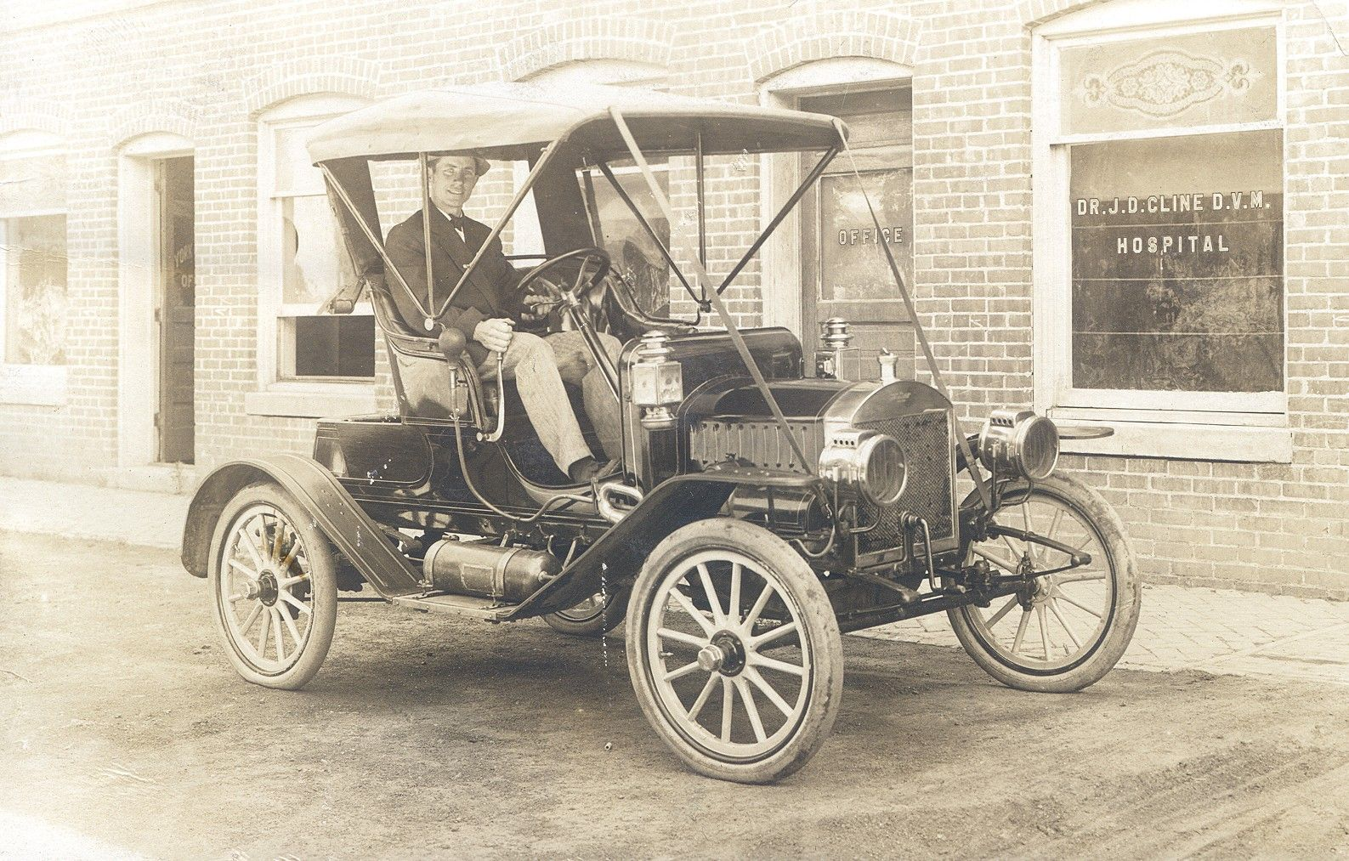
Is there an age problem?
How old is stuff in the universe?
Cars are 100 years old..
Oldest documents are a few thousands years old
Oldest records of homo sapiens are 2 millions year old
Oldest records of mammals are 50 millions year old
Not even close…

Slide 25
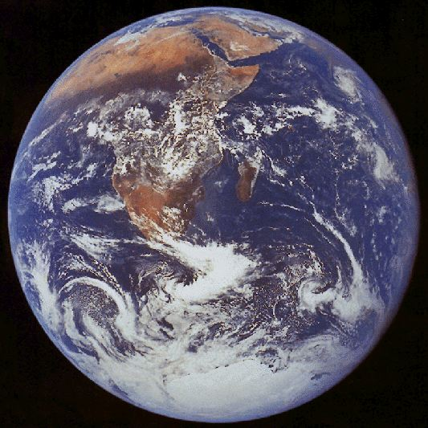
Is there an age problem? How old is Earth and the solar system?
Radioactive dating [Universe Chapter 8].
Uranium 238 decays to Lead 208 with a half life of 4.510 billion years.
By measuring the relative abundances of Uranium and Lead it has been measured that the oldest rocks on Earth are about 4.5 billions years old
The oldest rocks from the Moon have the same age
The oldest meteorites also have the same age
The oldest rocks from Mars have the same age
This suggests that the planets were formed approximately 4.5 billion years ago

Slide 26
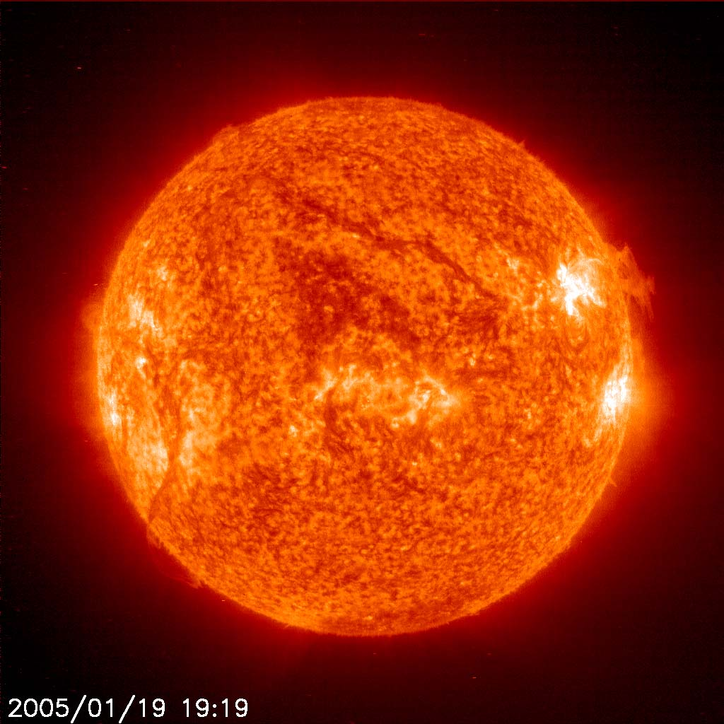
Is there an age problem? How old is the sun?
The age of stars can be inferred from stellar evolution models
The sun is 4.5 Gyrs old, consistent with the age of the oldest rocks in the solar system.
This is consistent with the idea that the planets formed from a protoplanetary disk around the young sun
The lifetime of the sun is estimated to be ~10 Gyrs.

Slide 27
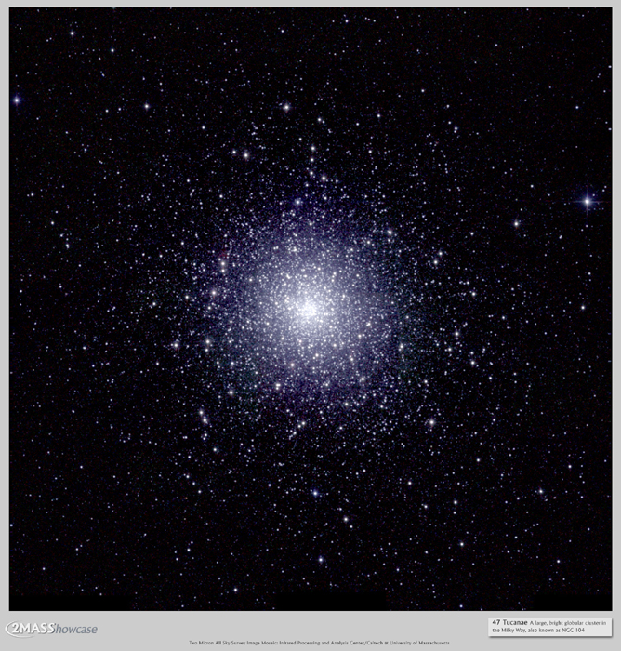
Is there an age problem? How old are the oldest stars?
The age of stars can be inferred from stellar evolution models, by analyzing their color magnitude diagrams [Universe 19].
Globular clusters are made of very old stars, all in the same location.
47 Tuc

Slide 28
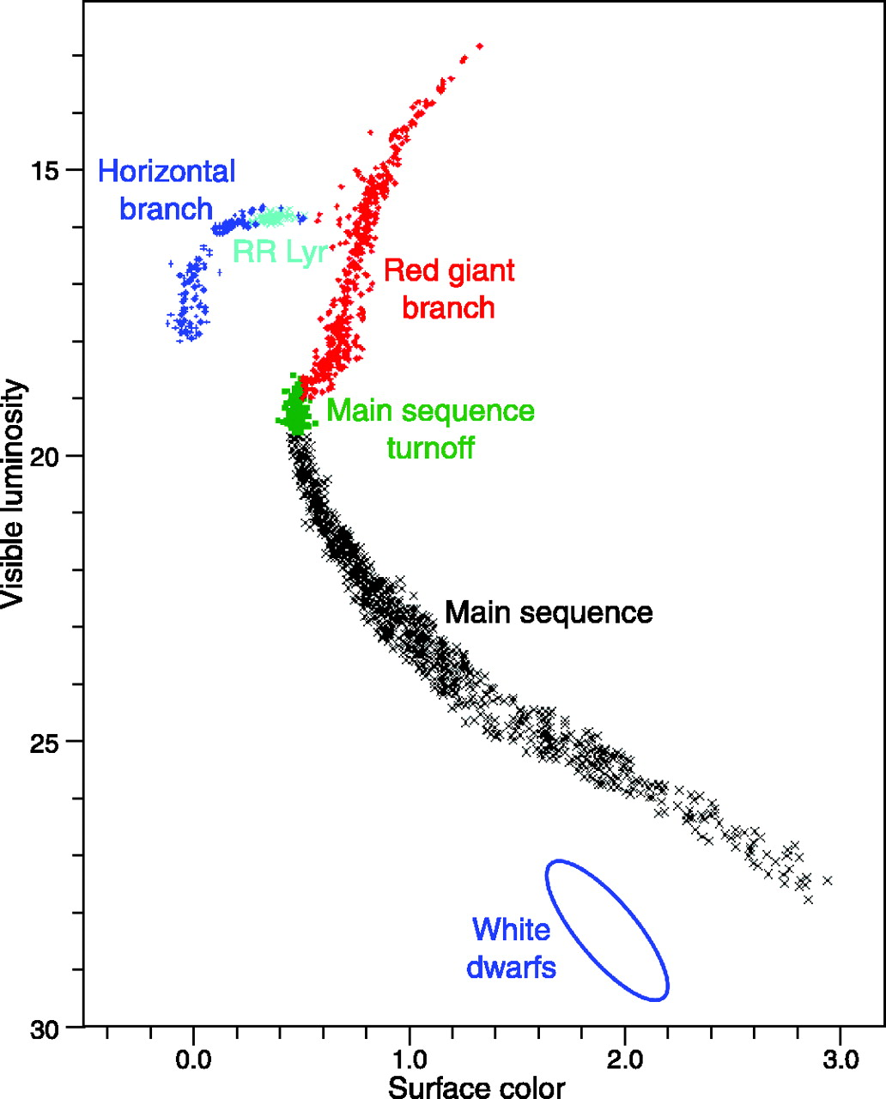
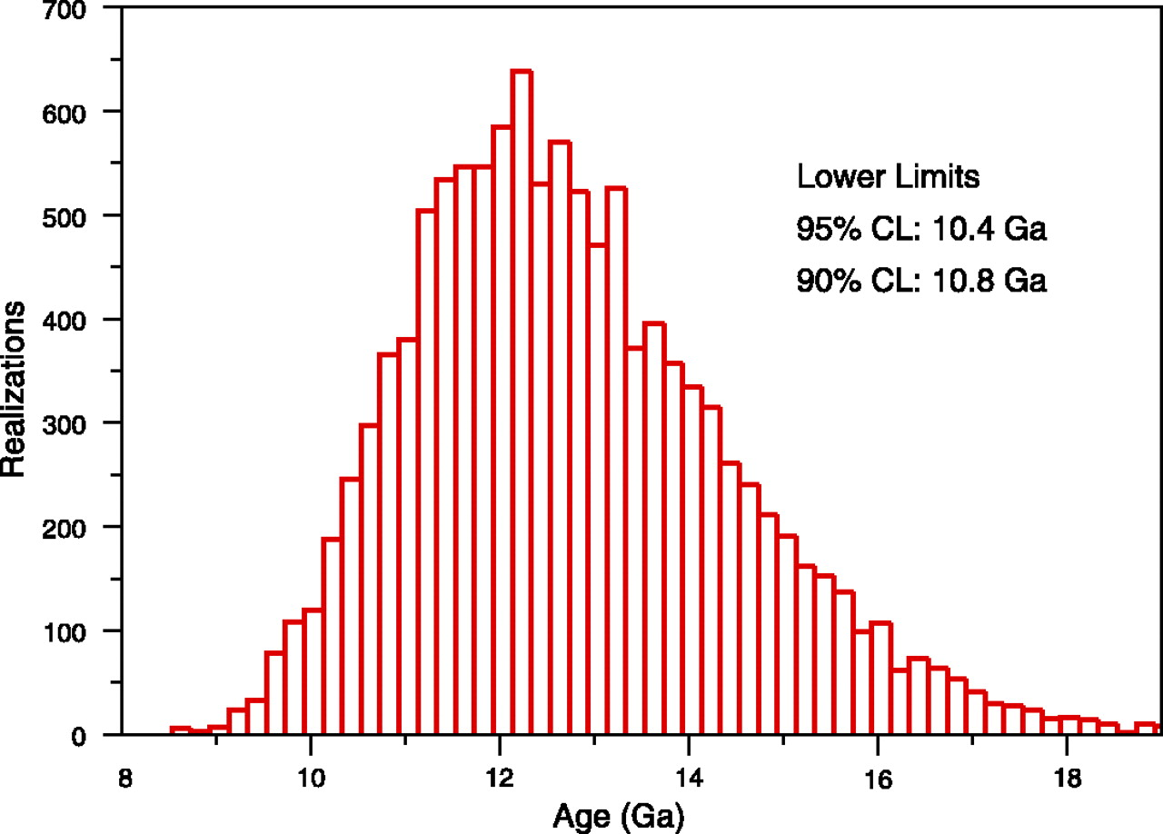
Is there an age problem? How old are the oldest stars? HR diagrams
Age of the oldest globular clusters
Ok with the current estimate 13.7 Gyrs.
Not with 9 Gyrs of Einstein-de Sitter

Slide 29
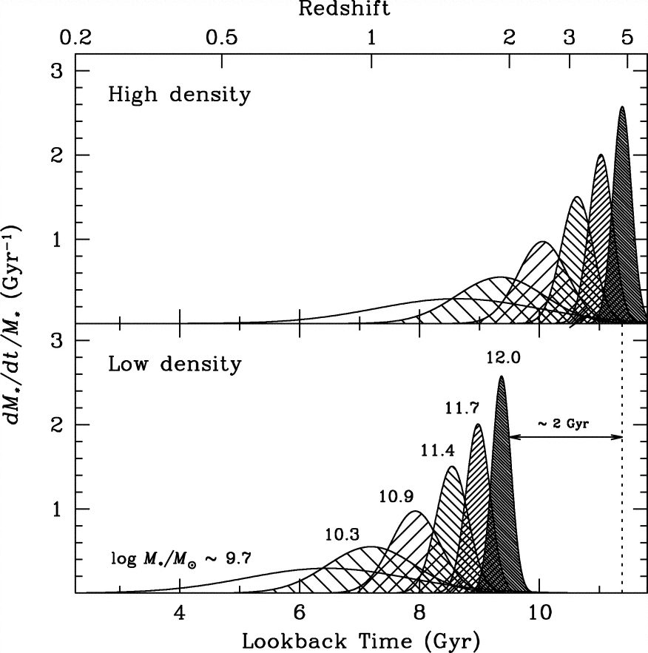
Is there an age problem? How old are the oldest galaxies?
The age of galaxies can be inferred from stellar evolution models, by analyzing their integrated spectra.
Elliptical galaxies are made of very old stars, up to 12 Gyrs or so.

Slide 30
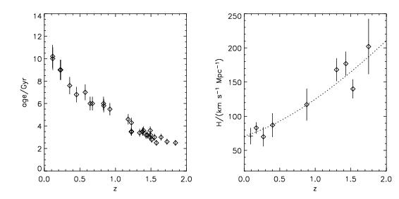
Is there an age problem? How about at high redshift?
Ages of the oldest stars at any redshift
There is a clear upper envelope

Slide 31
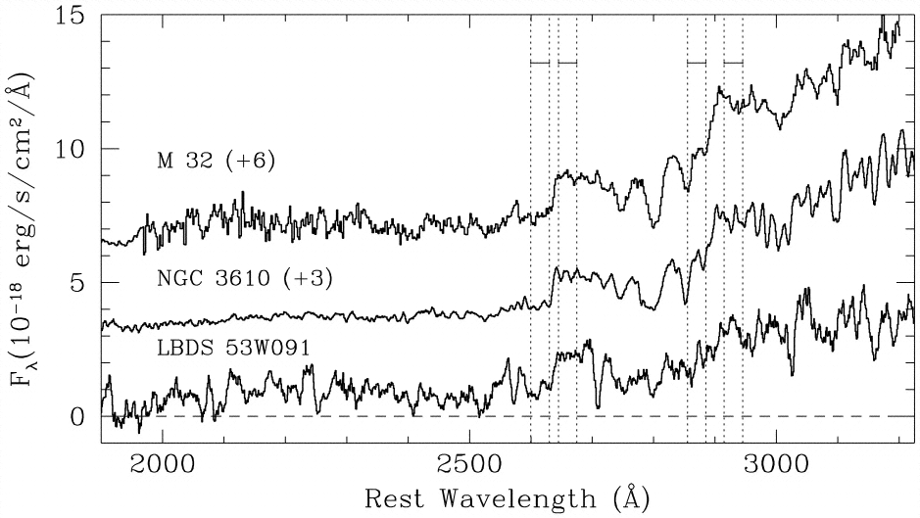
Is there an age problem? An old galaxy at z=1.55
53W091 z=1.55; 3.5 Gyr

Slide 32
Is there an age problem?
No
Quite the opposite, the age of the oldest stars in the Universe are remarkably consistent with the age of the universe itself, at any redshift where we can measure it.
This does not prove that the model is right, but is a great triumph of the theories of the big bang and that of stellar evolution.

Slide 33
The End
See you on thursday!

