Slide 1
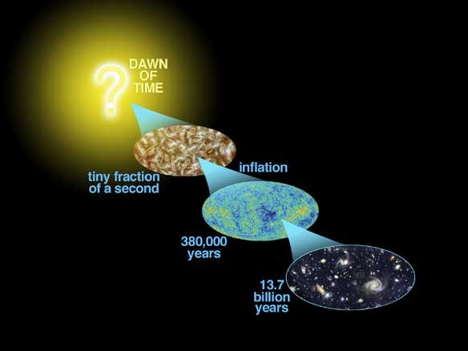
Astro-2: History of the Universe
Lecture 8; May 7 2013

Slide 2
Previously… on astro-2
Wherever we look in the sky there is a background of microwaves, the CMB.
The CMB is very close to isotropic better than 0.001%
The spectrum of the CMB is indistinguishable from a that of Blackbody at 2.725 K.
In the Big Bang model the CMB is interpreted as the fossil record of an epoch close to the beginning of time, when the Universe was extremely dense and hot and filled with radiation in thermal equilibrium

Slide 3
Previously… on astro-2.
The region of space that we can see is limited by the finite speed of light
We can only see as far as light has had time to travel, this is called our “horizon”.
We can only see inside our horizon, which is finite even if the universe is infinite
Horizons grow as time goes by.
Two points can be causally connected only if they are inside each other’s horizons
How is it possible that the CMB has the same temperature everywhere? This is known as the horizon problem.

Slide 4
Today.. On Astro-2.
Chemical composition of stars. Evidence for early fusion (hot big bang).
Matter content of the Universe. Definitions and census
Brief history of the Universe.

Slide 5
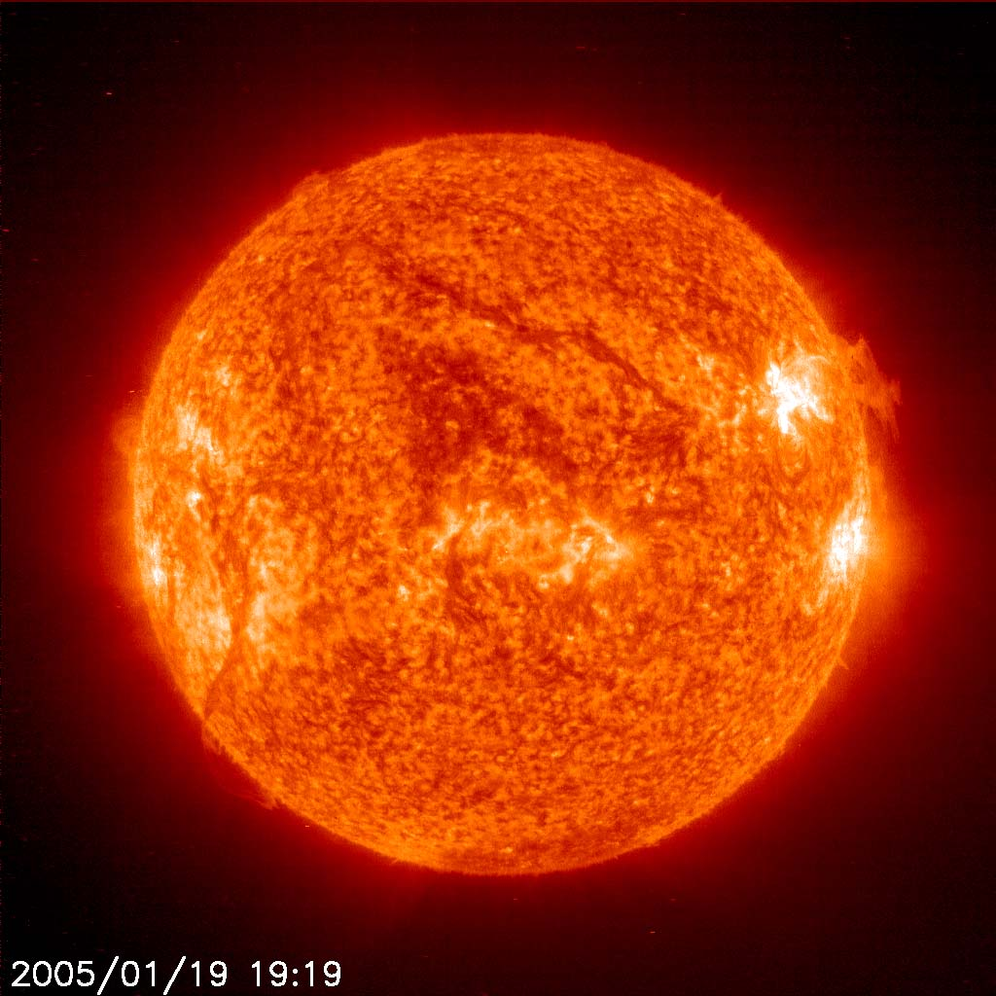
Chemical composition of stars. Sun
The sun is made of:
Hydrogen (74% by mass)
Helium (25%)
Heavier elements (1%) commonly referred to as “metals” by astrophysicists
This is way more helium that is expected from a universe initially made of Hydrogen where Helium is produced in stars…
This is a common problem: Helium abundance is always ~25%

Slide 6
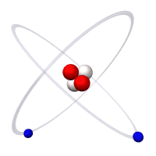
Helium abundance. The Big Bang solution
Helium is produced in the early Universe when the average temperature was high enough (above 10⁷ 10⁸ K) to allow for nuclear fusion.
Why do you need high temperature to do fusion?
We will see later on that the Big Bang theory predicts exactly the abundance of all heavy elements.

Slide 7
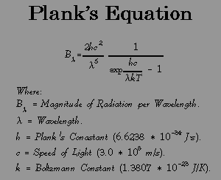
When was the Universe hot enough to form Helium?
Let’s compute this in terms of redshift.
During expansion, radiation remains a black body, but wavelengths stretch by a factor of (1+z)
A redshift z a photon of wavelength λ₀ today would have wavelength?
λ=λ₀ / (1+z)
So what is the relation between T and T₀?
T = T₀ (1+z)

Slide 8
When was the Universe hot enough to form Helium?
T_{He} = T₀ (1+z_{He})
So (1+z_{He})=T_{He}/T₀
T₀=3K
T_{He}~300,000,000K
So z_{He}~100,000,000

Slide 9
Helium abundance. Summary
Helium is too abundant and too homogeneous to have formed through fusion in stars
The Big Bang theory explains He abundance with primordial nucleosynthesis when the Universe was hot enough
T scales as (1+z), so that He was formed up to until z~100,000,000

Slide 10
Matter density of the Universe
Types of matter/energy (E=mc²) that we encountered so far:
Radiation
Neutrinos
Baryons
Dark matter
Dark energy
How much are they?

Slide 11
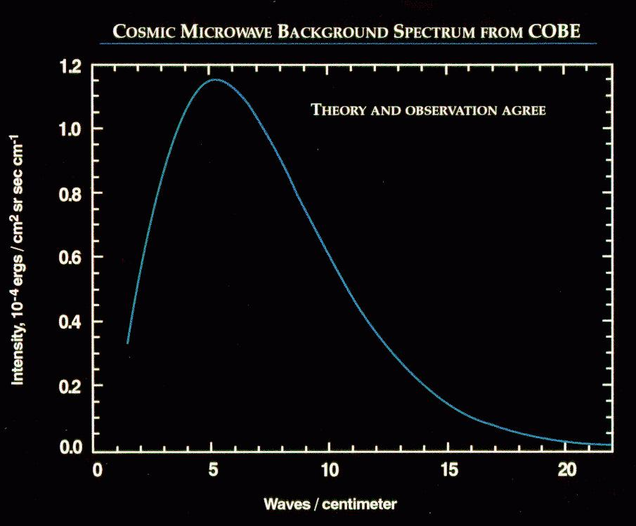
Matter density of the Universe. 1: Radiation
How much light is there in the Universe? The well defined quantity is of course the energy (or matter) density.
Is it fairly easy to compute the energy density of the CMB because it is a black body
For a black body the mass density is:
ρ_{rad}= 4 σ T⁴ /c³

Slide 12
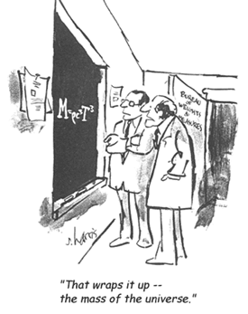
Matter density of the Universe. 1: Radiation
ρ_{rad}= 4 σ T⁴ /c³
Where c is the speed of light (300,000,000 m/s), T is the temperature, σ is constant (the Stefan-Boltzmann constant), 5.67e-8 W m⁻² K⁻⁴
So ρ_{rad} = 4.6e-31 (T/2.725K)⁴ kg/m³
Where 2.725K is?
How does this compare to air? [1kg/m³]

Slide 13
Matter density of the Universe. 1: Radiation in critical units
It is convenient to write this down in terms of the critical density, the amount of energy/matter needed to “close” the universe
Defined as:
ρ_{crit} =3H₀²/8πG
= 9.5e-27 kg/m³
The density of radiation is 4.8e-5 ρ_{crit}
This can be written as Ω_{rad} ~5e-5

Slide 14
Matter density of the Universe. 2: Neutrinos
Limits on neutrino mass density come from:
Oscillations (lower limit; superkamiokande)
large scale structures (upper limits <0.6eV; Melchiorri et al. 2008; recently Plank claimed a detection, but weak evidence)
In critical units neutrino mass density is between: 0.0010<Ω_{ν} <0.0025

Slide 15
Matter density of the Universe. 3: Baryons
People have counted the amount of mass in visible baryons.
Baryonic inventory (total=0.045+-0.003 from nucleosynthesis and CMB):
Stars Ω*=0.0024+-0.0007 (more mass in neutrinos than in stars!)
Planets Ω_{planet}~10⁻⁶
Warm intergalactic gas 0.040+-0.003
Most of baryons are in intergalactic medium, filaments in the cosmic web,

Slide 16

Matter density of the Universe. 4: Dark matter
Dark matter is much harder to count, because we can only “see” it via its gravitational effects
One way to count it is for example is to measure the dark matter to baryon ratio in clusters
Assume that this number is representative of the Universe because the collapsed volume is large
Take the fraction of baryons (from BBN) and multiply
This and other methods give Ω_{dm}=0.23
The total amount of matter is given by: Ω_{m}=Ω_{dm}+Ω_{b}=0.27

Slide 17

Matter density of the Universe. 5: Dark energy (or Λ)
Most of the energy in the universe appears to be of a mysterious form called dark energy (because we do not know what it is!)
Dark energy “repels” instead of attracting, and therefore causes the expansion of the universe to accelerate instead of slowing down
One form of dark energy is the cosmological constant (Λ), introduced by Einstein a long time ago, and this is a purely geometrical term… [in other words, it needs not be “something” could just be a property of spacetime]
According to current measurements Ω_{de}~0.72 or Ω_{Λ}~0.72.

Slide 18
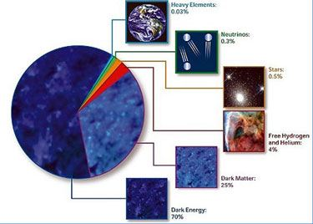
Matter density of the Universe. Summary
Numbers changed a little bit by Planck

Slide 19
But… was it always like this? A brief history of the universe…
We know the relative proportion of stuff in the universe nowadays
How do quantities scale with z?
What is z, remember?
Redshift z is connected to the LINEAR stretch factor of the universe d₀/d=(1+z) [subscript 0 means NOW]
How do volumes change with redshift?
If I take a box of the universe between some galaxies and measure its volume at different redshifts, what will I find?

Slide 20
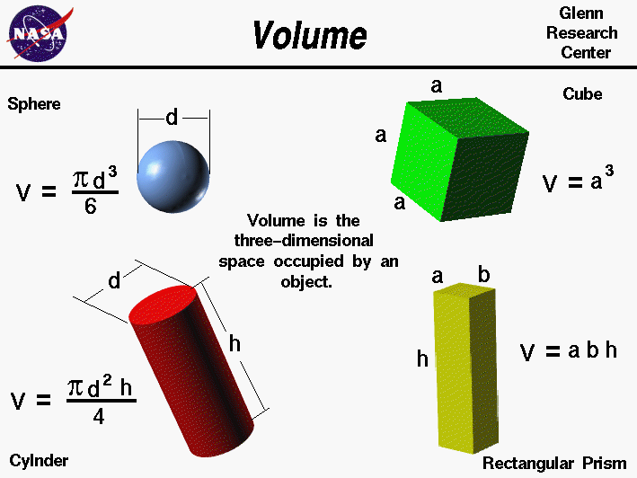
But… was it always like this? Volume and redshift
Volumes, by definition, scale as the third power of the linear dimension

Slide 21
But… was it always like this? Evolution of mass density
Volumes scale with redshift as: V/V₀=(1+z)⁻³
At z=9 my box of the Universe was how many times smaller than now?
If mass is preserved in a given form, how does density scale with redshift?
Density is ρ=M/V, M is constant, so…
Density ρ scales as ρ=ρ₀ (1+z)³
So mass densities Ω scale as Ω=Ω₀ (1+z)³!

Slide 22
But… was it always like this? Evolution of photon energy density
With photons there’s an extra term.
As the photons redshift each photon also looses energy (because a photon’s energy is proportional to its frequency, Universe Chap 5).
So for photons (and other massless particles) Density ρ_{rad} scales as ρ_{rad}=ρ_{rad,0} (1+z)⁴
So photon density scales as Ω_{rad}=Ω_{rad,0} (1+z)⁴

Slide 23
But… was it always like this? The cosmological constant
The cosmological constant is a constant, so it does not scale with redshift.
So Ω_{Λ} is a constant

Slide 24
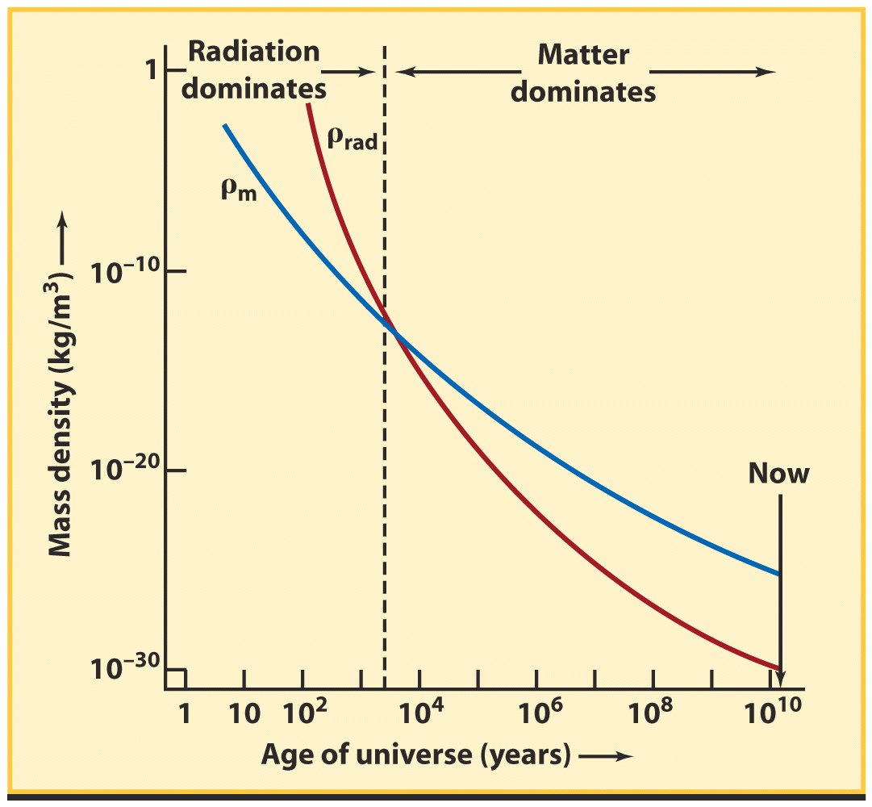
But… was it always like this? A history of the Universe
Since the scalings are different different objects will dominate a different times.
Ω_{rad}=Ω_{rad,0} (1+z)⁴
Ω_{m}=Ω_{m,0} (1+z)³
Dividing the two:
Ω_{rad}/Ω=1.85e-4 (1+z)
So at z~5000 the two were approximately equal
Before that time radiation dominated, after matter dominates

Slide 25
But… was it always like this? A history of the Universe. 2
How about the cosmological constant
Ω_{Λ}=Ω_{Λ,0}
Ω_{m}=Ω_{m,0} (1+z)³
Dividing the two:
Ω_{m}/Ω_{Λ}=0.375 (1+z)³
So only very recently (z=0.4; 4 Gyrs ago) the cosmological became important!
From now on Λ rules!
Against historical prejudice… (dicke coincidence)
Cosmological constant dominated

Slide 26
Discussion. Is the big-bang a good theory?
According to Stephen Hawking: “A theory is a good theory if it satisfies two requirements: It must accurately describe a large class of observations on the basis of a model that contains only a few arbitrary elements, and it must make definite predictions about the results of future observations. Any physical theory is always provisional, in the sense that it is only a hypothesis; you can never prove it. No matter how many times the results of experiments agree with some theory, you can never be sure that the next time the result will not contradict the theory. On the other hand, you can disprove a theory by finding even a single repeatable observation that disagrees with the predictions of the theory."

Slide 27
The End
See you on thursday!

